Slide 1
Work-Life Balance
How to find satisfaction at work and at home when you think you’re doing everything badly….

Slide 2
Sources & Resources
American Psychological Association http://www.apa.org/monitor/2012/07-08/ce-corner.aspx
Bacon, Laura. The Balance Matrix. http://www.laurenbacon.com/balance-matrix-my-answer-to-the-work-life-balance-question/
Bateson, Mary Catherine, PhD. “Composing a Life”. On Being podcast with Krista Tippett.
Drummond, Dike, MD. http://www.thehappymd.com/blog/bid/294952/Physician-Burnout-Presents-Differently-in-Male-and-Female-Doctors
Friedman, Stewart D. “Work+Home+Community+Self”. Harvard Business Review. Sept. 2014. pp111-115.
Lipsenthal, Lee, MD. Finding Balance in a Medical Life. 2007.
Remen, Rachel Naomi, MD. Kitchen Table Wisdom. And http://www.rachelremen.com/
Van Der Kolk, Bessel, MD. “Restoring the Body: Yoga, EMDR, and Treating Trauma” On Being podcast with Krista Tippett.

Slide 3
Objectives
Be able to describe what you mean when you talk about Work/Life Balance
Understand the value of knowing your own “life’s purpose”, and how that impacts your sense of Balance
Identify strategies that will help you feel more Balanced

Slide 4
What is Balance?
WORK v LIFE
Equal time spent on work and ????
Equal focus spent on work and ????
Equal ANYTHING spent on work and ????

Slide 5
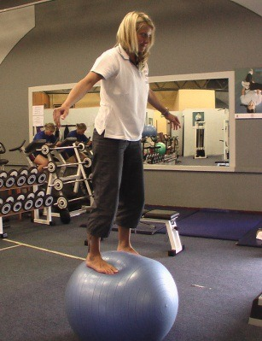
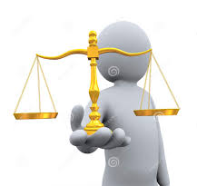
What is Balance?

Slide 6
What makes you feel out of balance?

Slide 7
We feel out of balance when…
We’ve failed to do something we think we should do
We’re spinning because we can’t prioritize what to do next
We’re worried we’ll miss out on something, or have regrets later
We feel exhausted or over stressed
What else?

Slide 8
What makes you feel in balance?

Slide 9
We feel in balance when…
We are at peace with how we spend our time
We look forward to what’s in front of us—whether it’s working hard, or being with family, or participating in an event with our community
We have the resources (time & money) to do what we want to do
What else?

Slide 10
Is this a question about work?
Or
Is this a question about how we understand and lead our life?

Slide 11
Major Life domains
Work or School
Home or Family (however you define that)
Community (friends, neighbors, religious or social groups)
Self (mind, body, spirit)
Emphasis on particular domains changes over time!

Slide 12
Who am i?
An exercise…

Slide 13
Work Addiction
A compulsive disorder.
Not measured by the number of hours you work, but:
how you approach work
how it controls you and your ability to focus on things unrelated to your career
Our professional system supports work addiction
These behaviors may feel productive, not damaging—until we look at them & their affect.

Slide 14
Tips for breaking the cycle of work addiction
Turn off your phone
Set a time to stop looking at email
Commit to family dinners at least X times a week
Exercise regularly, Mind/Body practice
May consider a 12-step program….
…admitting we are powerless over excessive work and that our lives have become unmanageable.
What else?

Slide 15
burnout
Exhaustion on one of 3 levels: Energy, Emotion, Spirit.
Depersonalization and cynicism. The loss of your ability to care, empathize, and connect. You may blame, shame or demonize the people you are charged to care for—and feel guilty about it.
Doubt –that your work really makes any difference or you may question the quality of what you do (this is a late and inconsistent symptom that is nearly absent in men).
Dike Drummond, MD
http://www.thehappymd.com/blog/bid/294952/Physician-Burnout-Presents-Differently-in-Male-and-Female-Doctors

Slide 16
What to do about this mess?
Understand your life purpose and/or values
Align your activities (including work) with your purpose/values (and get over your guilt)
Be Present
Manage your Stress
Evaluate your expectations
Shift your perspective
Mind/Body
Connect with others

Slide 17
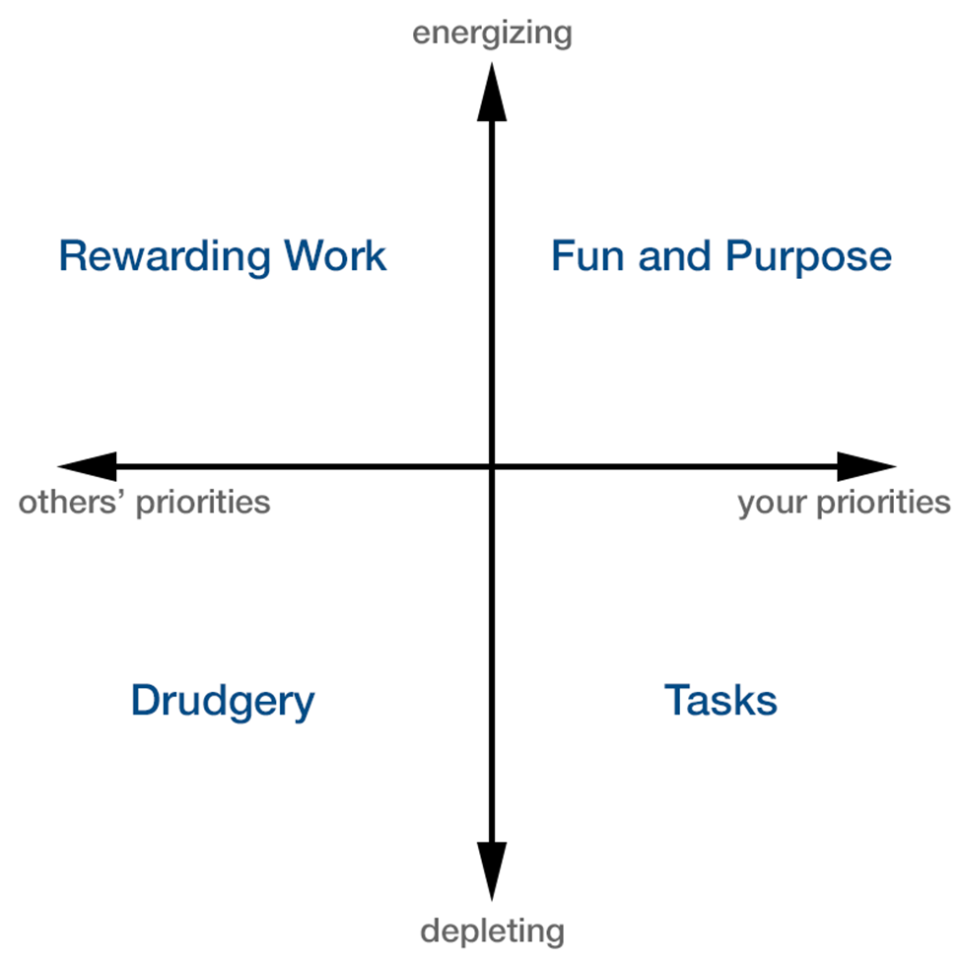
Balance Matrix lauren bacon
Impetus Axis
“Does this activity align with my values, goals, or purpose?”
“Does this get me closer to something that matters to me?”
“What intrinsic rewards do I stand to gain from this?”
Energy Axis
“Afterwards, will I feel more or less energetic?”
“Would I do it for the fun of it?”
“Do I feel bored, tired, or drained by this?”

Slide 18
What is your life’s purpose?
What can I do with my time that’s important?
What gives me Joy?
What gave me joy when I was younger?
What cranks my wheels in such a way that I forget to eat?
What legacy do I want to leave?

Slide 19
What is your life’s purpose?
Write a Personal Mission Statement
2-3 sentences
“I will help create healthier physicians, and healthier communities. I will be a loving and involved family member.”
Write a Personal Vision Statement
Concrete plans to attain your Mission
“I will accomplish my Mission in the following ways:”
Evaluate your activities and add or delete as possible for congruency with your Mission/Vision

Slide 20
Manage your stress
Evaluate your activities & your expectations
Shift your perspective
What is “homemaking”?
Connect with others
Mind/Body
Cognitive-behavioral therapy, Meditation, Prayer, Creative arts therapies (art, music, or dance), Yoga, Biofeedback, Tai chi, Relaxation, Guided imagery
One exercise—”What touched my heart today?”

Slide 21
Mind/Body
Research on meditation in medical students and residents has shown:
Decreases in depression and anxiety
Improved immunologic functioning
Increased spirituality and empathy
Improved knowledge of the effects of stress
Greater use of positive coping skills
An enhanced ability to resolve role conflicts

Slide 22
Be present
Mindfulness—a moment-to-moment awareness of one’s experience without judgment
Benefits
Reduces rumination and increases working memory
Reduces stress and anxiety, increases positive affect
Improves focus and suppresses distracting information
Increases cognitive flexibility
Improves relationship satisfaction
American Psychological Association http://www.apa.org/monitor/2012/07-08/ce-corner.aspx

Slide 23
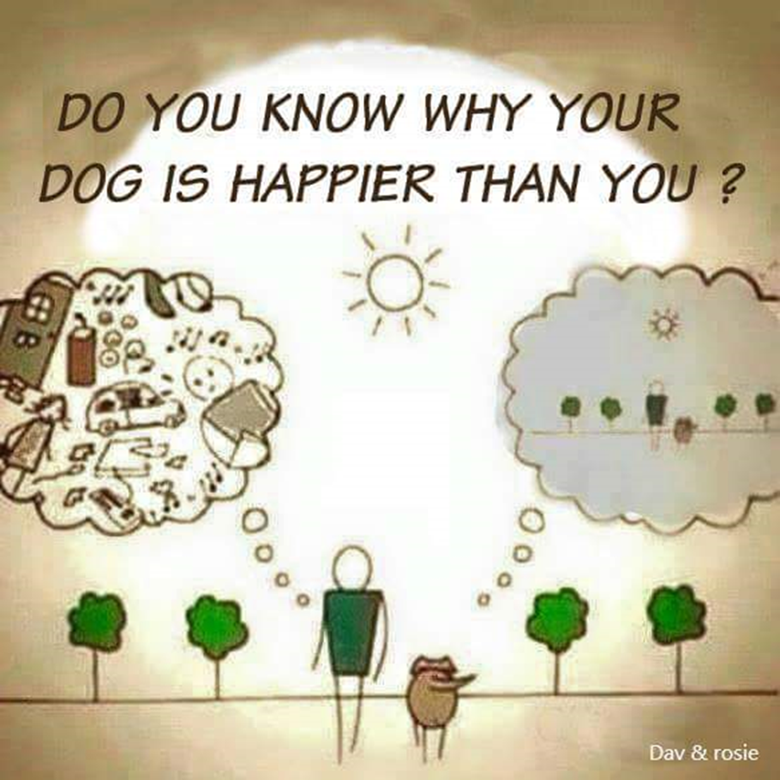

Slide 24
summary
Understand your Purpose
Re-balance if you’re spending too much time in the wrong quadrant
Re-frame or shift your perspective
Negotiate or Say No
Stress Manage
Remember—life has many stages

Slide 25
Balance is a myth Beth Nyland
why do we seek
balance?
some mythical
symmetry
between
work and play
public and private
activity and rest?
even the
lopsided
human heart
is cradled
by lungs
of different sizes

