Slide 1
LEADERSHIP DEVELOPMENT OPPORTUNITIES FOR WOMEN LEADERS
Virginia D. Hardy, PhD Vice Chancellor for Student Affairs

Slide 2
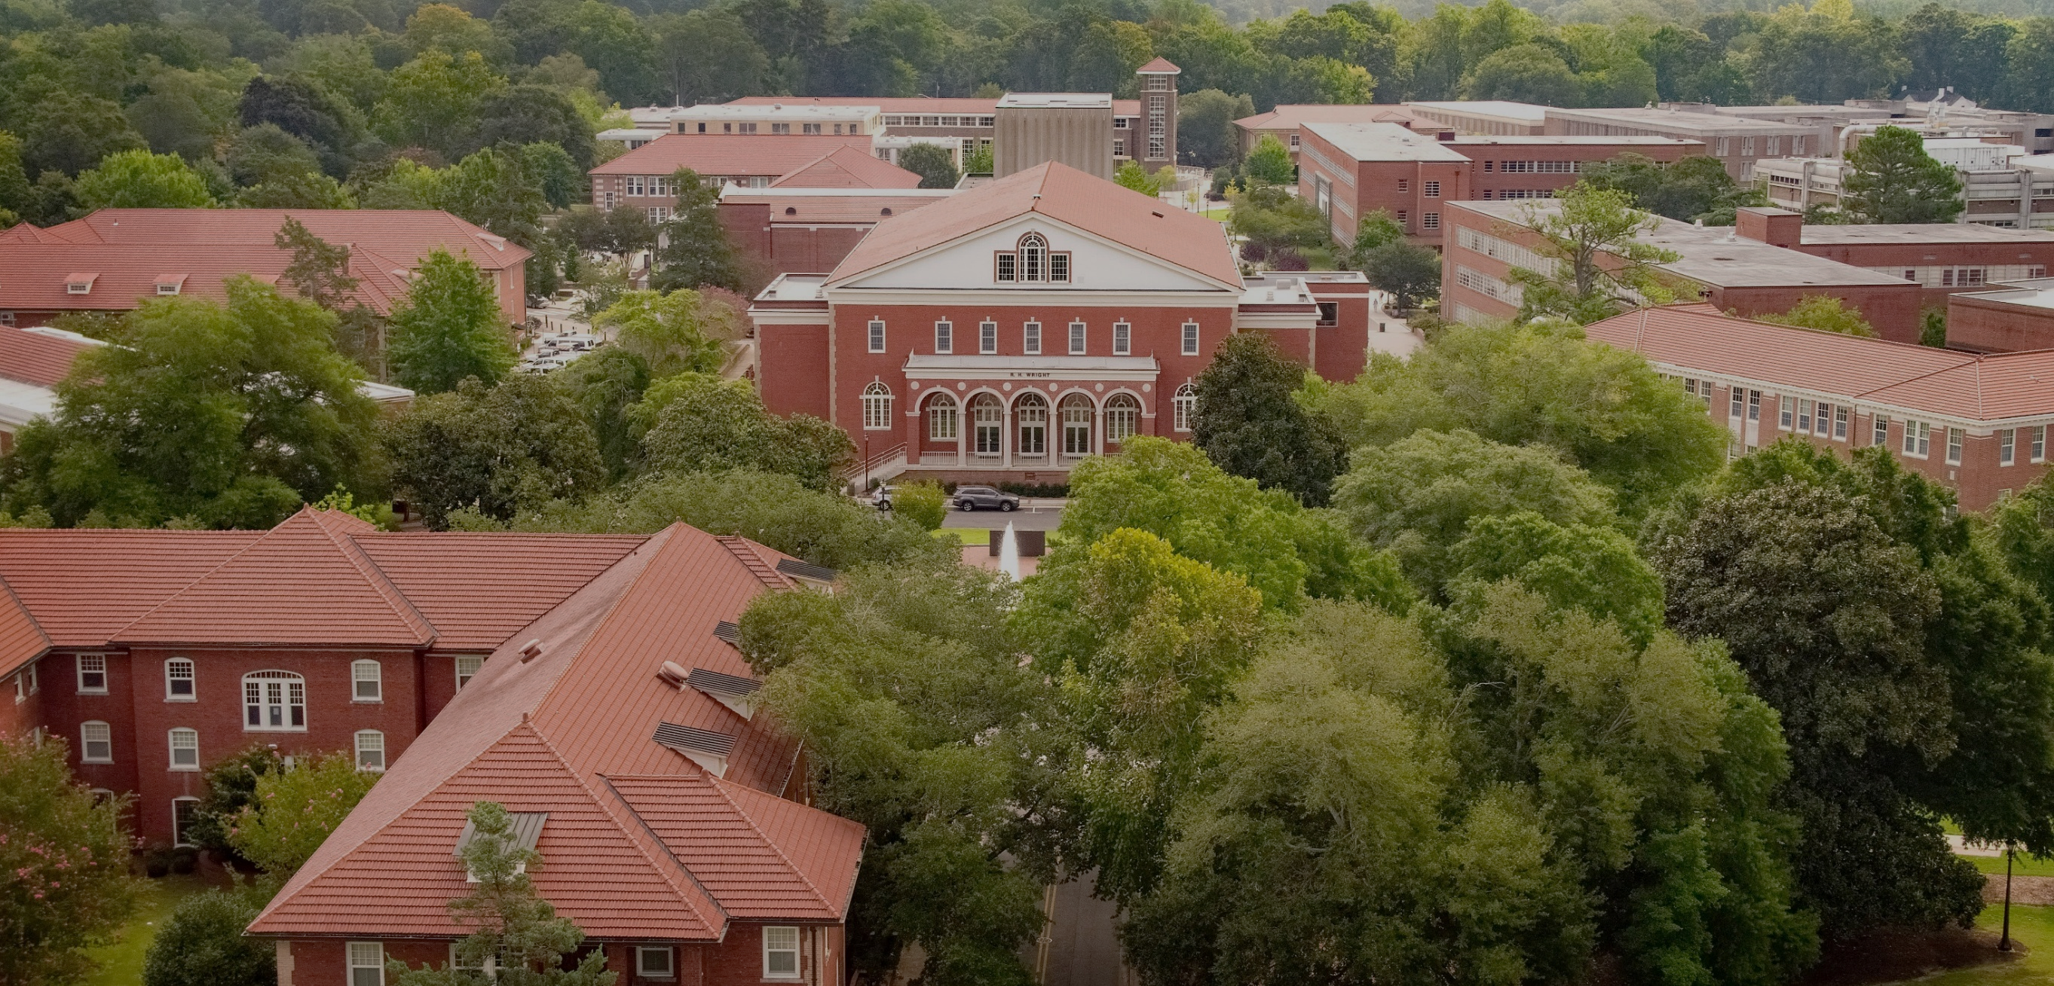
Even though women outnumber men at most universities, the global average of women in senior management positions remains flat

Slide 3
Objectives
To increase awareness of leadership and professional development opportunities and resources within the University and higher education that are available to women
Increasing collaboration teamwork and informal mentoring

Slide 4
What Women Say They Need to Succeed
Clear expectations about role and the path of advancement
An equitable and diverse workplace
Access to opportunities for development and advancement

Slide 5
Take Advantage of Your Network

Slide 6
Cadre of Advisors
Cadre of Advisors/Supporters
Coach – talks TO you
Mentor – talks WITH you
Sponsor – talks ABOUT you
ADDITIONAL ADVISORS
Connector: links you to people, networks
Point expert: knows your field and shares knowledge with you
Close friend: provides safe space

Slide 7
Wildacres Leadership Initiative
The William C. Friday Fellowship is a nonpartisan, results-focused leadership development opportunity for North Carolinians who wish to positively impact their communities through leadership grounded in improving human relations
Models leading with courage, speaking one’s truth, engaging differences with civility, collaborating to solve problems, and embracing equity and justice
http://www.fridayfellowship.org/

Slide 8
BRIDGES is an inclusive professional development program for women in higher education who seek to gain or strengthen their academic leadership capabilities.
help women identify, understand, and build their leadership roles in the academy
develop insights into leadership, with a particular focus on the special skills and attributes women bring to their leadership roles
acquire an understanding of the many facets of colleges and universities
refine and improve their cross-cultural communication skills, and
create a program of personal and professional development to benefit themselves and their institutions.

Slide 9
AAMC (GWIMS)
The Group on Women in Medicine and Science (GWIMS) advances the full and successful participation and inclusion of women within academic medicine by addressing gender equity, recruitment and retention, awards and recognition, and career advancement.
Professional Development Opportunities
Early Career Women Faculty Leadership Development Seminar
Mid-Career Women Faculty Leadership Development Seminar
Notes:
Early Career Women Faculty Leadership Development Seminar
This popular and highly interactive seminar provides women at the assistant professor or instructor level with the knowledge and skills required to navigate the academic medicine enterprise as well as continue on the path to leadership.
This three and a half-day seminar is designed for women physicians and scientists holding medical school appointments at the instructor or assistant professor level, and in the early stages of leadership positions within their discipline, department or institution. The seminar will present participants with a foundation for modeling leadership behavior and assist in creating individual leadership goals. Participants will gain insights into the realities of building a career in academic medicine and science. There will also be a focus on expanding your network of colleagues with the facilitation of peer discussion, small-group career advancement toolbox sessions, and various networking activities. Additionally, there will be an emphasis on establishing wellness practices and applying new skills to practice as participants return to their institution. Attendees will develop academic medicine and science career building skills such as communication, conflict management, and financial acumen, and employ strategic thinking about their career and leadership development.
Mid-Career Women Faculty Leadership Development Seminar
This leadership development seminar focuses on women physicians and scientists holding medical school appointments at the associate professor level, and holding leadership positions within their discipline, department or institution. The seminar's three and a half day curriculum is designed to provide mid-career faculty with the knowledge and skills required to continue advancing to leadership roles in academic medicine. This intensive and highly interactive seminar emphasizes the skills needed to advance to senior roles within academic medicine and provides time for participants to strategically reinvigorate and realign their career with their goals. The seminar covers leadership topics relevant to mid-career women faculty, such as: communication, overcoming challenges in the changing landscape of academic medicine, negotiation, wellness, politics, etc. all of which are central to being a leader at your academic health center. The personalized curriculum and interactivity of this seminar will help you and your peers discover pathways to leadership and brainstorm ways to advance women in academic medicine and science.
Attendees will develop academic medicine and science career building skills and employ strategic thinking about their career and leadership development.

Slide 10
Chancellor’s Leadership Academy
The Chancellor's Leadership Academy is an intensive professional development experience for faculty and staff who are ready to expand their capacity for leadership in higher education and who are committed to enhancing their contribution to the university. The Academy offers leadership development to high potential university members through quality curriculum, materials and experiences delivered by top-level administrative and academic leaders.
Purpose
Develop leadership capacity of high-potential university members
Frame leadership concepts in the context of higher education organizations and develop their application to personal and professional leadership development
Foster and create campus networks of innovative leadership practice and communities of learning
Support development of emerging and experienced leaders
Development of an understanding of and commitment to fostering a culture of leadership and cultural diversity at East Carolina University

Slide 11
CLA PURPOSE
Develop leadership capacity of high-potential university members
Frame leadership concepts in the context of higher education organizations and develop their application to personal and professional leadership development
Foster and create campus networks of innovative leadership practice and communities of learning
Support development of emerging and experienced leaders
Development of an understanding of and commitment to fostering a culture of leadership and cultural diversity at East Carolina University

Slide 12
CLA FACTS
To-date: 196 CLA Graduates
43% men
57% women
49% Faculty
51% staff
100% of CLA graduates expressed they had a positive, productive learning experience
33 CLA graduates have been chosen for more advanced leadership roles
19 CLA graduates have advanced at other universities/organizations

Slide 13
DISCUSSION

