Slide 1
Language, Communication & Influence

Slide 2

What is language?
An instrument for communicating ideas
A vehicle for negotiating relative status
A tool for power
A learned social behavior

Slide 3

Speaking Well…
Opens doors
Gives you options
Creates opportunities
Motivates others to action

Slide 4


Language: Content vs. Style
CONTENT
is what you say
STYLE
is how you say it
Notes:
Style often is more important than content; Others perceive us as more confident/competent based on our conversational style; Many misunderstandings and problems are caused by differences in conversational style

Slide 5

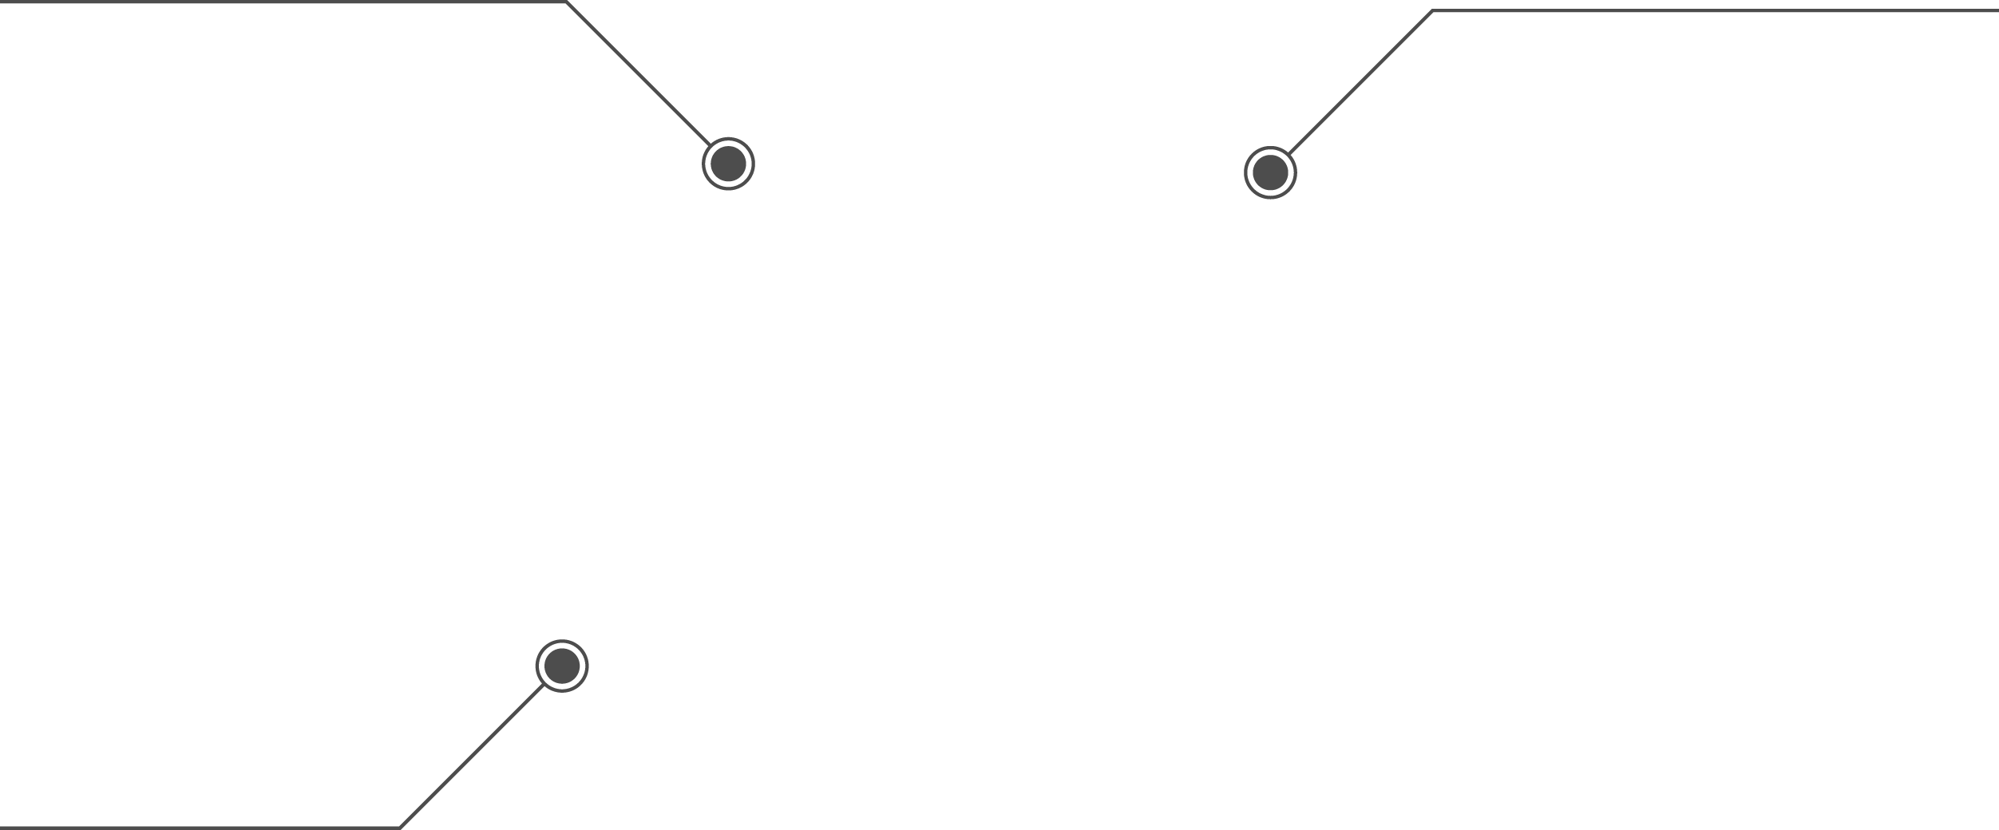
How We Communicate
7%
What we say
55%
Body language,
non-verbal
55%
55%
38%
How we say it
5

Slide 6
Style of Speech Influences:
Advancement
Recognition
Hiring

Slide 7
Speech styles and Confidence
Girls talk in order to be liked
Sounding too sure = not popular
Women more likely to downplay certainty
Men more likely to downplay doubts

Slide 8
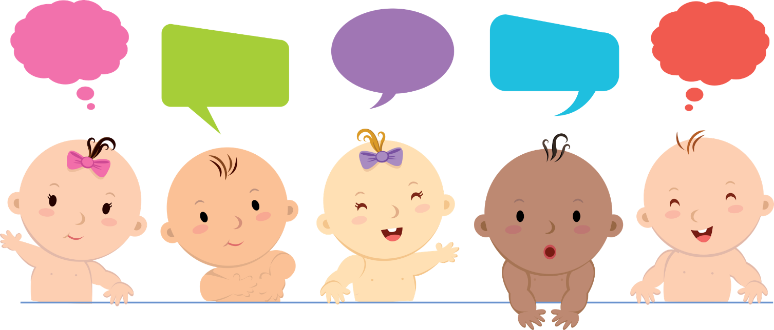
How We Speak is Learned
Children are raised with different worldviews
We judge others based on our worldview and style
Problems may arise if your worldview is not the workplace norm

Slide 9
Reflection …
Think of a life experience that has shaped your context/worldview. Consider your childhood experiences, family, friends, relationships, education, socio-economic situation(s), culture, race, ethnicity, religion, politics, and where you’ve lived:
________________________________________________________________ .
Given my life experience, my worldview includes: _____________________________ .(insert a core belief, value or assumption)
Therefore, I tend to: ________________________________________________ .
(insert an expectation, perception or interpretation)
As a consequence, I have difficulty understanding, respecting, or listening to someone who: ____________________________________________________________ .

Slide 10

Your Speech Style
Influencing speech
Confident speech
High-power speech
Low-power speech

Slide 11
The “Power Dynamic”
ONE UP
ONE DOWN

Slide 12
Elements of Low Power Speech
UNCERTAINTY
HEDGING
TAG QUESTIONS
“I sort of liked it”
“I’m not sure if this is right but…”
“This may sound crazy but…”
This is the best way to go, right?”
“Here’s the way we should go, OK?”
“Can I ask a question?”

Slide 13
Elements of Low Power Speech
INTENSIFIERS
TEEN SPEAK
EMOTION
“I really, really liked it!”
“It’s an awesome idea!”
“This is, like, so cool!”
Too much?
Not enough?
Women are penalized for expressing anger

Slide 14
Elements of Low Power Speech
SELF DEFEATERS
CONDITIONAL PHRASING
NEGATIVE STATEMENTS
“I think/ I believe”
- vs -
“I’m confident/ I’m convinced/ I’m optimistic/ I expect”
“I am not a crook”
- vs -
“I am an honest man”

Slide 15
High Power? Low Power?
Pronouns:
“I” -vs- “we”
Questioning
Interrupting

Slide 16
Elements of High Power Speech
}
SPEECH
RATE
Not too fast
Not too slow
}
VISUAL IMAGERY
Terms that push emotional buttons
Promotes identification & affiliation
}
DIRECT SPEECH
Active verbs; No fillers
“I’d like to welcome you to RDU” vs. “Welcome to RDU”
}
PROJECTION OF CERTAINTY
Exaggeration of certainty and minimization of doubt
Higher risk
Notes:
Visual imagery: “You can’t eat the whole elephant at once” “We need to pick a horse and ride it”

Slide 17

Putting It to Work
Working in table teams, answer the following questions:
Do you see differences between usage of high or low-power speech in your office?
  If so, is it by position, gender, or age?
When do you want to use high-power speech?
  Do you ever want to use low-power speech?
Notes:
INTRODUCE ACTIVITY: I’d like you to begin by thinking about someone you consider to be an excellent leader, or perhaps the best manager you’ve ever had.
Using the worksheet on page 5 in your workbook, jot down some of the characteristics that made him or her such a great leader. What did he/she do? How did that make you feel ?
Also take a few moments to think about someone you consider to be a poor leader. Using the same worksheet, jot down some of the characteristics that made him or her a poor leader. And again, think about what he/she did and how that made you feel .
Take a couple minutes to work on your own and then I’d like you to work with the others in your table group to share and compare these best/worst attributes.
TIMING: You’ll have up to 10 minutes to consolidate these on a flipchart, and add more things you come up with as a team.
QUICKLY DEBRIEF by having the groups share some of the key characteristics of a great leader.
ASK: What are you seeing here?
many of these leaders share common characteristics.
REPEAT by having the groups share some of the key characteristics of a poor leader.
TRANSITION with: THANK YOU … these are comprehensive lists we’ve built!
We’ll refer back to these in a little while.
Let’s move on now to talk about Building Leadership Credibility.
Timing: 20 minutes: Allow up to 10 minutes for table team/flipchart work and up to 10 minutes for sharing.
Materials: Flipchart for each team
Workbook: Great Leader/Poor Leader worksheet, page 5

Slide 18
Conversation rituals can also affect the perception of power
According to the experts:
  Women’s rituals focus on building rapport
  Men’s rituals focus on status
Conversation ritual =
saying words that feel right without considering their literal meaning
Different rituals are problematic when a ritual is not recognized

Slide 19


What is a Ritual?
http://www.upworthy.com/30-seconds-of-women-over-apologizing-followed-by-30-seconds-of-them-so-destroying-that-stereotype?c=upw1

Slide 20
Conversation rituals can affect the perception of power
}
  APOLOGIES
  Saying “I’m sorry” as a ritual way of restoring balance to a conversation
  THANKING
  Excessive or unwarranted thanking as a conversation closer
    - Girls are told “no” more frequently than boys
Don’t use these as a filler
Notes:
Apologies: when both parties share the blame, it’s a conversational ritual of both. if another doesn’t recognize the conversational ritual, it’s a one-down position. Negative position is if one apologizes a lot and the other doesn’t

Slide 21
Conversation rituals can affect the perception of power
}
  COMPLIMENTING
  Exchanging compliments is more common among women
  “ I don’t know where I stand!”
  SOLICITING OPINIONS
  Women more often ask others for their opinions
  “You’re not listening!”
Be aware of your intentions
Notes:
Soliciting opinions can be judged negatively: “she’s trying to get others to decide for her!”

Slide 22
Conversation rituals
}
  MIXING BUSINESS WITH NON-BUSINESS TALK
  Men: Sports politics
  Women: Personal lives
What small talk do you engage in?
Notes:
We see as trivial the type of small talk that another group engages in if it’s not our conversational ritual

Slide 23
Conversation rituals
}
  “TROUBLE TALK”
  One way more women establish rapport is by commiserating
  Men want to fix the problem
What small talk do you engage in?
Notes:
We see as trivial the type of small talk that another group engages in if it’s not our conversational ritual

Slide 24
Conversation rituals can call attention to our gender
}
  RITUAL OPPOSITION
  For most men, antagonism, opposition and arguments are a routine part of daily negotiation
  For most women, it’s not routine
Are you breaking an unwritten rule?
“It happened and it’s over”
vs.
Taking it personally
Notes:
The logic behind ritual opposition is knowing that your ideas will be scrutinized by others – encourage you to think more rigorously in advance

Slide 25
Conversation rituals can call attention to our gender
}
  TEASING
  Men socialize by insulting each other…but they really don’t mean it
  Women socialize by complimenting or self-deprecating…and they may not mean it either
Are you missing an opportunity to join an inner circle?

Slide 26
Conversational Rituals
}
Apologies
Thanking
Complimenting
Soliciting Opinions
Ritual Opposition
Teasing
Affect Perceptions of Power
}
Call Attention to Gender

Slide 27
Putting It to Work
Working in table teams, choose a Conversational Ritual:
Take turns giving examples of when you may have used this ritual or when someone used it on you
Discuss coaching strategies to address your reactions or the reactions of others and ways to build new habits
Apologizing Thanking
Complimenting Soliciting opinions
Ritual opposition Teasing
Notes:
INTRODUCE ACTIVITY: I’d like you to begin by thinking about someone you consider to be an excellent leader, or perhaps the best manager you’ve ever had.
Using the worksheet on page 5 in your workbook, jot down some of the characteristics that made him or her such a great leader. What did he/she do? How did that make you feel ?
Also take a few moments to think about someone you consider to be a poor leader. Using the same worksheet, jot down some of the characteristics that made him or her a poor leader. And again, think about what he/she did and how that made you feel .
Take a couple minutes to work on your own and then I’d like you to work with the others in your table group to share and compare these best/worst attributes.
TIMING: You’ll have up to 10 minutes to consolidate these on a flipchart, and add more things you come up with as a team.
QUICKLY DEBRIEF by having the groups share some of the key characteristics of a great leader.
ASK: What are you seeing here?
many of these leaders share common characteristics.
REPEAT by having the groups share some of the key characteristics of a poor leader.
TRANSITION with: THANK YOU … these are comprehensive lists we’ve built!
We’ll refer back to these in a little while.
Let’s move on now to talk about Building Leadership Credibility.
Timing: 20 minutes: Allow up to 10 minutes for table team/flipchart work and up to 10 minutes for sharing.
Materials: Flipchart for each team
Workbook: Great Leader/Poor Leader worksheet, page 5

Slide 28
Language and wording in feedback
}
  MEN
  Strategic, visionary, results-oriented
  Get rated on potential
Are you and others using the right words to describe you?
  WOMEN
  Hard worker, loyal, team player
  Get rated on past performance
Source: Janna Barsh and Lareine Yee. McKinsey & Co. Special Report: Unlocking the Full Potential of Women in The U.S Economy

Slide 29

Exercising your voice in a public setting
Research shows that women do not succeed as well as men at:
  Speaking up
  Articulating their own pre-meeting preferences
  Affecting the group decision
  Gaining influence in the eyes of others
Source: Tali Mendelberg, Professor, Department of Politics, Princeton University

Slide 30

What should you do?
Remember the “meeting before the meeting”
Get ahead of the point being discussed
Keep emotion out of it
Live to fight another day:
don’t retain angst

Slide 31

Homework Assignment
Rate that Comment
The next time you are in a meeting, write down everyone’s name and then rate their comments:
5 = “This is the most insightful comment I’ve heard in a while”
1 = “This is the dumbest comment I’ve heard in a while”
0 = “This person just repeated what someone else said but used different words.”
At the end of the meeting, average everyone’s score. They may not be as insightful as you thought … but they are speaking up!
Notes:
INTRODUCE ACTIVITY: I’d like you to begin by thinking about someone you consider to be an excellent leader, or perhaps the best manager you’ve ever had.
Using the worksheet on page 5 in your workbook, jot down some of the characteristics that made him or her such a great leader. What did he/she do? How did that make you feel ?
Also take a few moments to think about someone you consider to be a poor leader. Using the same worksheet, jot down some of the characteristics that made him or her a poor leader. And again, think about what he/she did and how that made you feel .
Take a couple minutes to work on your own and then I’d like you to work with the others in your table group to share and compare these best/worst attributes.
TIMING: You’ll have up to 10 minutes to consolidate these on a flipchart, and add more things you come up with as a team.
QUICKLY DEBRIEF by having the groups share some of the key characteristics of a great leader.
ASK: What are you seeing here?
many of these leaders share common characteristics.
REPEAT by having the groups share some of the key characteristics of a poor leader.
TRANSITION with: THANK YOU … these are comprehensive lists we’ve built!
We’ll refer back to these in a little while.
Let’s move on now to talk about Building Leadership Credibility.
Timing: 20 minutes: Allow up to 10 minutes for table team/flipchart work and up to 10 minutes for sharing.
Materials: Flipchart for each team
Workbook: Great Leader/Poor Leader worksheet, page 5

Slide 32
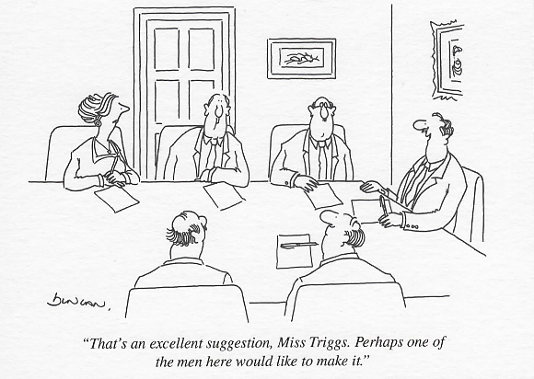

Slide 33
Body Language: Communicating Power & Status
}
HAND GESTURES
Energy or emotion?
}
HEAD NODS
Understanding or subservience?
Power players nod less
}
SMILES
Power players won’t mimic facial expressions of others with power
Women smile more
}
TAKING SPACE
Too much or too little?
When dealing with higher power players, we do opposite of mirroring – make ourselves smaller
Notes:
Visual imagery: “You can’t eat the whole elephant at once” “We need to pick a horse and ride it”

Slide 34
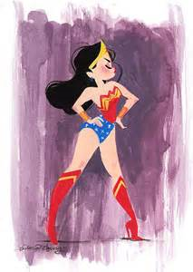
The Last Word…Power Posing
FAKE IT ‘TIL YOU MAKE IT!

Slide 35
Putting It All Together
INSIGHT: Using your personal development plan, write down key learnings/insights and actions you will take back to your role
POWER SPEECH: Are you aware of when you’re using high vs. low power speech?
CONVERSATIONAL RITUALS: Decide which conversational rituals you want to keep and which you want to lose
ACTION PLAN: Decide on a 30 day action plan. Be specific about timing and who you will talk to/get input from
Notes:
INTRODUCE ACTIVITY: I’d like you to begin by thinking about someone you consider to be an excellent leader, or perhaps the best manager you’ve ever had.
Using the worksheet on page 5 in your workbook, jot down some of the characteristics that made him or her such a great leader. What did he/she do? How did that make you feel ?
Also take a few moments to think about someone you consider to be a poor leader. Using the same worksheet, jot down some of the characteristics that made him or her a poor leader. And again, think about what he/she did and how that made you feel .
Take a couple minutes to work on your own and then I’d like you to work with the others in your table group to share and compare these best/worst attributes.
TIMING: You’ll have up to 10 minutes to consolidate these on a flipchart, and add more things you come up with as a team.
QUICKLY DEBRIEF by having the groups share some of the key characteristics of a great leader.
ASK: What are you seeing here?
many of these leaders share common characteristics.
REPEAT by having the groups share some of the key characteristics of a poor leader.
TRANSITION with: THANK YOU … these are comprehensive lists we’ve built!
We’ll refer back to these in a little while.
Let’s move on now to talk about Building Leadership Credibility.
Timing: 20 minutes: Allow up to 10 minutes for table team/flipchart work and up to 10 minutes for sharing.
Materials: Flipchart for each team
Workbook: Great Leader/Poor Leader worksheet, page 5

