Slide 1
The Heart of Mindful Living: An Approach to Resilience
Karen Goble, MA, Assistant Director Continuing Medical, Dental, Pharmacy Education, Integrative Health Coach, Chaplain, CBCT ® Instructor
December 10, 2018

Slide 2
https://elishagoldstein.com/3-key-practices-for-calm-self-compassion-and-happiness/

Slide 3
Objectives
Describe
Describe the foundations of mindfulness and how they contribute to resilience.
Identify
Identify core mindfulness practices and their application in everyday life
Discuss
Discuss practices that support well-being and resilience

Slide 4
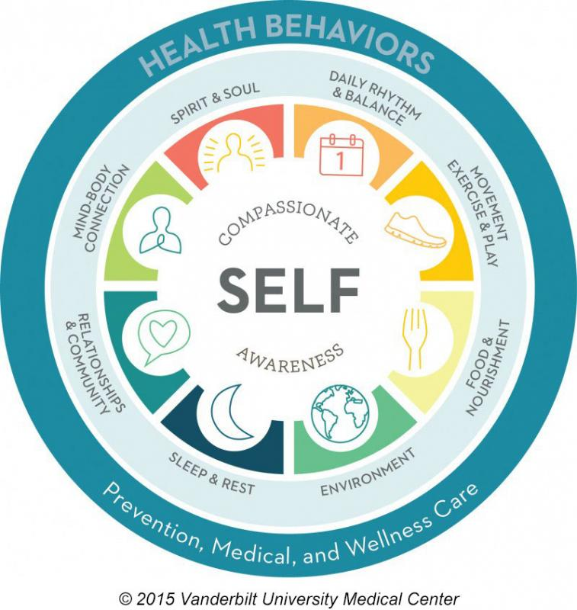
What is mindfulness?

Slide 5
Attentional Stability
The stability of the body supports the stability of the mind.
Notes:
Focused attention, self-situational awareness, divided, distracted

Slide 6
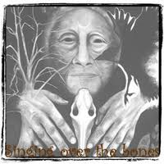
Attention
And, like this morning, here the sun is shining, the air smells good, there’s just a gentle breeze, and the fall colors are brilliant, and the dog’s happy and he’s prancing along, and as I am walking I am aware of every, I am aware of all of my five senses (Goble et al, 2016).
Notes:
This co-researcher shared an illustration depicting LaLoba and requested that her pseudonym be LaLoba – who transforms from dried out bones in the desert into a thriving wise woman.
She described her experience of mindfulness in IHC as contributing to her awakening and – coming back to life – to experiencing a sense of well-being – we can note the quality of presence in her description of mindfulness:

Slide 7
Mindfulness in Medicine
Mindfulness Based Stress Reduction (MBSR) (1979)
Jon Kabat-Zinn, PhD, University of Mass Medical Center
8 weekly sessions; 2.5 hr plus day long retreat
Widely studied in medicine and behavioral health
Notes:
JKZ describes as returning - body, breath, sense experiences including emotions and thoughts, present; being open, showing up involves courage (heart) because it involves vulnerability. Mindfulness helps us strengthen our heart (physiologically, see in discussion of Porges polyvagal system).

Slide 8
Foundation Practices
Awareness of breathing
Awareness of the body
Open field of awareness
Mindful eating
Yoga
Mindful movement
Walking meditation
Loving kindness
Compassion
Insight Dialogue
Attitudes of mindfulness
Notes:
Note hand on belly – vagal strategy – grounding – coming back to body - safety

Slide 9
To cultivate mindfulness:
Focused Attention practices (concentrative) create stability of attention, body, ANS, decrease mental proliferation (mind-wandering, rumination), concentration on object (breath)
Open Monitoring practices (insight meditation) that have no object of attentional focus but rather are receptive to whatever phenomena (physical, mental or emotional) arise
Reflective Meditation practices; Cultivation of qualities like loving-kindness, compassion and forgiveness; gratitude, Patience, Attitudes of Mindfulness

Slide 10
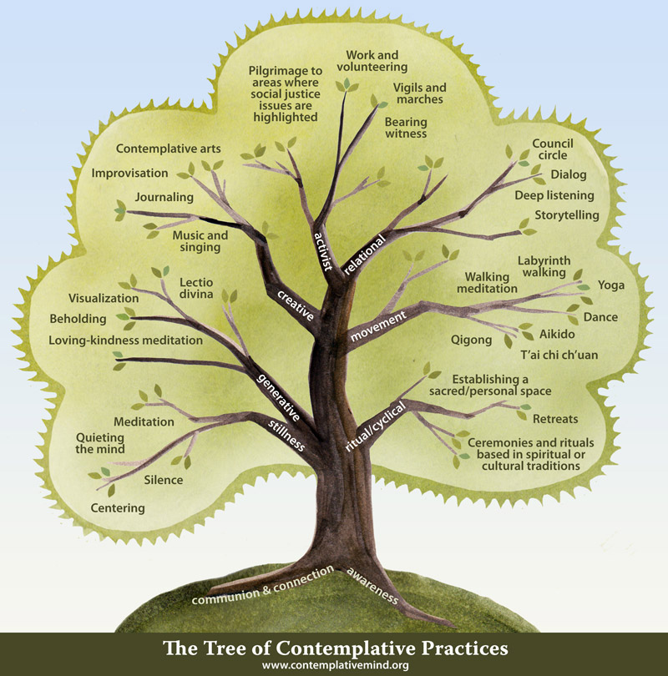
Notes:
Mindfulness – state; Mindfulness- practices invite awareness; Mindfulness – meditation, concentration
Note which of these or others you practice
Have practiced
Share w person beside
None, 1-2, 3-5, more

Slide 11
Way of navigating the 10,000 joys and 10,000 sorrows of human life. Resilience is bolstered by cognitive flexibility.
http://www.curiositiesbydickens.com/perspective-is-everything-boat-land/
Notes:
Back to why mindfulness - Life is like this
Our mental maps give rise to stories and fixed views
Mindfulness brings flexibility to explore both boat and land –
And that reduces our suffering. Cultivate well-being and tools for working with difficulties.

Slide 12
Mindfulness:
Noticing our habits and reactions
De-coupling the cue and response, event and reaction
Choosing the next step
Notes:
Norman Farb, Toronto First constituents of WB – attention & awareness: majority of time distracted, divided, default
Helpful daily functioning – don’t have to learn to tie shoes, route to work –
default network primary cause – communication breaks down, distraction, especially - autopilot
Also – leads to mistaken assumptions, judgments

Slide 13
Default Network
Mental Models
Reaction
Moral Distress Education Project
http://moraldistressproject.med.uky.edu/
The number of people who admit they feel “uncontrollable anger toward another driver” has doubled since 2005 (Washington Post, 9/1/13).
Notes:
Habit – beneficial or harmful – but below the surface of awareness – iceberg model. Neuroplasticity helps us understand that we Build neural pathways for a behavior to become automatic or the preferred/ comfortable behavior – thus, a habit feels right.
Mindfulness helps establish a beneficial habit or change unwanted habit – when we bring awareness to a habitual pattern and begin to notice internal and external cues, we will begin to change the behavior – insight to action is a core dynamic in health behavior change.
Reaction – short fuse – unmyelinated neural circuit to perceived threat – also reinforced as a neural pathway.

Slide 14
Hannah Elizabeth Gilmer
With permission: Officer L.B. Mixon GA Governor’s Safety Institute

Slide 15
What’s it got to do with Well-being and resilience?
Pause
Attentional stability
Perspective-taking
Care and Connection
Compassion (self)

Slide 16
Mindfulness Practice and Well-Being
Awaken from constraints of limiting views, default network, mental map, edge states
Respond rather than react to stressors
Present for your life and with others
Align your outer life to your inner life – and live a life that is grounded in a deep sense of meaning and purpose
Happiness (10%)

Slide 17
Between stimulus and response there is a space. In that space is our power to choose our response. In our response lies our growth and our freedom.
Viktor E. Frankl
Notes:
Moment of presence between stimulus and response – food & mouth – everything carried from morning & presence

Slide 18
What is Compassion?
Compassion involves both the heartfelt wish that others be free from suffering and the readiness to act on their behalf. It arises from a deep sense of affection for others. --Brooke Dodson-Lavelle, Emory CBCT Instructor
Survival of the social
Ancient response to those with whom we identify, kinship circle
--Frans de Wall, Age of Empathy
“Compassion meditation may shift habits of becoming overly distressed when we encounter another’s pain,“ Helen Weng, assistant professor of psychiatry, Osher Center for Integrative Medicine.
https://news.wisc.edu/training-compassion-muscle-may-boost-brains-resilience-to-others-suffering/
Notes:
Scientists at Stanford and Emory have started to map the biological basis of compassion, suggesting its deep evolutionary purpose. This research has shown that when we feel compassion, our heart rate slows down, we secrete the “bonding hormone” oxytocin, and regions of the brain linked to empathy, caregiving, and feelings of pleasure light up, which often results in our wanting to approach and care for other people.
Compassion can be trained, cultivated, grown – Emory (Stanford, Arizona, Albert Einstein Rio, Spain) training medical students, teachers, veterans, Atlanta group home youth and staff, parents and staff at Autism Center; persons with many medical concerns.

Slide 19
self-compassion
Kristin Neff, Self-Compassion: A Healthier Way of Relating to Yourself (2011).
See ourselves clearly
And make changes
Because we care about ourselves
And want to reach our full potential
B.J. Miller, MD
Notes:
Insight – supported by Attention & self awareness of core values – what matters most
Self-determined goal – action – self-regulation
Self-compassion (not limited by inner critic, views, edge states)
All have potential

Slide 20
Self-Compassion & Resilience…
“This is why people are relating to my story -- all of us suffer heartache. All of us suffer difficulties in our lives. And if you say to yourself 'find a way,' you'll make it through."
Perspective-taking
Self-Awareness & problem-solving (respond vs react)
E.I.: Manage difficult emotions and difficulties
Resource and stay – optimism & grit
Social connection; team
Diana Nyad
Notes:
Resilience
"It doesn't matter ... what you come up against because none of it's going to be pleasant. You're hardly ever out there going, 'Oh, my God, isn't it a beautiful moon tonight?' The crew is feeling that. But you're kind of suffering through the whole thing. So my thought was, 'everything you come up against say to yourself “find a way” – North Start – emphasis – all in this together

Slide 21
The G.R.A.C.E. Model
Gathering attention: focus, grounding, breathing, presence
Recalling intention: connection to vision and values; the resource of motivation
Attuning to self /other: affective resonance [check-in],
self-compassion, awareness of our edges
Considering: what is helpful for the person, both expertise and perspective taking
Engaging, then Ending, closure for yourself and patient
JOURNAL OF PALLIATIVE MEDICINE, Volume 16, Number 9, 2013, ª DOI: 10.1089/jpm.2013.0105 Rushton,C.H., Kaszniak, A. W., Halifax, J.S.

Slide 22
Gather Attention
Create the space between stimulus and response
Shift from autopilot or distraction to presence
Breath
Grounding
Use senses
How do you come back to presence?

Slide 23
Recall Intention: Kindness & compassion
The heartfelt wish that others be free of suffering
Practice – the intentional generation of well-wishes
Wishing a mentor,
those dear to us, ourselves,
those with whom we have difficulty,
all persons
safety, health, happiness, ease,
freedom from suffering.
Notes:
the intentional generation of a heartfelt positive emotional state - Compassion involves the heartfelt wish that others be free from suffering

Slide 24
ATTUNE TO SELF/OTHERS: Mindful Check-In: Body Scan
Sense into the body and notice what’s present:
Breath – is it slow, fast, deep, shallow?
Warm or cold? Alert or sleepy?
Hungry or thirsty or satisfied?
Hands clenched or open?
Shoulders, neck tight or relaxed?
Chest open or contracted?
Facial muscles tight or soft?
Notice other sensations in the body – restlessness, heaviness, relaxation, numbness
Allow the attention to sweep the body, gathering a sense of the body as a whole
The body breathing
Ground by shifting awareness to contact of feet with floor, body with seat, wall
Notes:
Distress, trauma – threat to integrity – body, emotional; Sometimes our mind & bodies get stuck in the energy of chronic stress, trauma. We are outside the Resilient Zone. Our body may be stuck in the High Zone, amped up, or frozen; numbed out, stuck in the Low Zone. Sometimes we bounce between the High Zone and the Low Zone. There are some key concepts that you need to know about that will help you understand a little more about what happens to your nervous system after distressing events: Stuck in the HIGH ZONE: When you experience a distressing event, your body and mind go on alert. The body’s alert system causes your heart rate to speed up and your breathing to become faster and shallower. It also slows down your digestion. This amping up of your nervous system happens without thinking and when we are in danger it helps us run away or fight whatever the threat may be.
Stuck in the LOW ZONE: If the threat and danger last for too long, your body may not put on the brake anymore, and so your body is always running in the High Zone. If it runs in the High Zone for too long, it can crash into the Low Zone and you may feel numb, depressed and tired.
"Triggers" are things that remind your nervous system of distressing events from your past. They can include people, places, sounds, body sensations, words, and/or smells connected to distressing events in your life and they can cause you to be bumped out of your Resilient Zone. There can be external triggers or internal triggers. For some people, there can be so many triggers that they can be stuck in the High Zone or the Low Zone much of the time.

Slide 25
CE: Consider, Engage, End

Slide 26
What is Well-Being? Well-Being is a skill!
Wear Red Day 2/1/2019

Slide 27
Mindfulness Resources
Brantley, J. (2007). Calming your anxious mind. 2nd ed. Oakland: New Harbinger Publications.
Brantley, J. & Millstine, W. (2007). Five good minutes at work. Oakland: New Harbinger Publications.
Davidson, R.J. & Goleman, D. (2017). Altered Traits: Science Reveals How Meditation Changes Your Mind, Brain, and Body.
Epstein, R. (2017). Attending: Medicine, Mindfulness, and Humanity. New York: Scribner.
Farb, N.A., Segal, Z.V., Mayberg, H., Bean, J., McKeon, D., Fatima, Z, & Anderson, A.K. (2007). Attending to the present: mindfulness meditation reveals distinct neural modes of self-reference. Soc Cogn Affect Neurosci (2007) 2 (4): 313-322 first published online August 13, 2007 doi:10.1093/scan/nsm030
Halifax, J. (2018). Standing at the Edge: Finding Freedom Where Fear and Courage Meet. New York: Flatiron Books.
Hayes, S. C. (2004). Acceptance and commitment therapy and the new behavior therapies: mindfulness, acceptance, and relationship. New York: Guilford Press.
Kabat-Zinn, J. (2013). Full catastrophe living. Rev. and updated. New York: Bantam Books.
Kabat‐Zinn, J. (2003). Mindfulness‐based interventions in context: past, present, and future. Clinical psychology: science and practice, 10(2), 144-156.
Ludwig, D. S. and J. Kabat-Zinn (2008). Mindfulness in medicine. JAMA 300(11): 1350-1352.
Neff, K. (2011). Self-Compassion: The proven power of being kind to yourself.
Salzberg, S. (1995). Loving-kindness: the revolutionary art of happiness. Boston: Shambhala.
Sheridan, C. (2016). The Mindful Nurse: Using the Power of Mindfulness and Compassion to Help you Thrive in Your Work. Rivertime Press.
Siegel, D. J. (2007). Mindfulness training and neural integration: differentiation of distinct streams of awareness and the cultivation of well-being. Social Cognitive and Affective Neuroscience, 2(4), 259-263.
Siegel, D. J. (2010). Mindsight: The new science of personal transformation. NY: Bantam Books.

Slide 28
Mindfulness Resources
Center for Mindfulness in Medicine, Health Care, and Society. Department of Medicine, UMASS Medical School. https://www.umassmed.edu/cfm/
Center for Mindfulness. UC San Diego School of Medicine. Department of Family Medicine and Public Health. https://health.ucsd.edu/specialties/mindfulness/Pages/default.aspx
Cognitively Based Compassion Training. Emory-Tibet Partnership and Science Initiative. https://tibet.emory.edu/cognitively-based-compassion-training/
Center for Compassion and Altruism Research and Education. Stanford Medicine. http://ccare.stanford.edu/
http://elishagoldstein.com/videos/the-stop-practice/
https://www.tarabrach.com/meditation-the-rain-of-self-compassion/

