Slide 1
Climbing the ladder in high heels: how to keep from slipping off
Lynn M Schnapp, MD
Professor of Medicine
Division Chief
Pulmonary, Critical Care, Allergy & Sleep Medicine
Medical University of South Carolina

Slide 2
Disclosures
Research Funding
National Institutes of Health
BMS
Ironwood
I love what I do

Slide 3
How to get there

Slide 4
My Journey…
Start
?
Now

Slide 5
Professor
Tenure
Associate Professor
Assistant Professor

Slide 6
Promotion
What is your faculty track?
Know your institutions tracks, criteria
Does your faculty track align with your actual responsibilities?
Can you switch tracks?
What are the criteria for promotion in your track?
What is the timeline for promotion
Is there an up and out policy?

Slide 7
Tenure
Am I on a tenure-track?
What does tenure mean?
What are the criteria for tenure?
Based in demonstrated professional competence in teaching, scholarship, clinical practice and service
Potential for future contributions in a like manner
Institution's needs and resources
No assistant professor will be awarded tenure unless concurrently promoted to associate professor

Slide 8
Climbing up the ladder
Meet with Chair annually
Review Individual Development Plan with specific goals
Maintain a complete and updated CV
Institutional CV
NIH biosketch
Short CV

Slide 9
Academic CV
Name, degree, address (no SSN, no DOB)
What is your answering machine message?
Education (nothing earlier than college)
Degrees and inclusive dates
Professional positions
Postdoc, Research Assistant
Academics don’t want description of work, or skill sets
Explain any gaps
Honors/Awards (explain if not obvious)
Grant Funding (yours, not your PI’s)

Slide 10
Curriculum Vitae
Publications
Number
Bold your name
Indicate name change*
Indicate co-first authors
Underline mentees
Separate sections for submitted, in preparation, reviews
Separate section for abstracts

Slide 11
Curriculum Vitae
Editorial Boards
Or: Ad hoc reviewer for …
Invited presentations/talks (not abstracts)
Local, regional, national
NO DUPLICATION OF INFORMATION

Slide 12
Mentorship
Year | Mentee Name | Mentee’s Role | Current Position | Comments (i.e. Mentee honors, awards, etc.)
2012-13 | Sue DeMonas, MD | Fellow | Asst Professor, MUSC | F32 NRSA; Fellow of the Year, DoM
2013-2015 | Al Veolus | Graduate Student | Postdoctoral Fellow, Somewhere | Travel Award, ATS
2014-present | Bran Mouffin, RD | Dietician, MICU |  | Site PI, International Nutrition Project, 2015 Emerging Dietetics Leader Award, 2016

Slide 13
Educational Portfolio
Academy of Medical Educators
Membership on Society Educational Committee
Highlight mentees on publications
Submit educational activities as poster or manuscript
MedEd Portal

Slide 14
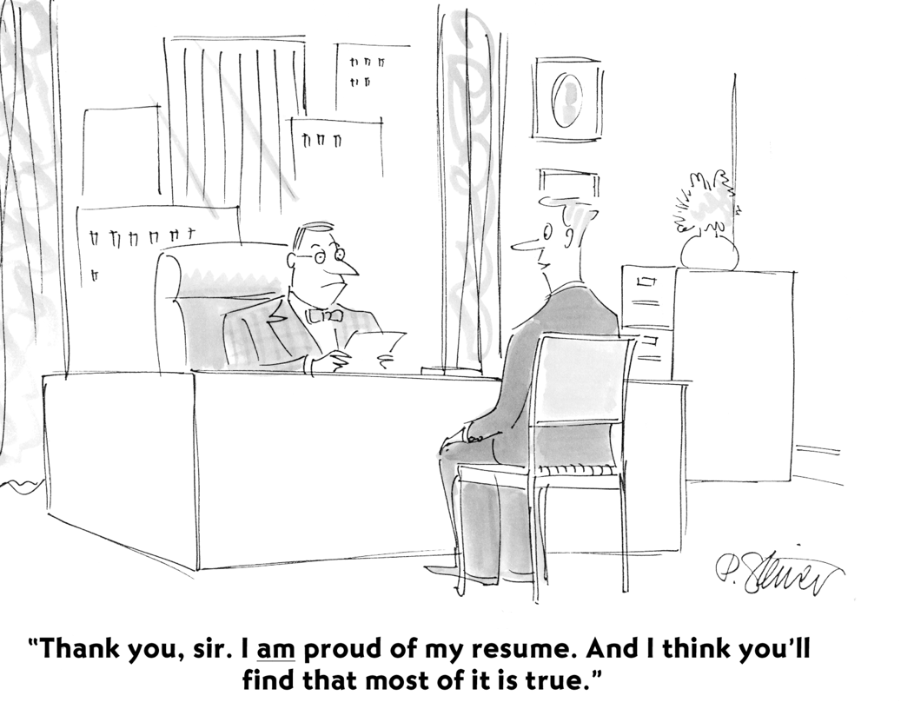
© The New Yorker Collection from cartoonbank.com.
All Rights Reserved.

Slide 15
Developing a national reputation
Requirement for promotion at academic medical centers, regardless of track
Promotion to Associate: local/regional reputation
Promotion to Professor: national and/or international reputation
Parental kvelling rights

Slide 16
How is national reputation measured?
Scholarly productivity and its impact
Extramural grant funding
Invited presentations at national meetings
Visiting professorships
National awards
External Study Sections

Slide 17
How is national reputation measured?
Leadership in national professional society
Author of guideline, policy statements
Editorial boards
Invited chapters, book editor
Regional and national clinical referrals
Name recognition

Slide 18
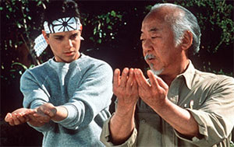
Mentor versus Sponsor
Mentor
"trusted counselor, guide, tutor or coach”
"person who imparts wisdom"
Sponsor
Champions
Focus on career development
Motivated by advancement goals

Slide 19
Mentor versus Sponsor
You need a mentor AND a sponsor
Mentors talk with you
Sponsors talk about you
Mentors help you skill up
Sponsors help you move up

Slide 20
Tiara Syndrome
Symptoms include keeping your head down, delivering excellent work and hoping that the right people will notice — and place a tiara on your head!
Hope is not a strategy!

Slide 21
Get yourself known
Network at conferences, at seminars, or when a speaker is invited to your institution
Prepare a pitch for yourself to present the important elements of your work and achievements clearly and concisely when asked
Ask questions at conferences during talks

Slide 22
Professional Meetings
Regional meetings good place to practice your presentation skills, build local networks
National versus regional
Always try to submit an abstract
Practice and get feedback before meeting
Don’t go overboard. Quality is better than quantity
Great for networking, collaborations

Slide 23
Professional Societies
Identify the best society for your career goals
Focus on one or two societies:
In-depth experience more helpful than superficial involvement

Slide 24
Learn the organizational structure of your society
How and when is committee membership determined
How is meeting content determined?
Are leaders elected or selected?
Are there opportunities for junior members?
Are there mentoring programs within your society?

Slide 25
Learn the organizational structure of your society
Email the appropriate individuals to get involved
Include your CV, brief description
Be patient
Be persistent
Be proactive

Slide 26
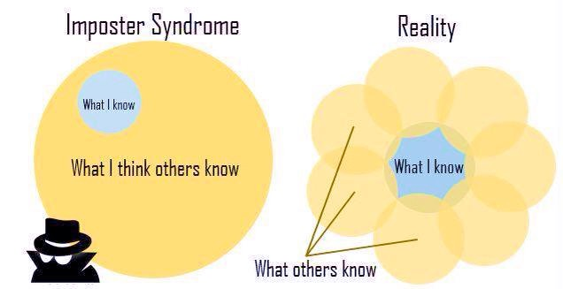
Become a musician!
Toot your own horn!!

Slide 28
Toot your horn
Identify awards, honors and get your mentor or sponsor to nominate you
Provide draft of a glowing letter of support for yourself
Volunteer for key activities
Propel you forward

Slide 29
How to get involved nationally
When opportunity knocks, answer!
Provide substantive feedback when asked
Be honest about your availability
Know what is being asked of you
Be true to your word
Follow through
Respect others

Slide 30
Putting it together
Social Media
Keep track of everything!!
Keep all your evaluations, letters from students, patients, etc
Keep on updated and complete CV
Have an “expert” review your CV

Slide 31
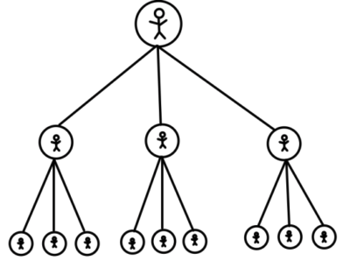
Pay it Forward!

Slide 33
Invest in good shoes!!
Paul Green
Aquatalia
Haflinger

Slide 34
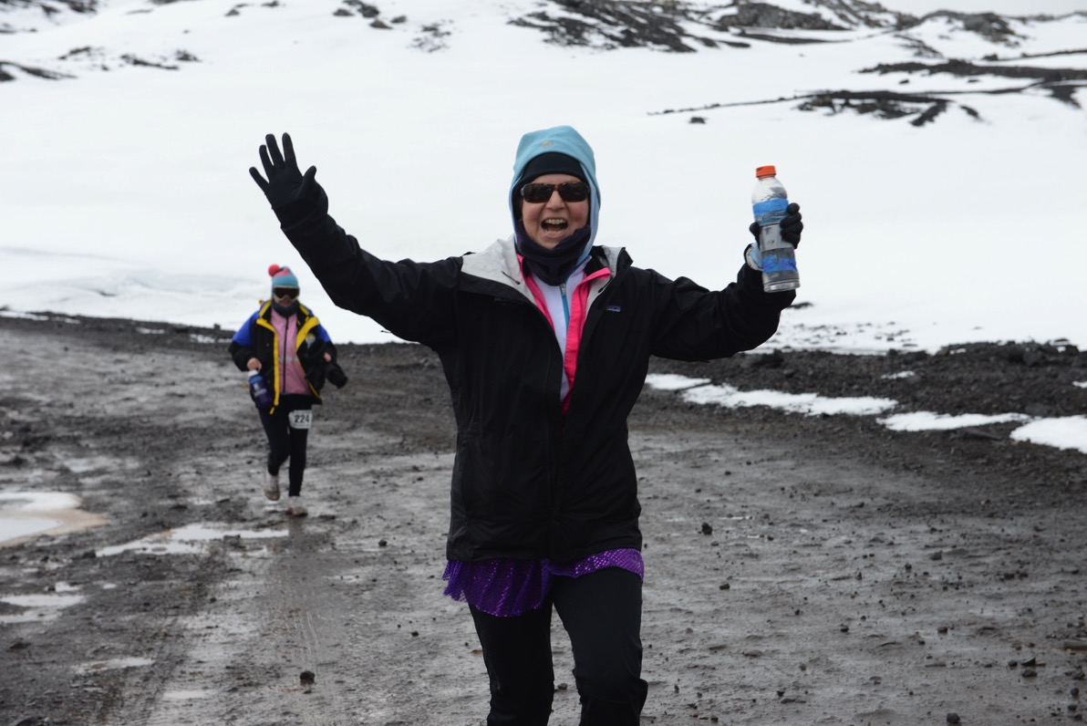
It’s a marathon, not a sprint

