Slide 1
Calendar/email efficiency
Susan Schmidt, MD
Associate Dean for Student Affairs
Clinical Associate Professor of Family Medicine
Brody School of Medicine
January 24, 2018
Notes:
-I attended the Early Career AAMC Women’s Faculty Seminar in 2010 and the Mid-Career in 2016 – both were immensely helpful to find like-minded folks and equip me with ‘tools’
-these email/calendar lessons are from 2010

Slide 2
Your EMAIL tips
Unsubscribe
Answer as soon as reading
Delete on phone
Dragon software
Only address 1-2 times per day
Setting rules
Turning off alerts
Notes:
-BWFC survey
-awesome ideas
-how many of you answer your email as soon as you read it?
-how many of you batch your email?
-how many of you have email folders?
-whose total number of emails in their inbox is over three digits?

Slide 3
Getting things done
Notes:
-this was introduced to me at the AAMC Early Career Faculty Development Seminar in 2010
-I did not adopt ‘the whole system’, but the concepts have been quite helpful
-plan to capture/organize and execute all of your work – get it out of your head!
-no specific planner or technology needed (show my notebooks)

Slide 4
5 steps
Capture every task
Clarify what needs to be done
Organize by category and priority
Reflect on next steps
Engage and get to work
Notes:
Capture – EVERYTHING! Use a tool to get all of your tasks somewhere. Capture a task as soon as it is assigned or you think of the need. Make the system easy enough to capture the task quickly (not tempting to delay).
Clarify – Break down big projects into manageable steps. If you can do it immediately, do so. If you can delegate, do so.
Organize – By category and priority. If you need a due date or a reminder, put those on your calendar.
Reflect – Define the next action for each task. In-depth review periodically (weekly).
Engage – Get to work! Choose next action and do it.

Slide 5
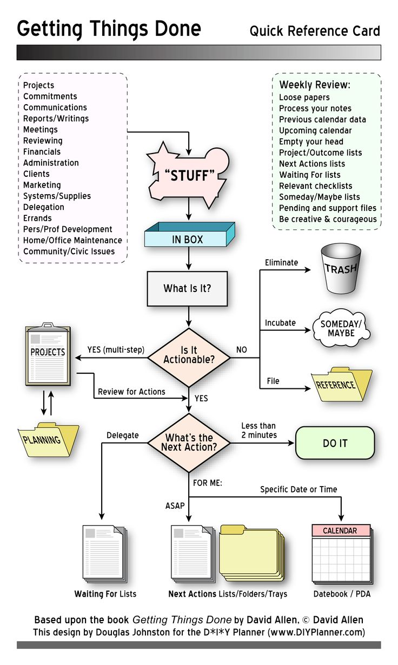
GTD algorithm
Notes:
Once you identify the work, you have to have a system to identify what to do with incoming information.
Projects – temptation bundling. Different list – WHITE BOARD
LESS THAN 2 MINUTES!

Slide 6
EMAIL – 4 possible choices
Send (new emails)
Delete
Respond
File
Notes:
-needed new emails
-delete any FYIs or anything you do not need to read
-respond to all emails – answer people, even if just a ‘thank you’
-file – waiting, read, someday, travel, student/project specific, etc.

Slide 7
Calendars – 3 items
Time-specific actions
Day-specific actions
Day-specific information
NOTHING ELSE!
Notes:
appointments, meetings, things with a set date/time
appointments and tasks (reminders) with no specific time, but on a certain day
directions or event details

Slide 8
Weekly review
Schedule it!
Get Clear
Get Current
Get Creative
Notes:
-clean up workspace, empty inbox
-review calendar and make sure that all of the tasks are done prior to the meetings, etc. the following week – if not, set them in motion! – review to-do list and update
-think about new projects, ideas and how to make them happen

