Slide 1
Sydney Hendricks and Mansi Trivedi Service-Learning Distinction Track Scholar The Development of an Integrative Medicine Intervention to Support the Health of the Home Insecure
Dr. Daugherty

Slide 2
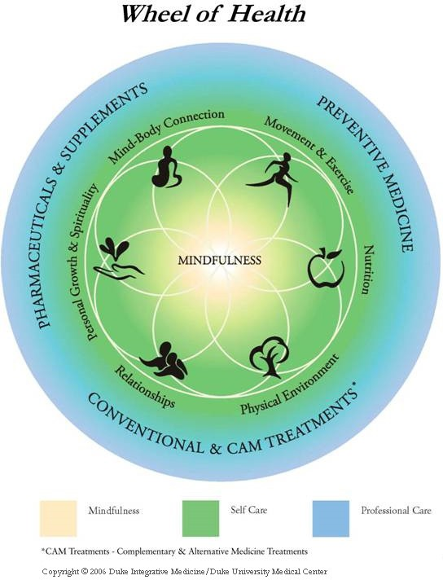
Introduction
Lack of access to integrative medical services in non-white, low income, and less educated populations
Aim: create a holistic wellness program for the home insecure population of Greenville, North Carolina

Slide 3
Type of Project: Feasibility Study
Methods
Population: Home Insecure in Greenville, NC
Intervention Mapping
Core Principles of Community Engagement
Frameworks

Slide 4
Evaluation
Intro
Technique
Wrap-Up
Breathing Techniques and Meditation
Anxiety
Spinal Twists
Lower back and Hip Pain
Heart Opening Series
Upper back and Shoulder Pain
Balance
Lower Extremities

Slide 5
Discussion
Our project demonstrates the process of developing an evidence- based health intervention
The goals of the intervention developed:
Address specific needs of the home insecure
Increase access to integrative medical modalities for vulnerable populations
Provide practical tools and techniques that participants can incorporate into their daily lives

Slide 6
Discussion
Barriers:
COVID 19 Impact
Sustainability:
Free Clinic
Community Integrative Medical Partners
Future:
Pilot Study

