Slide 1
Greyson Vann
Health System Transformation and Leadership Distinction Track Scholar
Standardized Resident Physician Transitions of Care in the Emergency Department
Mentor: Jennifer Bennett, MD

Slide 2
Introduction
Transitions of care (TOC) are one of the most common and dangerous occurrences in an emergency department (ED).
24% of ED malpractice claims specifically implicate TOC.¹
  Highlights the importance of TOC in patient safety events
At ECU/Vidant, emergency medicine resident physicians receive training on TOC, but a system is not uniformly used.
Aim Statement:
  “Resident physicians in the emergency department will use a standardized patient TOC format 50% of the time in 8 months.”
1. Cheung DS, Kelly JJ, Beach C, et al. Improving Handoffs in the Emergency Department. Ann Emerg Med. 2010;55(2):171–80.

Slide 3
Methods
Target Population: Emergency Medicine and Emergency Medicine/Internal Medicine residents at ECU/Vidant
May 2019: QI and TOC presentation at resident conference; small group fishbone diagrams of factors affecting TOC
July 2019 PDSA 1: I-PASS used for 2-weeks with residents providing anonymous feedback
December 2019-January 2020: Qualtrics survey assessing resident perception of TOC
June 2020 PDSA 2: Presentation on TOC given during EM intern orientation

Slide 4
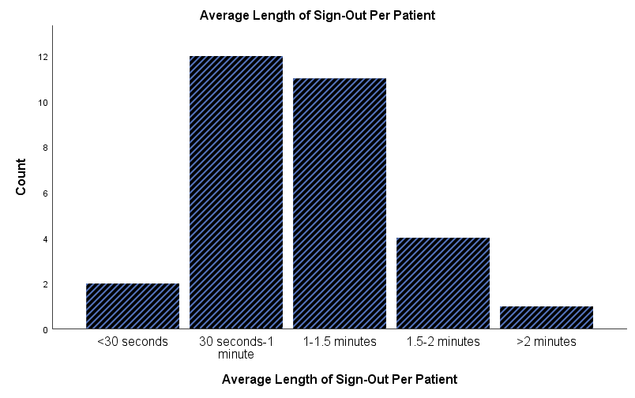
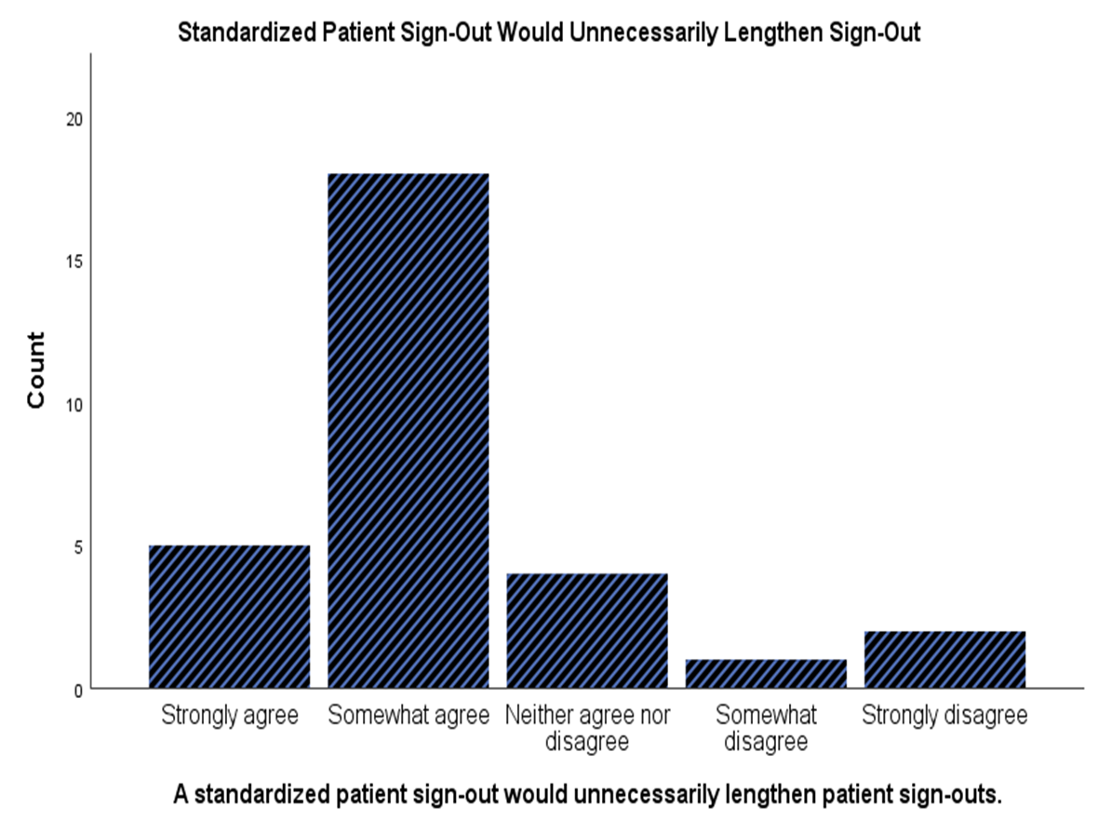
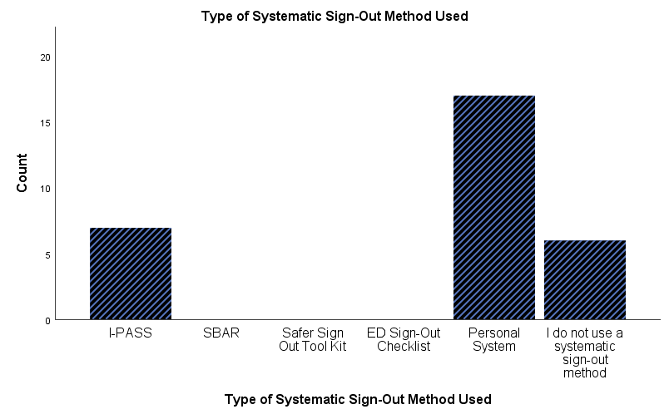
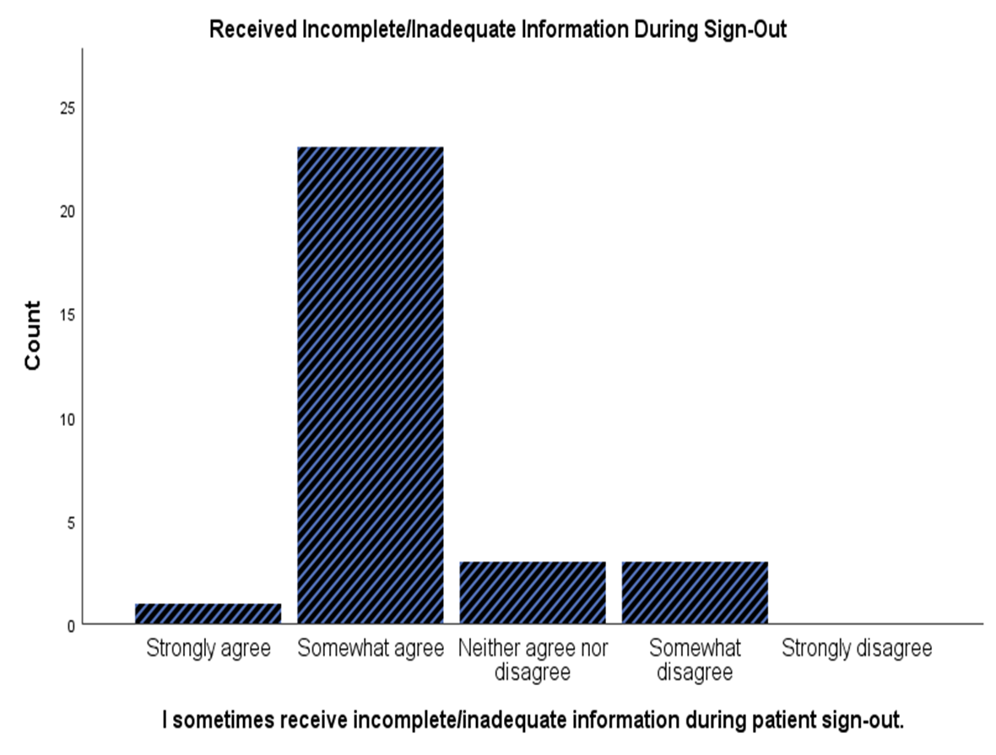
Results
Unable to measure standardized TOC method usage, ED length of stay, and TOC duration post-intervention.

Slide 5
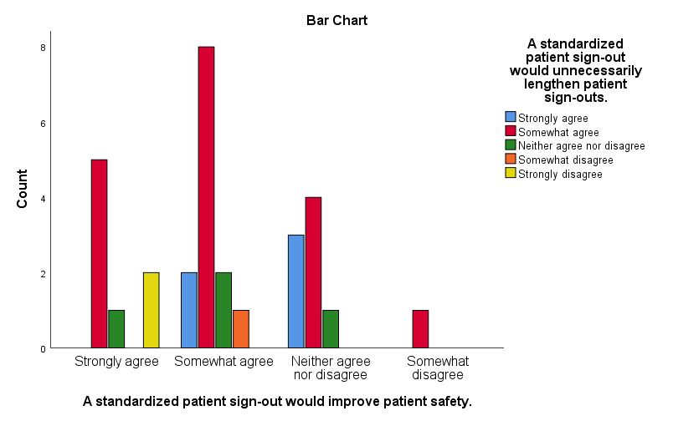
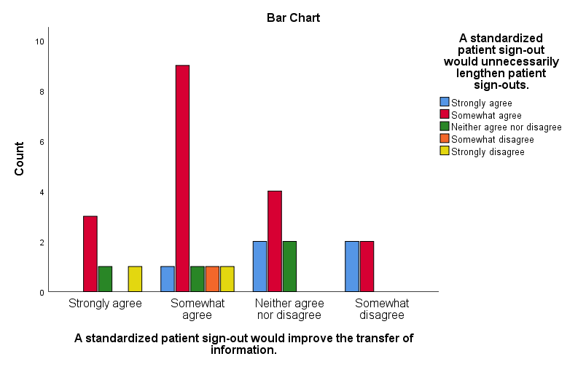
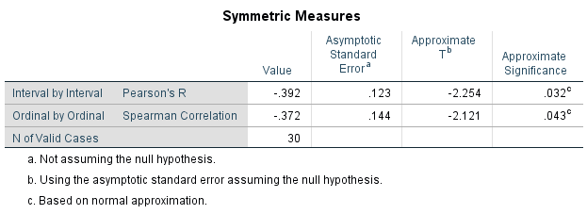

Results

Slide 6
Conclusion
An attempt to implement a standardized TOC method among EM and EM/IM residents at Vidant Medical Center was unsuccessful.
Residents perceive that a standardized TOC method would unnecessarily lengthen TOC, yet believe that a standardized TOC method would improve patient safety and improve the transfer of information.
Limitations:
  Single-center project and small sample size (n=30)
  Barriers to Implementation:
    Lack of buy-in
    COVID-19 pandemic
  Barriers to Data Collection:
    Manpower limitations
    Timing conflicts with residency requirements
Potential Future Steps:
  Use of champions to achieve adequate buy-in
  Simulation session practicing and comparing standardized TOC method vs the usual method

