Slide 1

Chris Chase
LINC Scholar
Improving Diabetic Retinopathy Screening in the Outpatient Primary Care Setting
Melissa Prado, MD, MSc
Audy Whitman, MD, MSc

Slide 2

Introduction
Pitt County, NC Diabetic Population:
  9.9% of all adults over 20 years old; 12,476 residents
Initial FM Gold Module Annual Retinopathy Screening: 8%
Barriers:
  EHR Incompatibility with outside Ophthalmology
  Lack of Dedicated ECU Physicians Ophthalmology Division
Global Aim: We aim to improve the health care quality of diabetic patients at the ECU Family Medicine Gold Module.
Specific Aim: We aim to increase the % of diabetic patient annual eye screening to 30% from 3/2018 to 12/2019.

Slide 3
Methods
PDSA Cycles
  Standards of Care Discussion
  Onsite Retasure Eye Scanner
  Same Day Screening
  Scan Room Layout Rearrange
  Retasure Maintenance Contract and Replacement
  Dedicated Scanning Staff Hired
  Exam Room Signage

Slide 4
Methods
Outcome Measure
  Number of diabetic patients screened positive per 100 total
Process Measures
  Diabetic Eye Screening Quality Dashboard Metric %
  Retasure Scanning Success and Failure %
  % Patients Scanned Same Day
  % Retasure Scans finding diabetic retinopathy
Balancing Measures
  % Patients requiring multiple scan attempts
  % Patients rescheduled after Inadequate Scan
  % Patients referred for outside screening after failed scan

Slide 5
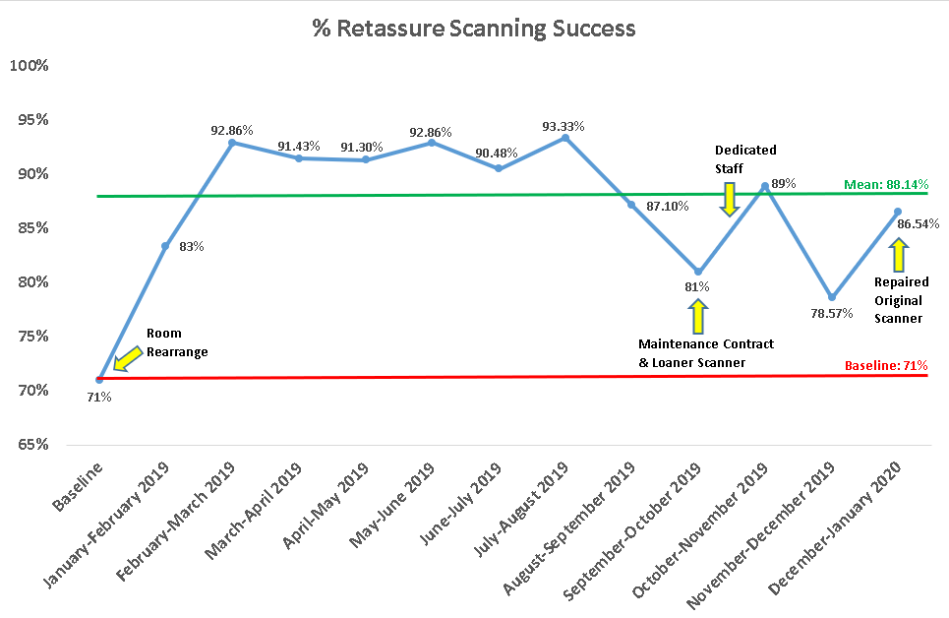
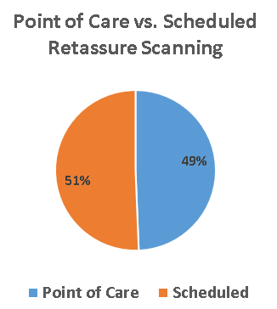
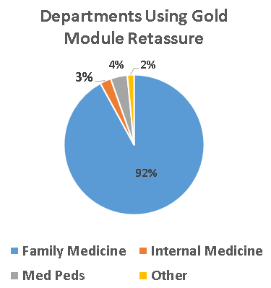
Results

Slide 6
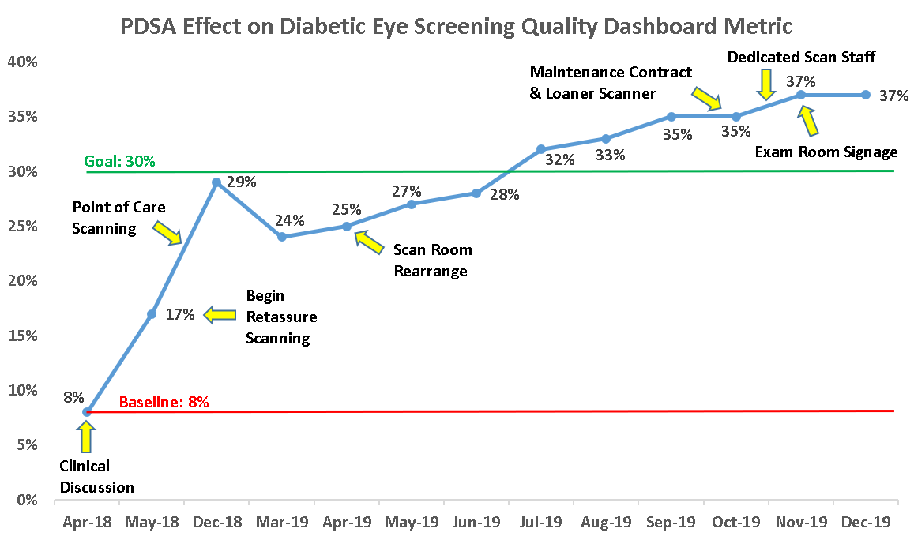
Results
Increased 4.6X

Slide 7

Results
Number of positive annual screenings for diabetic retinopathy per 100 diabetic patients seen in ECU Physicians Family Medicine Gold Module:
March 2018: 0.96 per 100 patients detected
January 2020: 4.44 per 100 patients detected

Slide 8
Discussion
Global and Specific Aims Achieved
QI Interventions increased annual rate of diabetic retinopathy detection by 4.6X in ECU Physicians Family Medicine Center’s Gold Module
Limitations
  Balancing Measures
Lessons Learned
  Flow Mapping
  Ophthalmologic telemedicine services can offset lack of that specialty in this scenario
  Maintenance Contract Effects

Slide 9
Conclusions
Annual diabetic retinopathy screening % can be increased with the use of:
Increased Clinical Awareness
Automated Retassure Eye Scanner
Space to Maneuver Patients onto Scanner
Regular Maintenance of Scanner
Optimized Clinic Flow

Slide 10
References
  Yau JW, Rogers SL, Kawasaki R, Lamoureux EL, Kowalski JW, Bek T, et al. Global prevalence and major risk factors of diabetic retinopathy. Diabetes Care. 2012; 35:(3)556–564.
  Bourne RR, Stevens GA, White RA, Smith JL, Flaxman SR, Price H, et al. Causes of vision loss worldwide, 1990–2010: a systematic analysis. Lancet Global Health. 2013; 1:(6)e339-e349.
  World Health Organization. 2016. Global Report on Diabetes
  Willis, J. et al. Vision-Related Functional Burden of Diabetic Retinopathy Across Severity Levels in the United States. JAMA Opthalmology. 2017. 135(9): 926-932
  Leasher, J. et al. Global Estimates on the Number of People Blind or Visually Impaired by Diabetic Retinopathy: A Meta-analysis From 1990 to 2010. Diabetes Care. 2016. 39(3): 1643-1649.
  Garg S & Davis RM. Diabetic Retinopathy Screening Update. Clinical Diabetes. 2009. 27(4): 140-145.
  (Redacted for editing)
  Ojeda A. A Quality Improvement Project to Increase Eye Care Screenings and Recommendations for Patients with Type II Diabetes Mellitus. Doctor of Nursing Practice. 2017. 19
  Cuadros J. & Bresnick, G. EyePACS: An Adaptable Telemedicine System for Diabetic Retinopathy Screening. Journal of Diabetes Science and Technology. 2009. 1;3(3):509-16
  Riddick FA. The Code of Medical Ethics of the American Medical Association. The Ochsner Journal. 2003. 5(2); 6-10
  Birnbach DJ et al. A ubiquitous but ineffective intervention: signs do not increase hand hygiene compliance. Journal of Infection and Public Health. 2017. 10(3): 295-298

Slide 11
Questions?

