Slide 1
Breann A. Zeches
Research Distinction Track Scholar
Using Fluoroscopic Techniques to Determine α-Synuclein Macromolecular Assembly and Lewy Body Amyloidosis Endogenously and Post-SARS-CoV-2
Dr. Tonya Zeczycki, PhD

Slide 2
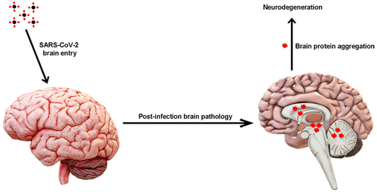
Introduction
Parkinson’s Disease (PD), the second most common neurodegenerative disorder, is characterized by dopaminergic-neuronal cell death and proteinaceous intraneuronal inclusions, termed Lewy bodies. These inclusions largely contain aggregated, insoluble α-synuclein amyloids.
Familial mutants of α-synuclein exhibit exaggerated polymerization, where it clinically presents with earlier diagnosis and rapid progression of symptoms. However viral post-infection neurological complications resembling PD have also been observed following SARS-CoV-2.
OBJECTIVE: Further investigation into the notion that viral coat proteins in SARS-CoV-2 serve as a catalyst that accelerate aggregation-prone proteins to form amyloids more readily and incite neurodegeneration.

Slide 3
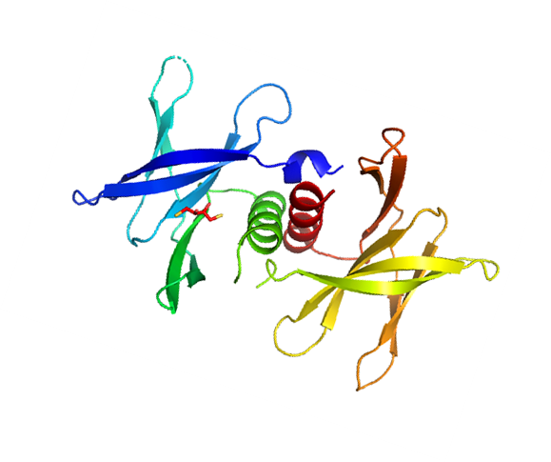
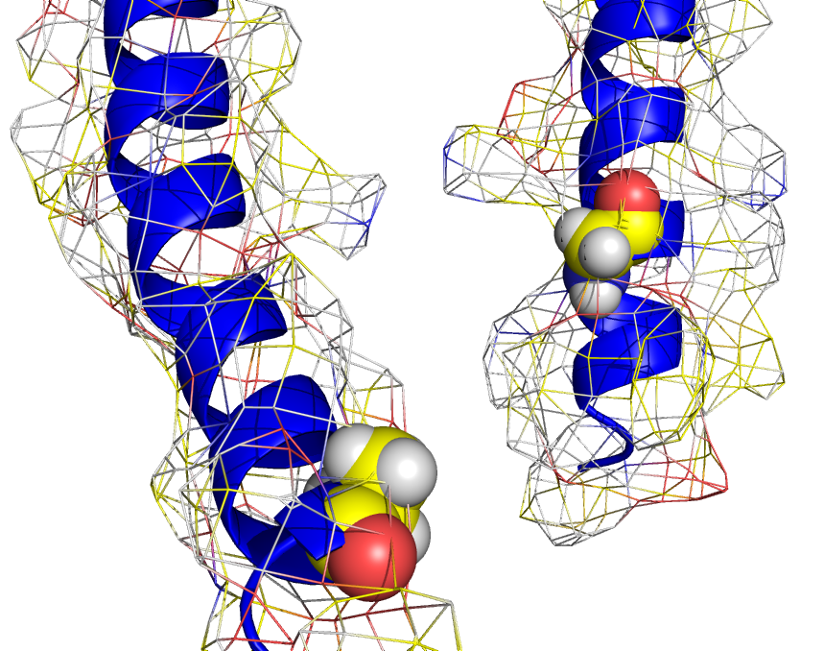
Methods
Equilibrium binding studies with fluorescently tagged α-synuclein at the N-and C-termini (G7C and A91C mutants, respectively), monitored the binding interactions between TG2 and α-synuclein.
Familial mutant parameters were determined versus WT. Thermodynamic parameters associated with complex formation were determined both by SPR.
Fluorescence spectroscopy mapped the solution state protein-protein interaction interface between recombinant host and virus proteins.
Both equilibrium binding studies and fluorescence anisotropy monitored the macromolecular complex interactions between α-synuclein and NSP9.
G7C
Gly
Ala
A91C
N-terminus
C-terminus
Site-directed mutagenesis at residues 7 and 91 representing the N- and C-terminal respectively. Experimental cysteine replacement utilized for thiol-reactive probing

Slide 4
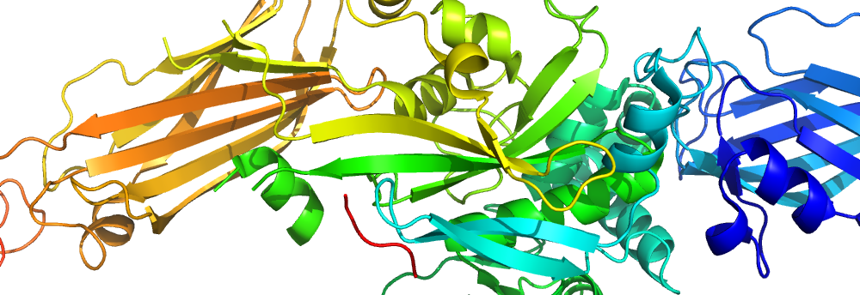
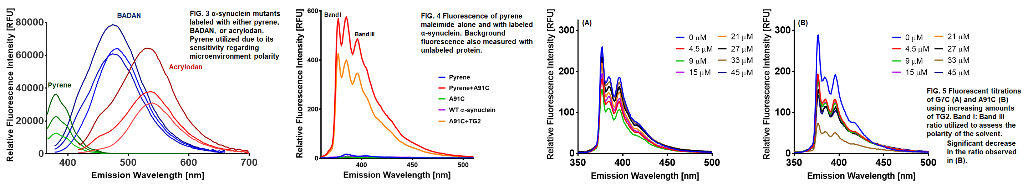
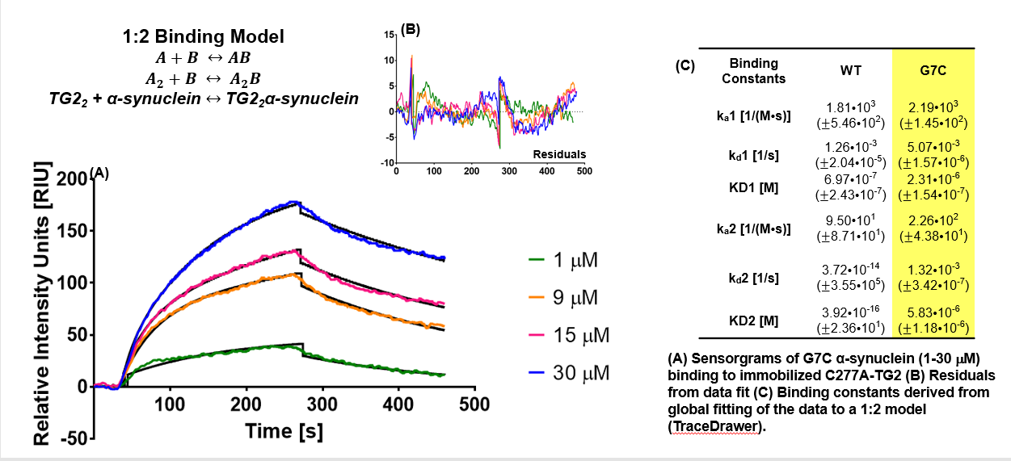
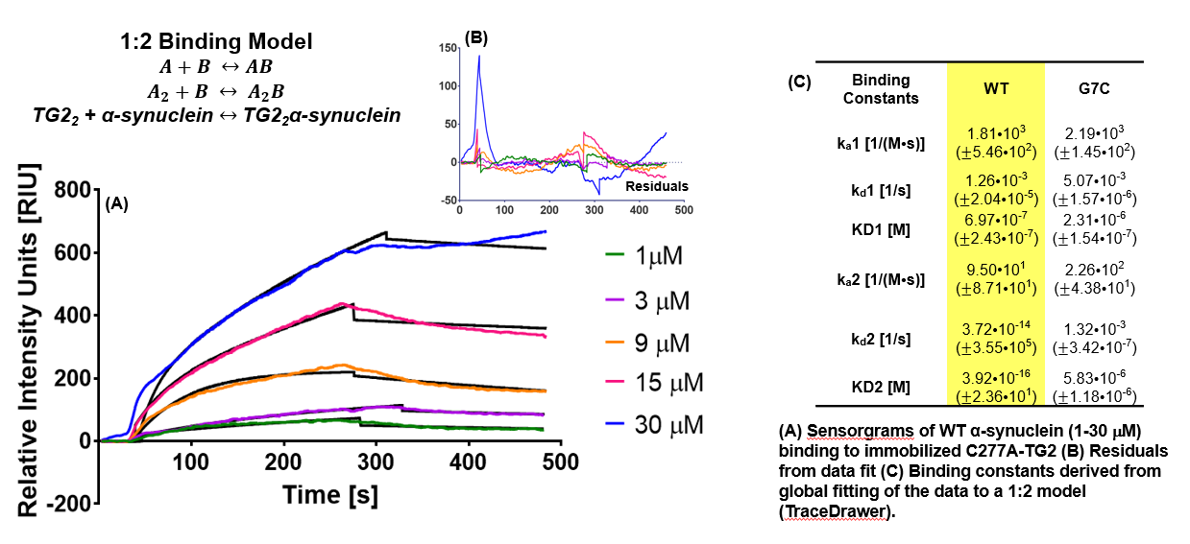
Results
1
2
3

Slide 5
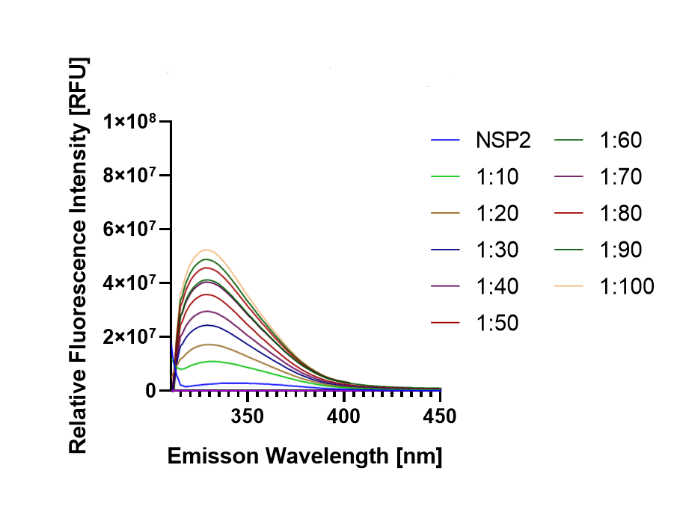
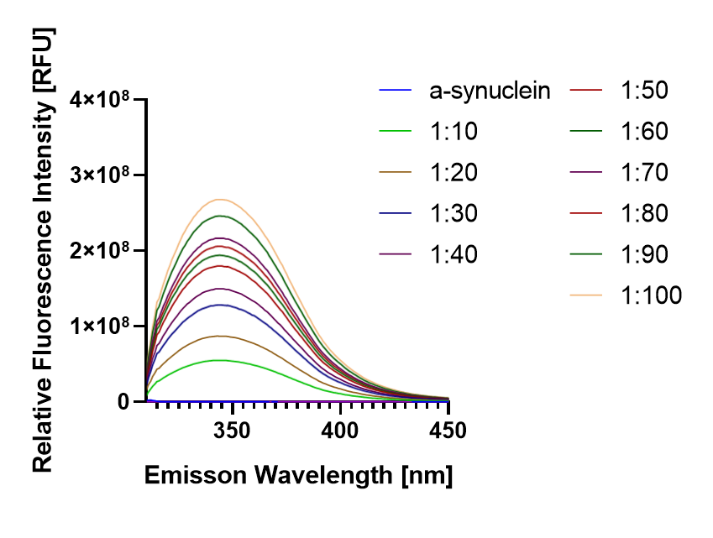
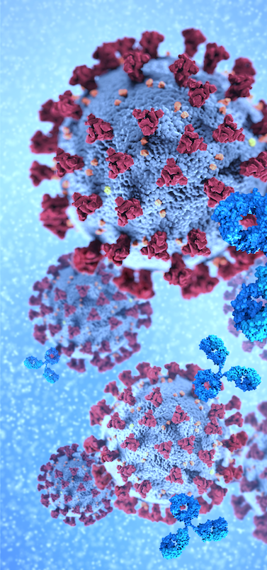
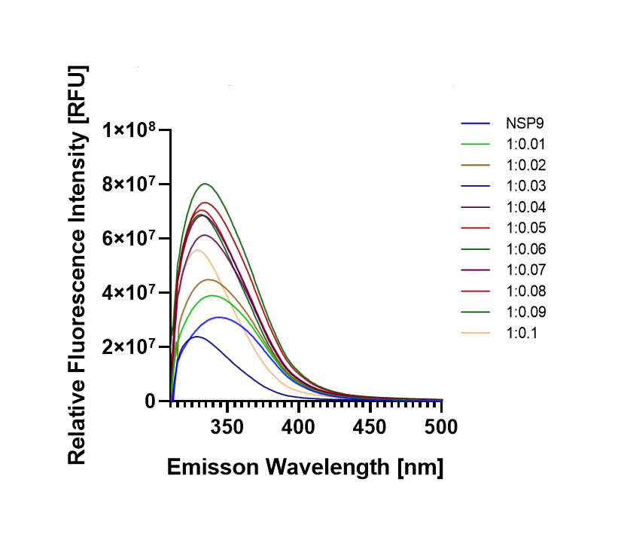
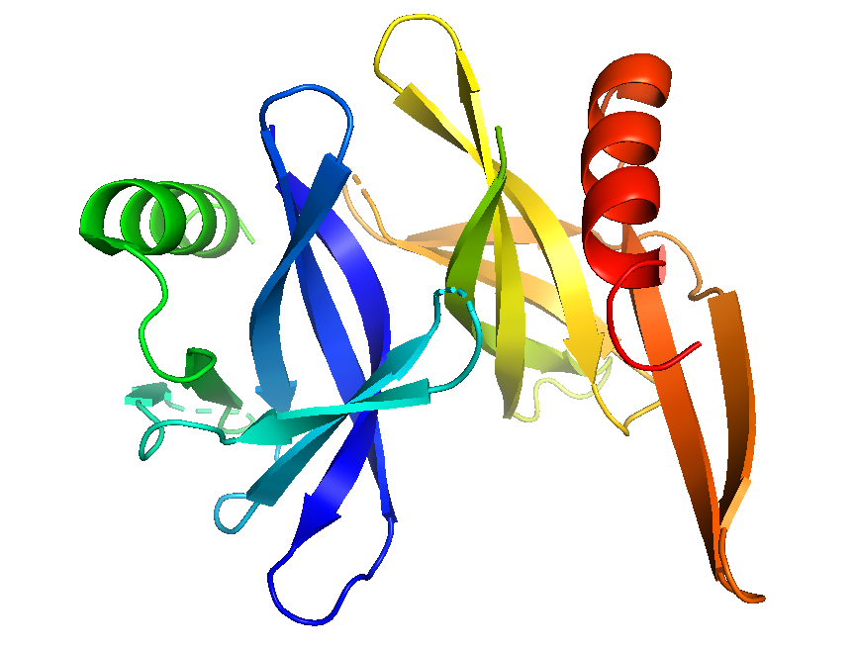

Results
NSP9, found in viral coat, is thought to act as a replicase and single-strand RNA binder in SARS-CoV-2

Slide 6
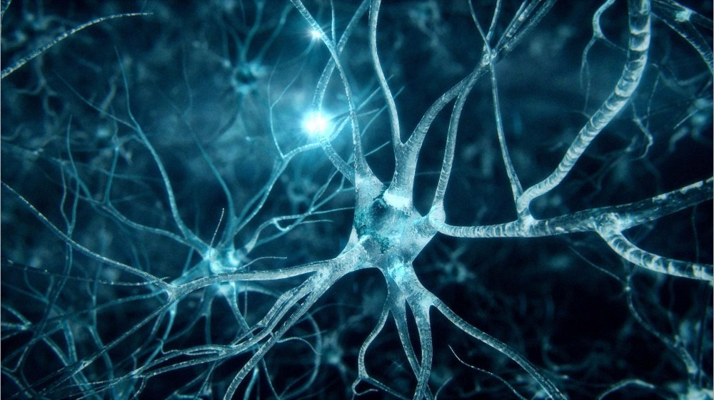
Conclusion
These are the first steps towards understanding the kinetic, thermodynamic, and structural mechanisms driving the formation of both pathogenic familial and post-viral parkinsonian disorders.
Understanding these mechanisms is key to advancing potentially novel and repurposed cyclic peptide inhibitors that bind to both host and SARS-CoV-2 viral coat proteins as both therapeutic and prophylactic candidates.
Longitudinal clinical study of patients inoculated with SARS-CoV-2 is warranted to monitor for progression of possible nascent neurological symptomology with progression of potential neurodegenerative change.

