Slide 1
Amber Whitley
LINC Distinction Track Scholar
Reducing Blood Wastage in a Large Level I Trauma Center
Mentor: Dr. Susan Weiss

Slide 2
Introduction
  Blood transfusions are required in 25% of trauma patients with 2-3% needing a massive transfusion
  Between 2011 and 2013 there was a 12.1% decline in collections of whole and red blood cells (RBC)
  Recent decline in blood collections and the demand for life saving transfusions highlights the need for effective blood management
  Commonly blood products are wasted because products are not used within a viable timeframe and due to “cold chain” compromises during transport
  AIM Statement
  Global: Reduce cost by improving efficiency and decreasing blood waste in the Transfusion Service.
  Specific: Reduce cryoprecipitate waste to 15% and plasma wastage to 5%.
Notes:
AABB (American Association of Blood Banks

Slide 3
Methods
Population: Blood Products (Cryoprecipitate, Plasma & RBC)
Intervention:
  March 2018, the MTP was revised to issue cryoprecipitate in the third round and an extra unit of plasma was added to each round
  April 2018, a point of service emergency blood refrigerator was installed in the trauma bay area of the Emergency Department
  May 2018, pooled plasma was replaced with individual plasma units for therapeutic plasma exchange (TPE) procedures
PDSA Cycle:
  PLAN: 3 interventions, Laboratory Technologists training, Trauma Service Education/Awareness
Notes:
Measures:
Outcome: Decrease the amount of blood product, specifically cryoprecipitate and plasma wasted to reduce cost.
Process: At VMC cryoprecipitate was initially issued during the 2nd round of blood product in emergent situations. We worked with the trauma service to revise the massive transfusion protocol to now issuing cryoprecipitate in the 3rd round. Previous, VMC use pooled plasma for therapeutic plasma exchange. We worked with nephrology to provide individual units of plasma instead of pooled plasma and standardized the use of regular plasma for all cases.
Balancing: Effects on patient fibrinogen levels, increased orders from clinicians.
Cryoprecipitate Wastage: Cryoprecipitate is received frozen to maximize shelf life and must be thawed before transfusions. The entire thawing process takes roughly thirty minutes. Thawed cryoprecipitate must be discarded if not transfused within 6 hours. At Vidant Medical Center, cryoprecipitate was issued during the second round of the massive transfusion protocol (MTP) causing the transfusion service to thaw cryoprecipitate when the MTP was activated. If a second round is not needed, the thawed cryoprecipitate is discarded. Frequently products were thawed before the assessment of need, as a majority of MTPs do not require a second round. The MTP was distributed as followed: 5 RBCs + 4 plasma + 1 platelet, 5 RBCs + 4 plasma + 1 platelet + 5-pack cryoprecipitate, 5 RBCs + 5 plasma + 1 platelet, 5 RBCs + 5 plasma + 1 platelet + 5-pack cryoprecipitate. March 2018, the MTP was revised to issue cryoprecipitate in the third round and an extra unit of plasma was added to each round. The revised MTP was dispensed as followed: 5 RBCs + 5 plasma + 1 platelet, 5 RBCs + 5 plasma + 1 platelet, 5 RBCs + 6 plasma + 1 platelet + 5-pack cryoprecipitate, 5 RBCs + 6 plasma + 1 platelet + 5-pack cryoprecipitate. Trainings and educational meetings were held following the revision for smooth transition and to preserve patient safety. Laboratory technologist were trained to dispense blood products in alignment with the new protocol. Clinicians on the trauma service were informed of the revision and emphasis placed on minimizing wastage by following transfusion guidelines.
Plasma Wastage: Analogous to cryoprecipitate, plasma is received frozen and thawed plasma must be discarded if not transfused within 24 hours. At Vidant Medical Center, therapeutic plasma exchange (TPE) required cryopoor, pooled plasma to be thawed, preventing transfusion to a different patient if the original procedure was cancelled. May 2018, pooled plasma was discontinued and replaced with individual plasma units for TPE procedures. If plasma is thawed and the procedure cancelled, the use of individual plasma units allows transfusion to a different patient, reducing plasma wastage. If a transfusion reaction develops during a TPE procedure, the use of individual plasma units allows identification of the specific unit, improving patient safety.
Red blood cell Wastage: Level I trauma centers must have the ability to quickly and efficiently provide life-saving transfusions to acutely hemorrhaging patients. At Vidant Medical Center to meet the immediate need for blood availability in emergency situations, medical professionals transported blood from the blood bank to critical care areas. The US Food and Drug Administration and the AABB require RBC to be stored between 2°C and 6 °C.⁶ If a RBC unit is issued but not transfused, it is returned to the blood bank for use by a different patient. However, if the unit does not remain within the temperature range it will not be accepted by the blood bank and will be discarded. To remain in compliance with the “30-minute rule”, blood banks discard RBC units exposed to uncontrolled temperatures during storage or transport for more than 30 minutes.⁷ RBC wastage often occurs due to improper blood handling during transport or if issued but not transfused within 30 minutes. April 2018, a point of service emergency blood refrigerator was installed in the trauma bay area of the emergency room to improve patient care and streamline trauma operations. Fewer “cold chain” compromises are noted because of the close proximity of blood in emergent situations, limiting RBC wastage. Patient safety is improved as patients receive RBC for transfusions quicker, minimizing rapid decline and hemodynamic instabilities associated with profuse hemorrhages

Slide 4
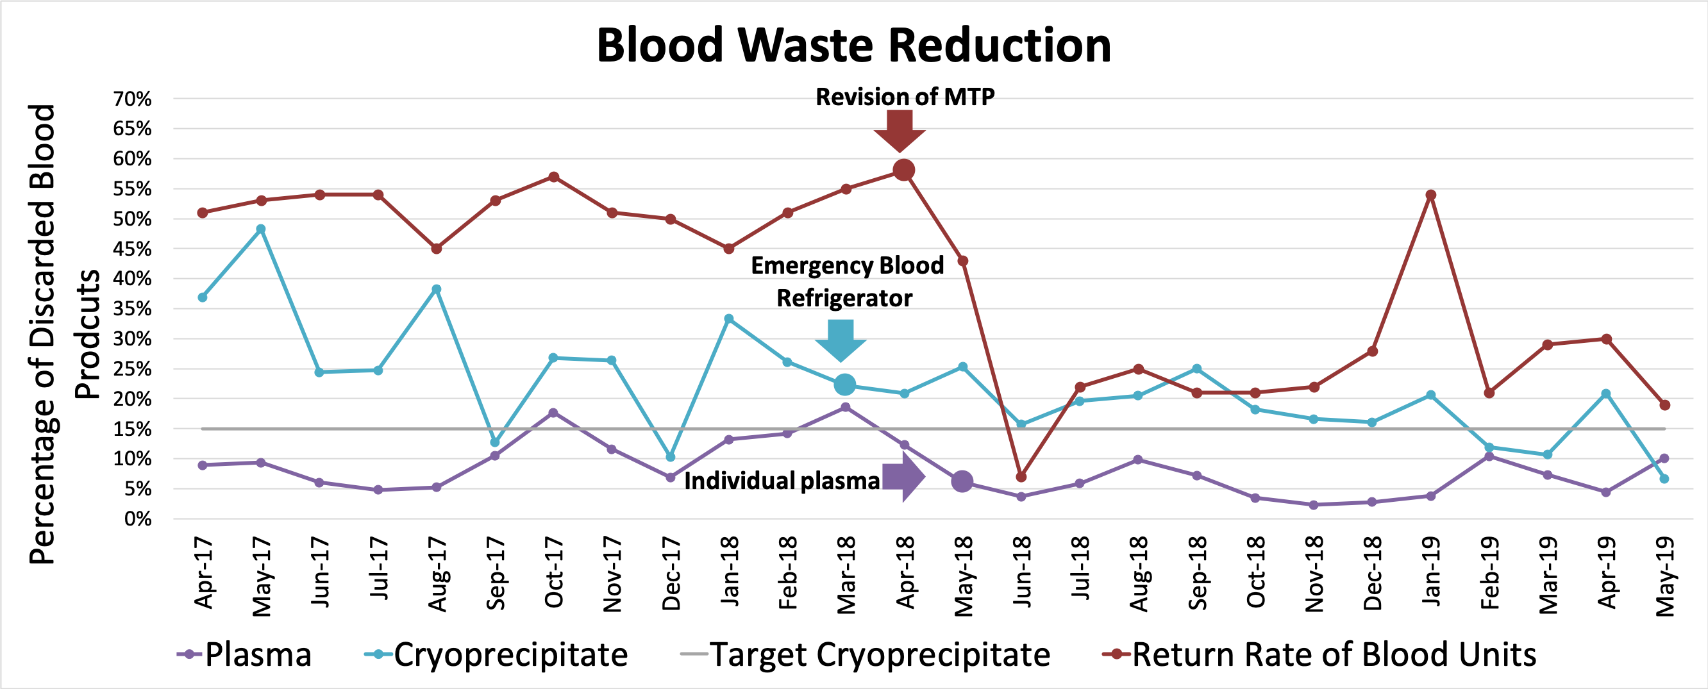
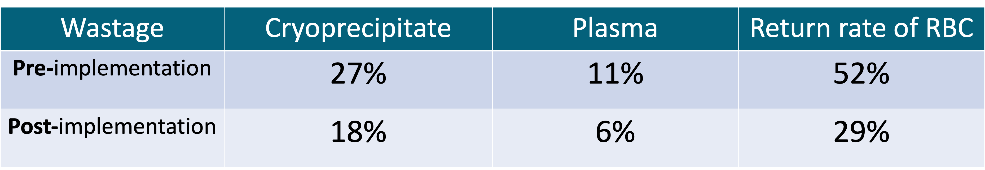
Results
Wastage | Cryoprecipitate | Plasma | Return rate of RBC
Pre-implementation | 27% | 11% | 52%
Post-implementation | 18% | 6% | 29%
Wastage | Cryoprecipitate | Plasma | Return rate of RBC
Pre-implementation | 27% | 11% | 52%
Post-implementation | 18% | 6% | 29%
Wastage | Cryoprecipitate | Plasma | Return rate of RBC
Pre-implementation | 27% | 11% | 52%
Post-implementation | 18% | 6% | 29%
Notes:
Specific AIM was not achieved
Talk about increase in RBC

Slide 5
Results

Slide 6
Conclusion
This multifaceted approach to reducing blood wastage with simple, inexpensive, high impact interventions produced significant reductions in cryoprecipitate and plasma over a short period & produce copious hospital savings.
Limitations:
  The study was conducted in a single teaching, level 1 Trauma center
  This study did not examine the impact of these interventions on platelet waste
Future Efforts:
  Future efforts to identify addition sources of blood waste & services other than trauma with high wastage
Notes:
There are few limitations to this study. First, the study was conducted in a single teaching, level 1 Trauma center. Results may be different in a private hospital or higher level trauma centers due to limited access to specialists and fewer severely injured patients. Although the beginning data supports the durability of these interventions, given the rather short timeframe of the study, it is not clear if these savings and lower wastage rate are sustainable. A longer study period needs to be incorporated in future studies. Finally, this study did not examine the impact of these interventions of platelet waste, although Table 1 shows a slight annual reduction in platelets discarded.

