Slide 1
Caroline Bessey
Service-Learning Distinction Track Scholar
Medical Play
Dr. Ryan Moore

Slide 2
Collaborative Team Members
Katri Thiele, MS4
Jared Barkes, MS2
Katie Hall, Director of Marketing and Volunteer Services at RMH

Slide 3
Introduction
Project focus: Investigate the effectiveness of medical play in decreasing the anxiety and stress experienced by the younger siblings of N.I.C.U. patients throughout their stay in the Ronald McDonald House.
Reason for starting project: Minimal integration of child life resources in the N.I.C.U.
Notes:
Define medical play !

Slide 4
Methods
Participants: Families with children who are staying at the Ronald McDonald House here in Greenville, NC.
Sessions are held weekly and lead by medical student volunteers.
This resource is equipped with toy replicates of items that children might see in the N.I.C.U.
Before participation, a pre-survey and post-survey is completed to evaluate knowledge and comfort with scenario.

Slide 5
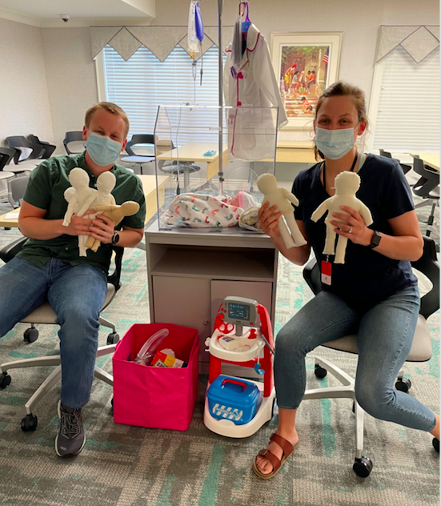
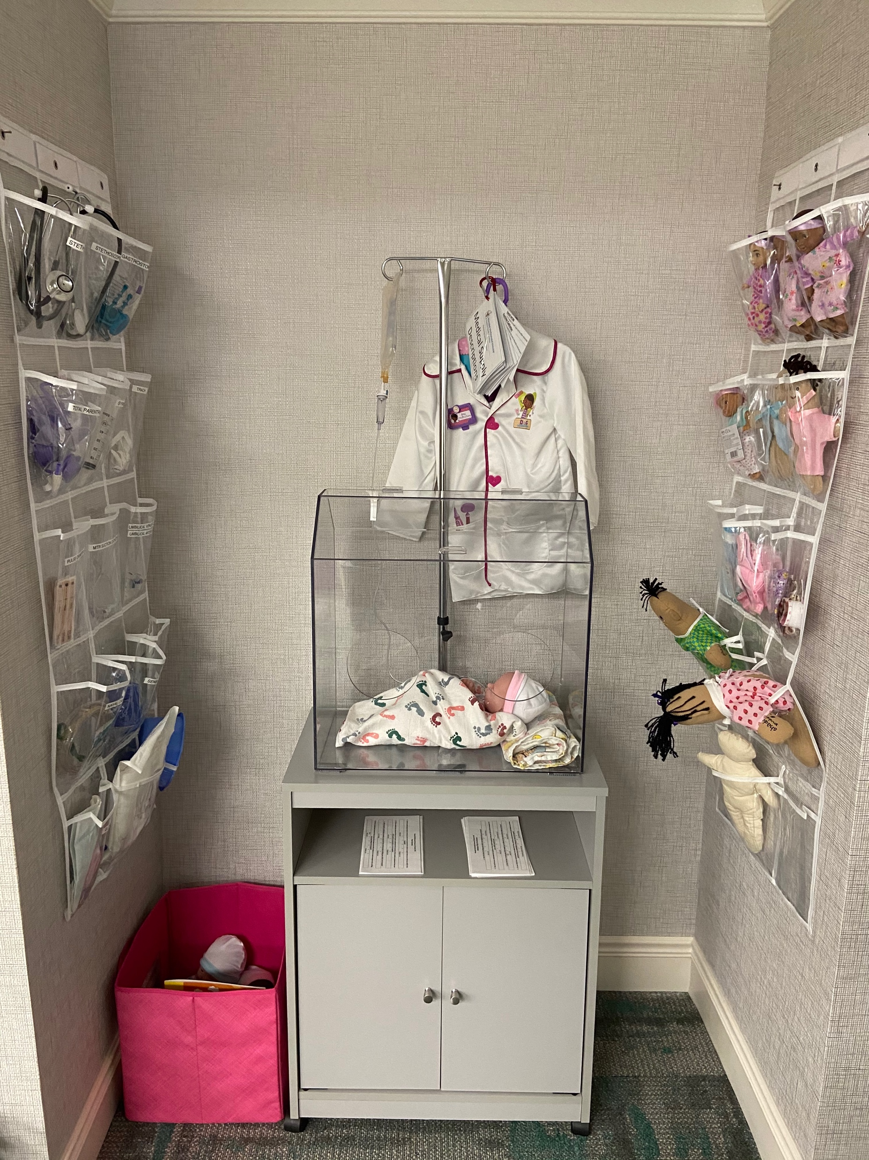
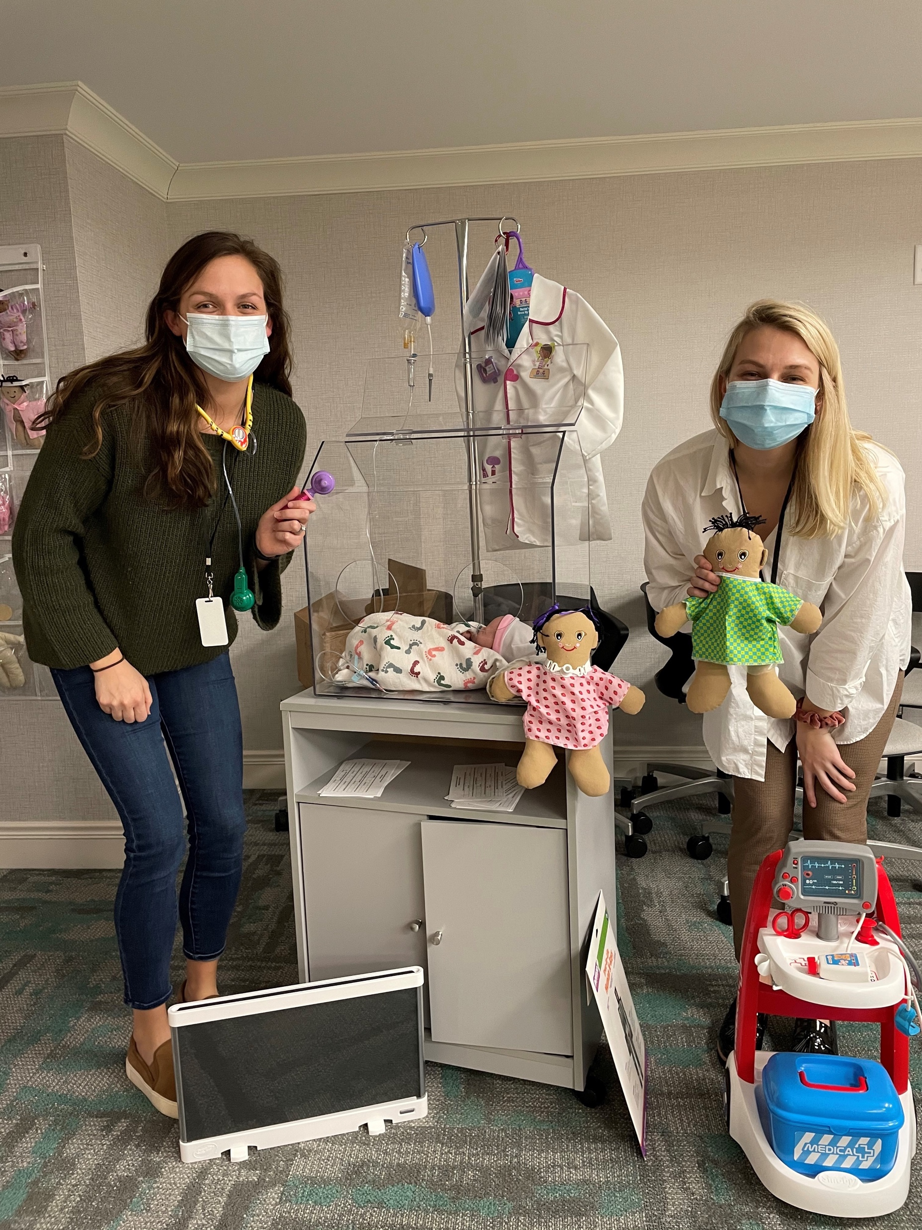
Methods

Slide 6
Results
RMH now has a medical play session
A survey was developed
5 medical students involved in volunteering consistently
7 sessions held and have received great feedback from participants

Slide 7
Conclusion
We project that this will be a beneficial emotional and educational resource for the families staying at the Ronald McDonald House.
We believe this will strengthen the relationship between the families and their providers by giving them additional insight into medical terminology and equipment.
Sustainability: Medical Education Scholar, Jared Barkes, will be taking the lead on this project along with other SLDT scholars.

