Slide 1
Hannah Verrilli, Hannah Smith
SLDT Distinction Track Scholar
Understanding Experiences of Patients with Autism and their Families
Dr. Arne Anderson

Slide 2
Introduction
A positive physician-patient relationship is key
contributes to better adherence with treatment plans
increases overall satisfaction with health care
However, people with Autism Spectrum Disorder have historically had less satisfaction with this relationship.
Disconnect in medical education and education on caring for patients with Autism
many medical students around the world have shortcomings in knowledge about caring for patients with Autism.
physicians actively working with patients with Autism also report needing additional training on Autism Spectrum Disorder
Notes:
to helping patients better understand their health and treatment options, contributes to better adherence with treatment plans, and increases overall satisfaction with health care.

Slide 3
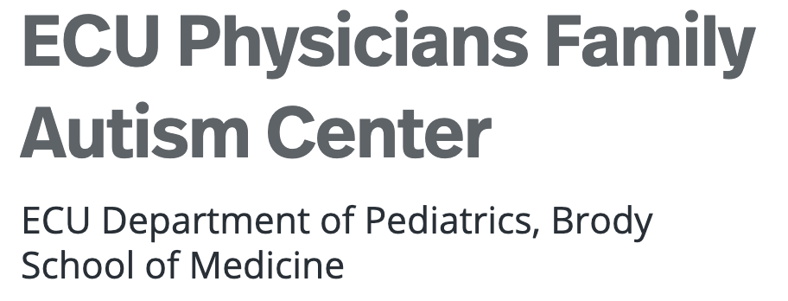
Introduction
Aim: Better understand the experiences and needs of families who have children with Autism Spectrum Disorder.
Goal: use this information to better inform the medical community about how they can best care for this specific population in terms of meeting the needs of these families and fostering a supportive and understanding physician-patient relationship.

Slide 4
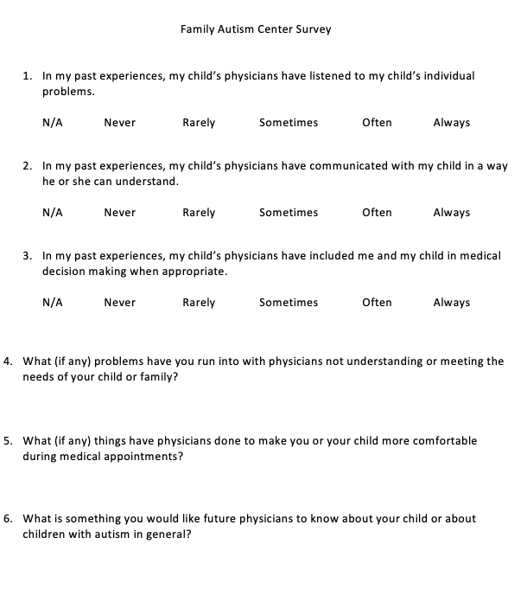
Methods
A phone survey was conducted with parents of children with Autism at the Family Autism Center in Greenville.
The goal is to survey 40 families.
Statistical analysis will be performed to look for average satisfaction in different areas of physician-patient interaction on the Likert scale and look for themes in answers to the open-ended questions
Notes:
This survey used a Likert scale to quantify satisfaction with all medical providers in the past in terms of how well providers listened to, communicated with, and included the child/family in decision making when appropriate. Open ended questions were also asked to better understand what problems these families have faced, what things have made them more comfortable, and what they would like for physicians to know in the future. This survey is still a work in progress with hopes to interview 40 families. Statistical analysis will be performed to look for average satisfaction in different areas of physician-patient interaction on the Likert scale and look for themes in answers to the open-ended questions.

Slide 5
Results
Due to COVID-19 related delays, responses are still being collected and there is not enough data to analyze at this time
We have interviewed three families so far, each of whom have had positive things to say about their relationship with providers in Greenville to date.

Slide 6
Conclusion
This information will hopefully provide insight on the satisfaction of families with children with Autism and how we as future providers can better educate and prepare ourselves to care for these patients early in our medical career.
A potential outcome with this study is that families who are integrated into care at the Autism Center are seeing physicians who have specialized training in care of patients with Autism, and Greenville is a heavily resources area for children with disabilities. The results may reflect satisfaction in relationships for families in heavily resources areas.
Potential source of sustainability: FMIG or PIG Leadership Teams, Research Distinction Track

