Slide 1

Coculture with healthy Scwhann cells promote neurite growth and survival of irradiated major pelvic ganglia neurons
Josh Randolph
2021 Distinction Track Scholar
Brody School of Medicine at East Carolina University
Johanna Hannan, Ph.D.
Notes:
Our study investigates the role of Schwann cells in the survival and growth of major pelvic ganglia after radiation
Radiation impairs neurotrophic effect of Schwann cells cultured with irradiated major pelvic ganglia neurons

Slide 2
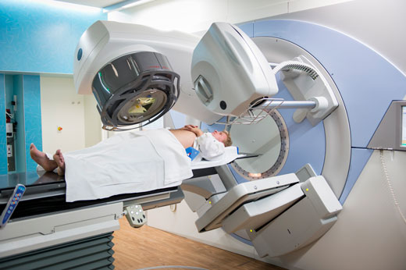
Introduction
A third of prostate cancer patients will undergo radiation therapy (RT)
30-50% of PCa patients will develop RT-induced erectile dysfunction (ED)
Ex vivo RT diminishes neurite outgrowth in dissociated neuron culture, but enhances outgrowth in cultured whole ganglia
Schwann cells (SCs) facilitate neuron repair in response to nerve injury
Hypothesis: Coculturing irradiated major pelvic ganglion neurons will reduce cell death, preserve nitrergic neuron populations, and promote axonal regeneration.
Notes:
Approximately one third of prostate cancer patients undergo radiation therapy. Unfortunately, a large proportion will develop erectile dysfunction, in part due to radiation-induced neuropathy. We have previously reported that ex vivo radiation causes dissociated neurons in culture to grow shorter neurites, while neurons within whole ganglia grew longer neurites. Within these ganglia are Schwann cells, which are known to facilitate neuron repair after certain types of injury.

Slide 3
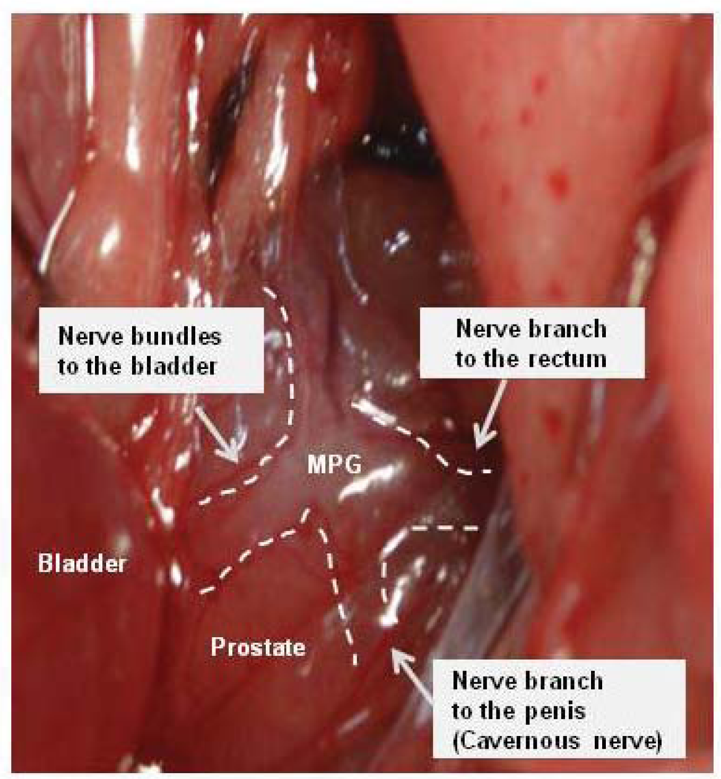
Methods
12 week male Sprague-Dawley rats (n=12)
Major pelvic ganglia (MPG) were excised and radiated (0 or 800 cGy)
Schwann cells and neurons were dissociated
Four experimental groups:
  1. Control SC + Control MPG
  2. Control SC + RT MPG
  3. RT SC + Control MPG
  4. RT SC + RT MPG
After 72 hours of growth, neurons were
imaged to analyze:
  neurite length and branching
  apoptosis
  autonomic neuron density
Notes:
For our experiment, we used major pelvic ganglia, which are paraprostatic nerve structures that control erectile function in rats. We extracted paired MPGs from 12 sprague-dawley rats, to which we then delivered 0 or 800 centigray. Schwann cells and neurons were dissociated from the MPGs tissue and then co-cultured. We created four experimental groups where none, only one, or both of the cell types had been irradiated.
After 72 hours of growth, cultures were fixed, stained, and imaged to assess neurite length, branching, apoptosis, and autonomic neuron density.

Slide 4
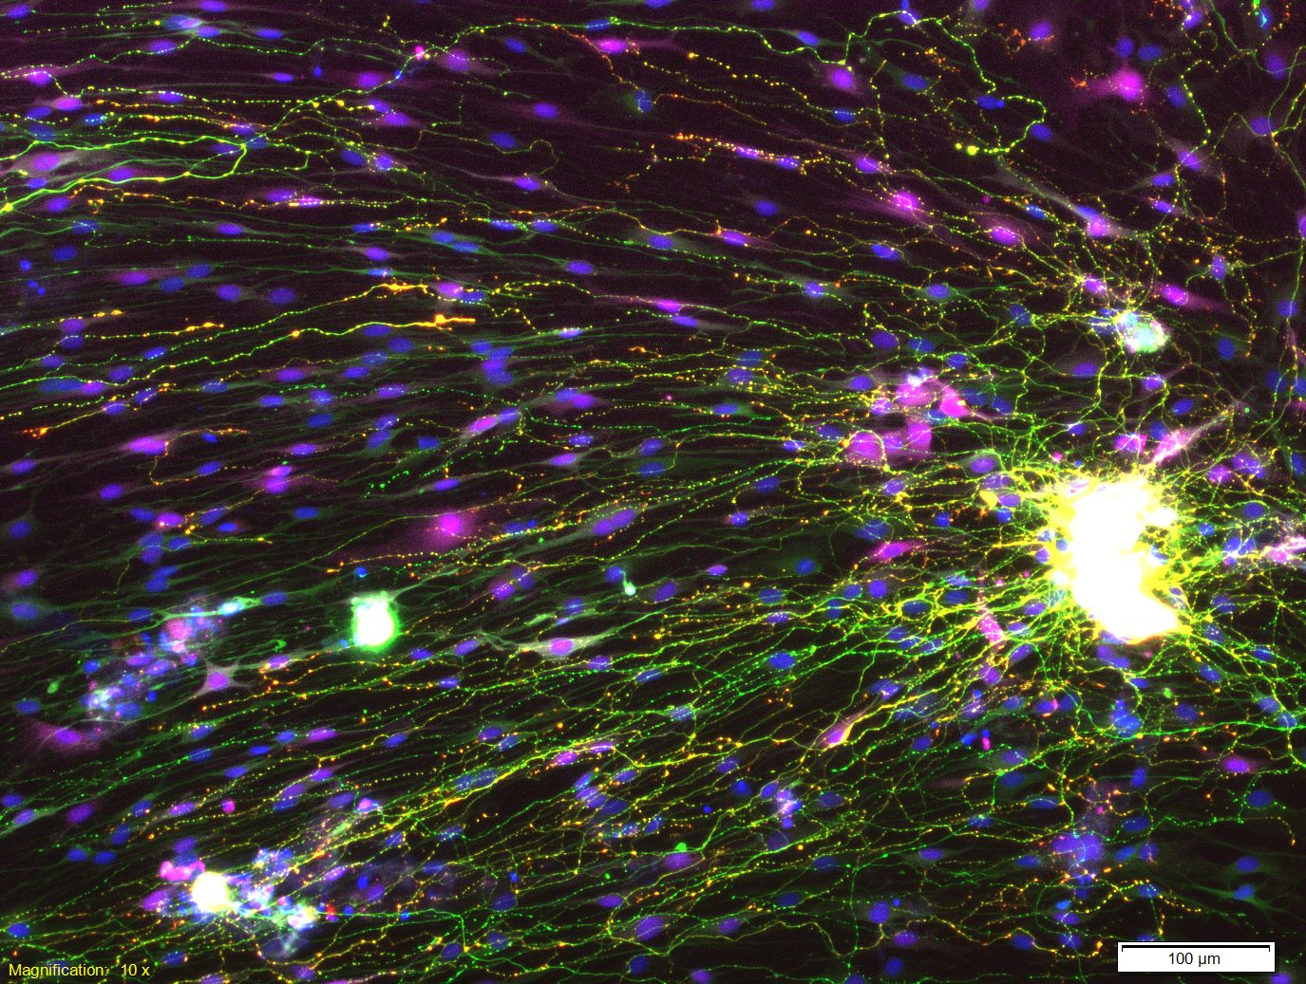
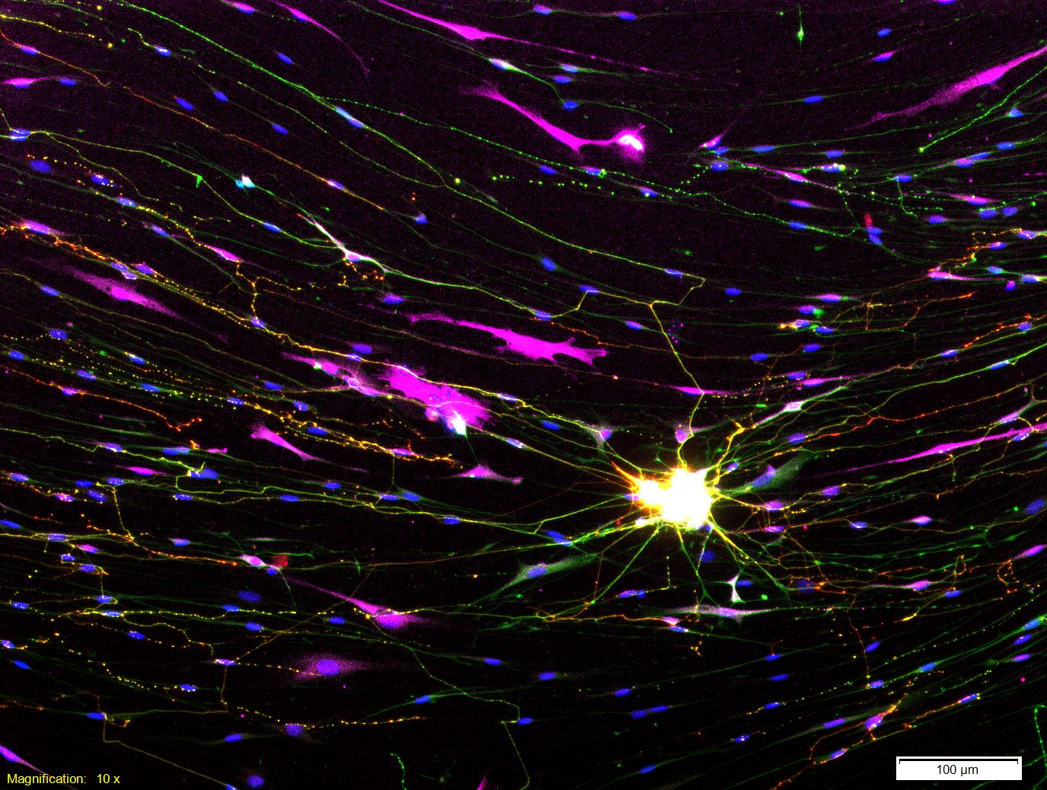
Results
Neurite outgrowth increased in RT-MPG + con-SC, branching decreased when both were irradiated
TUJ1
nNOS
S100
DAPI
RT-MPG + con-SC
RT-MPG + RT-SC
Notes:
We found that radiated neurons cultured with control schwann cells grew much longer neurites than all other groups. Neurite branching saw a significant reduction in neurite branching when both neurons and Schwann cells were radiated. Below are representative images of stained co-cultures.

Slide 5
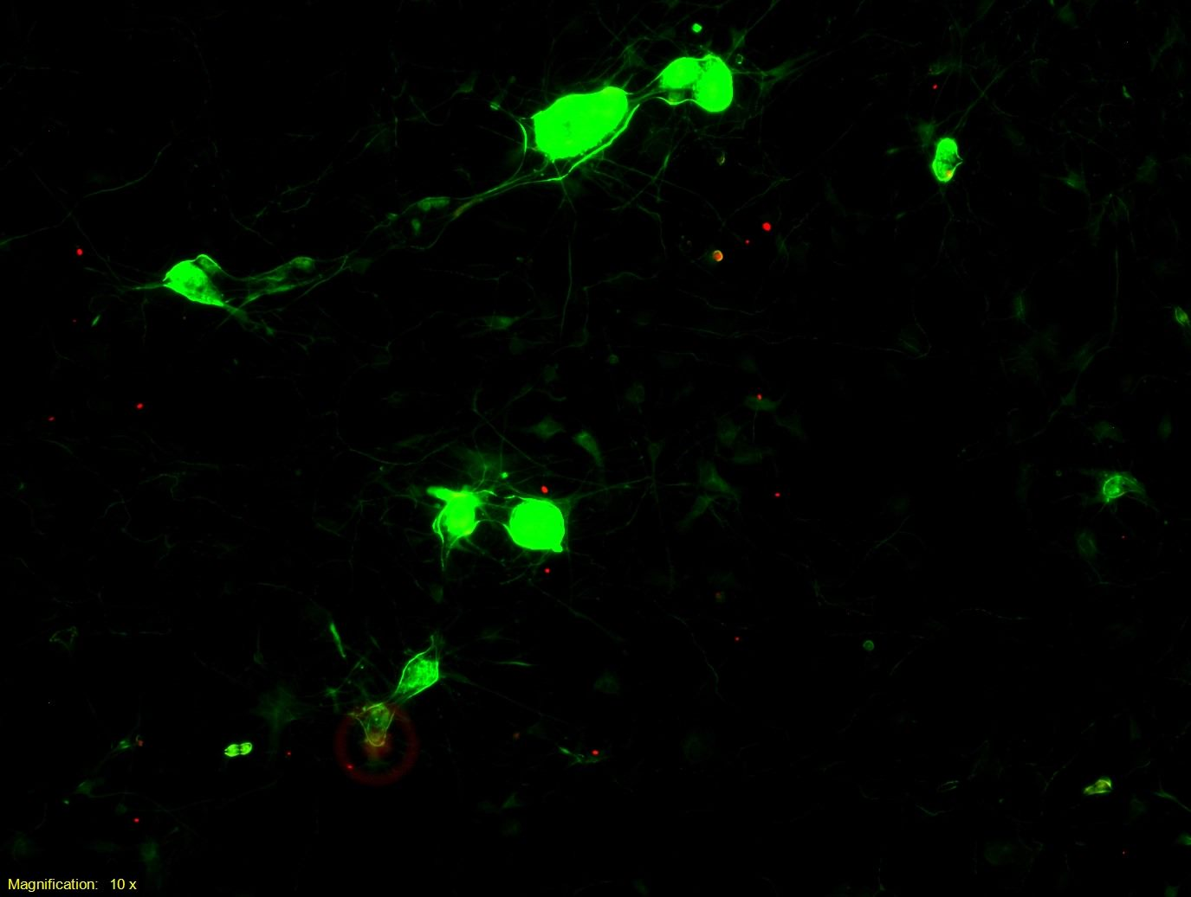
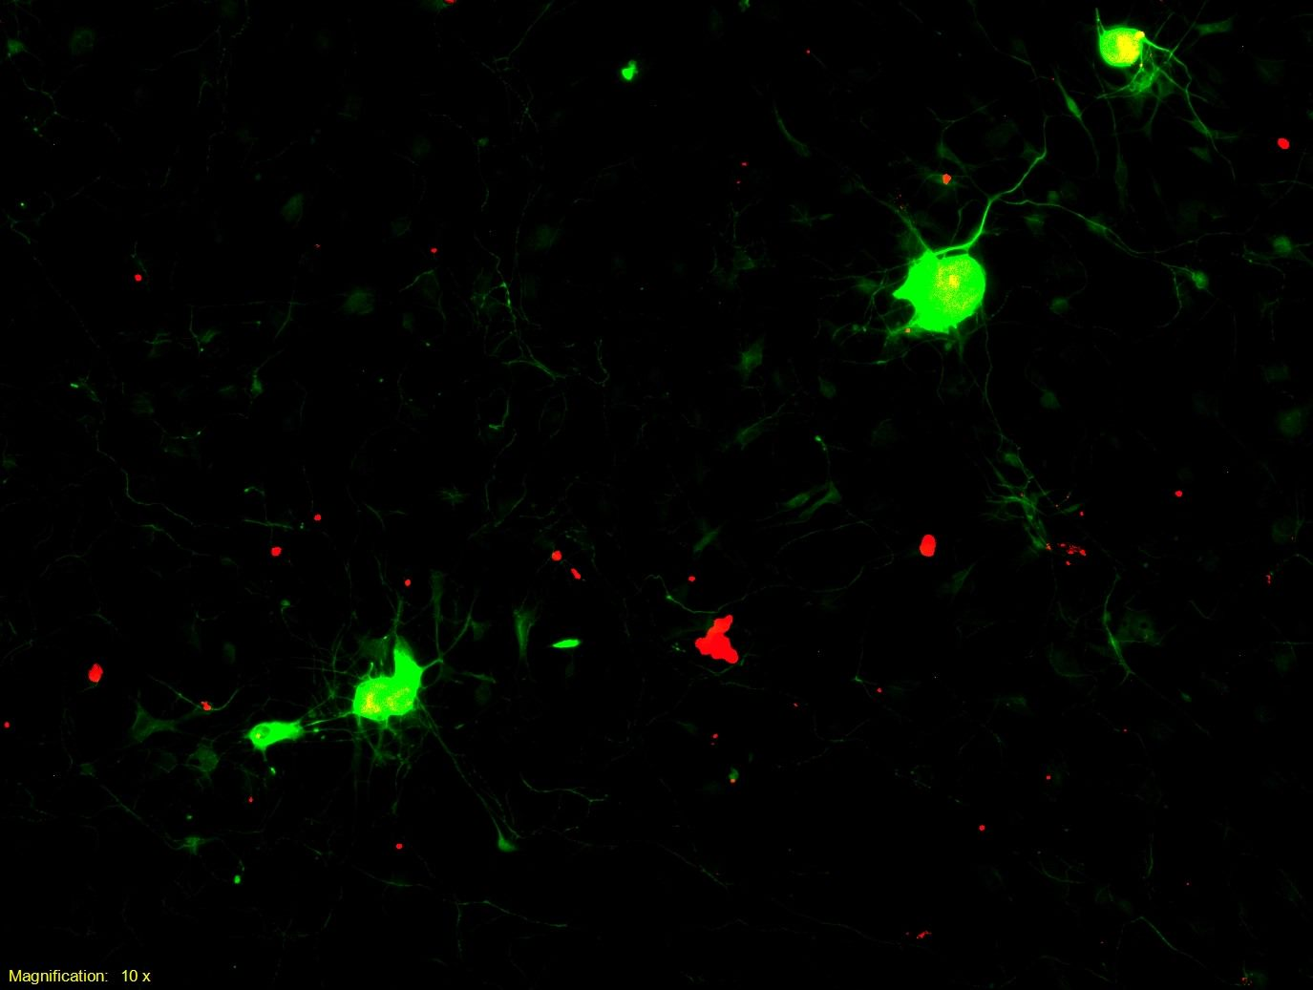
Results
Apoptosis was partially decreased in healthy SC coculture
TUJ1
TUNEL
DAPI
con-MPG + con-SC
RT-MPG + RT-SC
Proportion of nitrergic neurons decreased in RT neurons regardless of RT or con SCs; adrenergic neurons did not change
Notes:
Apoptosis was signficantly increased in irradiated neurons, whether they were cultured with radiated or control Schwann cells. Radiated neurons also showed decreased nitrergic neuron density, again regardless of schwann cell radiation status. Adrenergic neuron density was similar in all groups.

Slide 6
Key Findings
Coculturing irradiated MPG neurons with healthy SCs stimulates neurite growth and mitigates neuron apoptosis.
The presence of naïve SCs did not have a significant effect on autonomic neuron density.
Further studies are required to confirm these findings in vivo in order to fully understand if SCs play a role in RT-induced ED
Notes:
In conclusion, Radiation-naïve Schwann cells enhance neurite outgrowth in irradiated neurons
Radiation leads to increased apoptosis and loss of nitrergic neurons that cannot be overcome by the presence of Schwann cells
Further studies are required to confirm these findings in vivo in order to fully understand if the Schwann cells play a role in radiation-induced ED

