Slide 1
IFN-β Induces a Novel Lineage of Murine CD4⁺ CD8⁺ “Double-Positive” FOXP3⁺ Regulatory T Cells
Zack Pruitt
Research Distinction Track Scholar
Mark Mannie, Ph.D.

Slide 2
Introduction
IFN-β is used as a primary treatment for Multiple Sclerosis but its mechanism is not understood.
CD4⁺ and CD8⁺ single positive Tregs are established, but CD4⁺ CD8⁺ double positive Tregs represent a novel cell type and has never been studied.
Objective: Initial objective was to show higher concentrations of IFN-β would elicit elevated percentages of CD4⁺ Tregs. Transitioned to understanding the induction, maintenance, and phenotype of this unique Treg subset
Hypotheses:
  High concentrations of IFN-β elicit higher percentages of CD4⁺ Tregs compared to lower concentrations.
  Culture with IFN-β or TGF-β would result in greater rates of CD4⁺ CD8⁺ “Double-Positive” Tregs compared to culture without either cytokine.
  Higher concentrations of TGF-β would result in greater expression of CD8 in this subset.
  The CD8 coreceptor on this Treg subset would be an CD8αβ heterodimer phenotype, rather than the CD8αα homodimer phenotype.

Slide 3
Methods
In vitro, naïve conventional T cells (Tcons) or established regulatory T cells (Tregs) were cultured in designated concentrations of TGF-β, IFN-β, or both. Culture lasted three days.
FOXP3 expression was tracked using FIG (Foxp3-IRES-GFP) mouse report. T cells specific for Myelin Oligodendrocyte Glycoprotein (MOG) were tracked using 2D2 TCR transgenic mice.
Following culture, cells were stained with fluorochrome-conjugated antibodies and were analyzed using LSRII Flow Cytometer.
Data analysis was performed using FloJo Software, Sigma Plot and Graph Pad Prism.

Slide 4
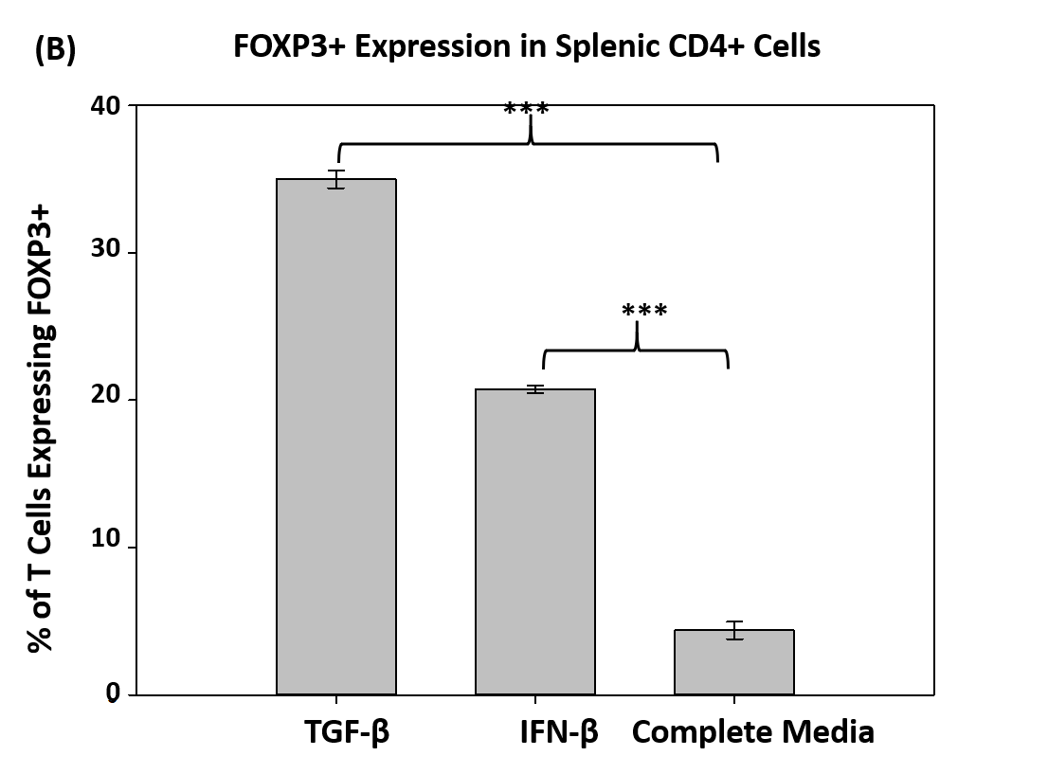
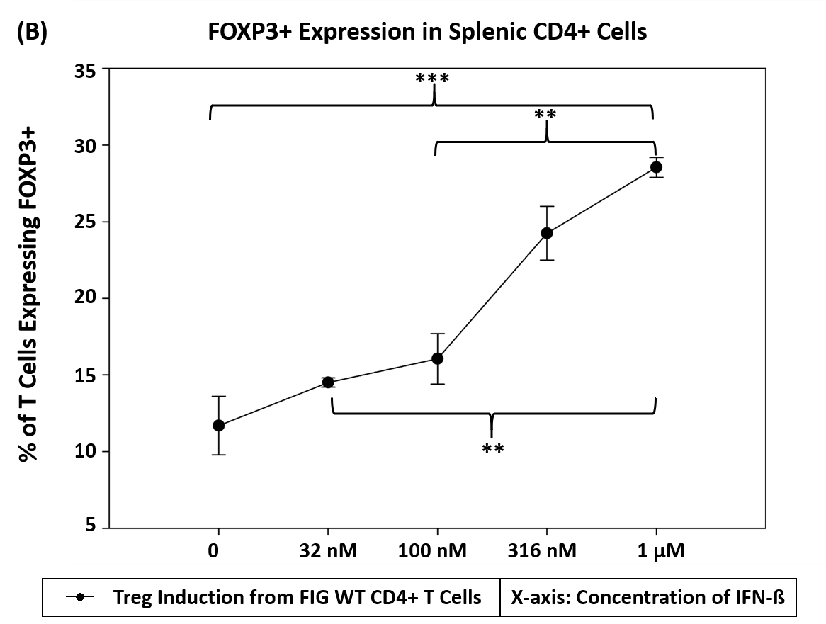
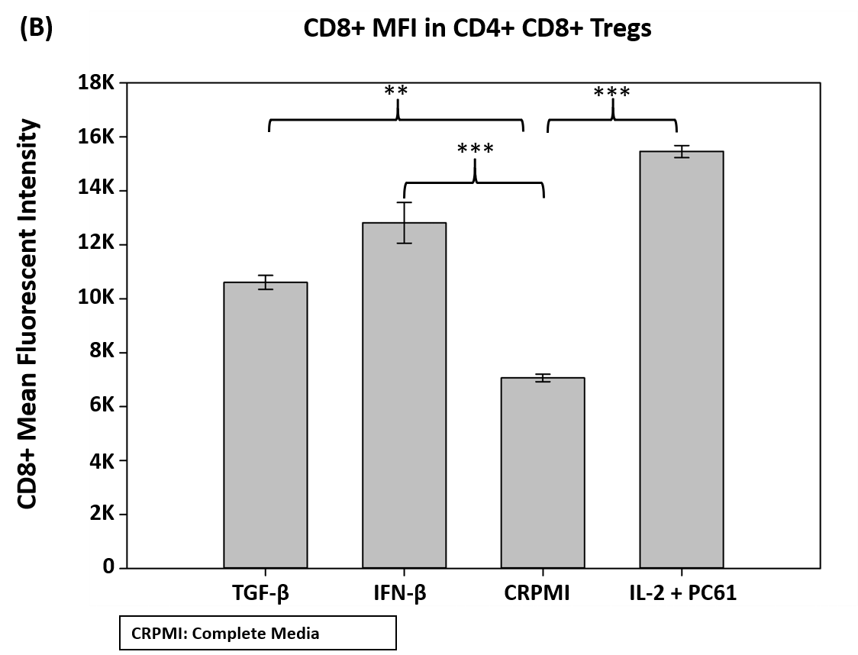
Results
IFN-ß induced greater FOXP3+ expression than Complete Media control in FIG WT mouse.
Greater concentrations of IFN-ß induced more FOXP3 expression in FIG WT mouse.
IFN-ß and TGF-ß maintain greater CD8+ expression than Complete Media in 2D2-FIG mouse Treg line.

Slide 5
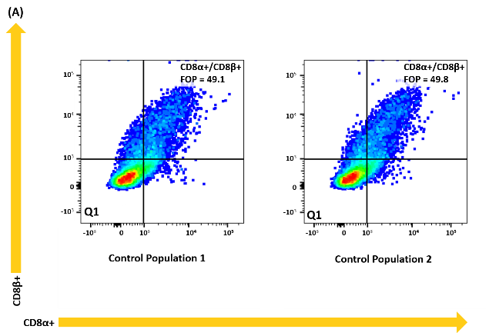
Results
***
***
***
***
Greater concentrations of TGF-β resulted in greater rates of CD8+ expression on Tregs
There is a large positive correlation between CD8α and CD8β expression on MHC-II Restricted 2D2-FIG Tregs

Slide 6
Conclusion
Findings:
  IFN-β induces Tregs from wild-type Tcon population.
  Increasing concentrations of IFN-β are more effective at Treg induction.
  IFN-β and TGF-β maintain higher levels of CD8⁺ expression on “Double-Positive” Tregs compared to culture without cytokine.
  Concentrations greater than 100 pM of TGF-β are more effective at maintaining CD8+ expression, compared to lower concentrations.
  CD8 coreceptor on “Double-Positive” Tregs is CD8αβ heterodimer.
Questions left to be answered:
  What other culture conditions may increase cell yield?
  What physiologic function do these cells have?

