Slide 1
Improving Emergency Department Sepsis Identification and Time to Treatment Initiation
Tyler Powell, LINC Scholar
Mentor: John Kohler, Sr., MD, MBA

Slide 2
Introduction
Introduction
In 2015, the Centers for Medicare & Medicaid Services implemented the Severe Sepsis and Septic Shock Early Management Bundle, a new time-to-treatment based measure to assess quality of care for patients with sepsis
In the FY 2019, our hospital’s Sepsis CMS Core Measure (SEP-1) compliance was 44% (national average in 2017 was 50%)
A quarter of these failures resulted from missing the 3-hour window for appropriate antibiotic administration, indicating room for improvement in identifying these patients sooner so care can be initiated promptly
Aim Statement
Global Aim: To improve quality of care and time to treatment initiation for patients with sepsis presenting to Vidant Medical Center’s Emergency Department
Specific Aim: To increase SEP-1 compliance by 25% (from 44% to 55%) by the end of FY 2020

Slide 3
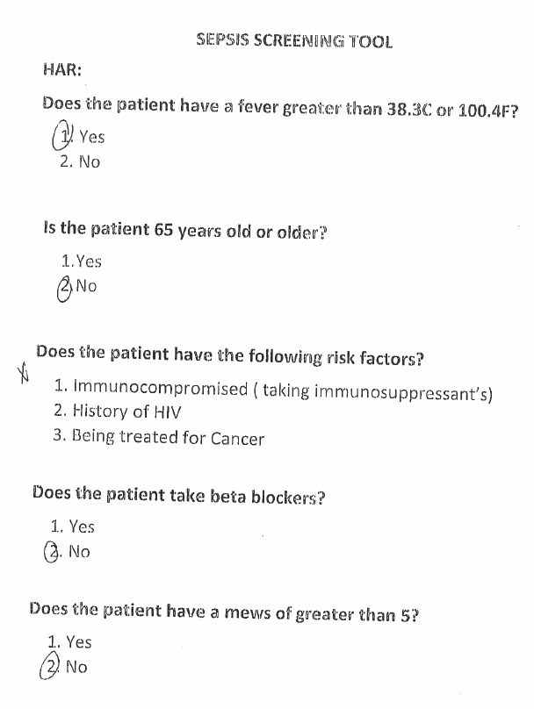
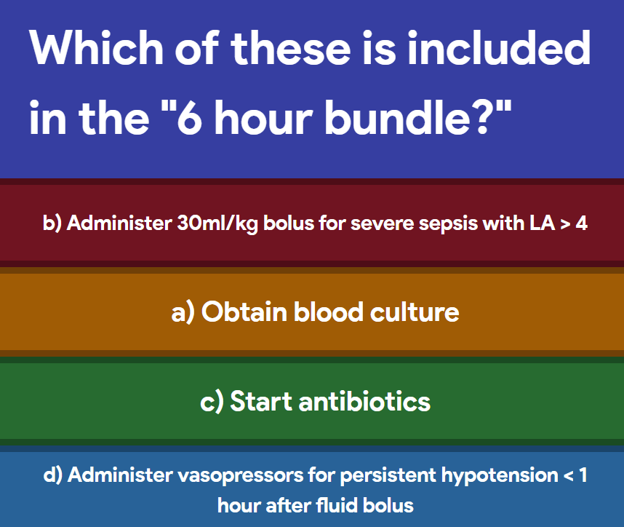
Methods
Project Timeline: January 2020 – October 2020
Project Team: Quality Nurse Specialist, ED Pharmacists, ED Nurses, ED Physicians, IT Staff, Medical Student
PDSA #1: Triage Screening Tool (Jan 2020)
  Within a week of the roll-out, very few tools had been completed. Feedback indicated that adding a manual step to existing workflow was unnecessarily complicated, so the tool was discontinued.
PDSA #2: Sepsis Gimkit Game (June 2020)
  An online interactive educational tool, the game consisted of 50 questions about sepsis management. This was distributed to ED nursing staff as part of their required education.
PDSA #3: Sepsis Narrator (August 2020)
  Nursing documentation tool that prompts time-based interventions based on patient presentation and vital signs. Following implementation, staff felt it was double documentation and wanted to explore other job aids including: paper check lists, reminder signs
PDSA #4: Sepsis Order Set (October 2020)
  When patients are identified as septic or at risk for sepsis, the order set can be used to prompt appropriate interventions. It includes suggested labs, fluid, and antibiotic suggestions based on suspected source

Slide 4
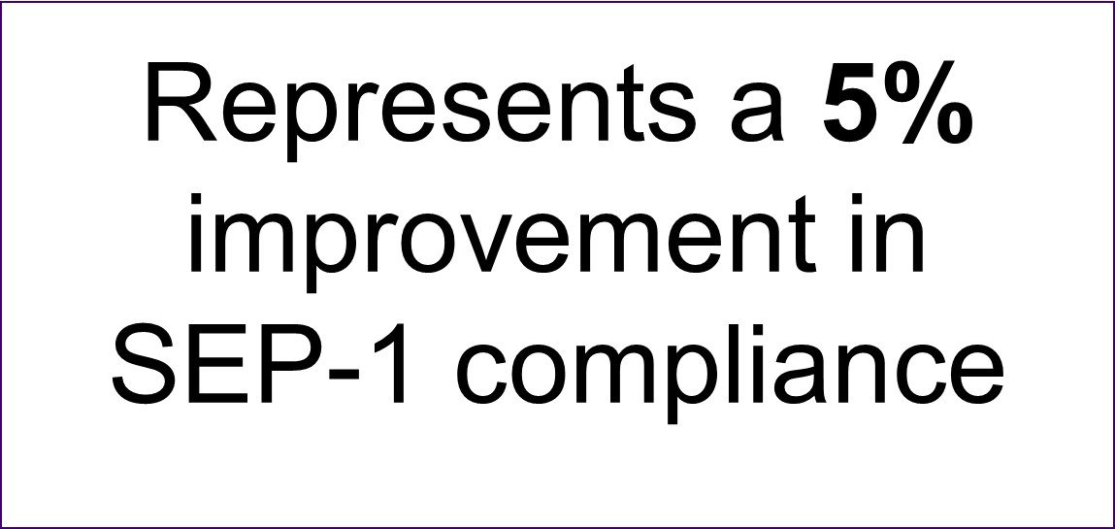
Results

Slide 5
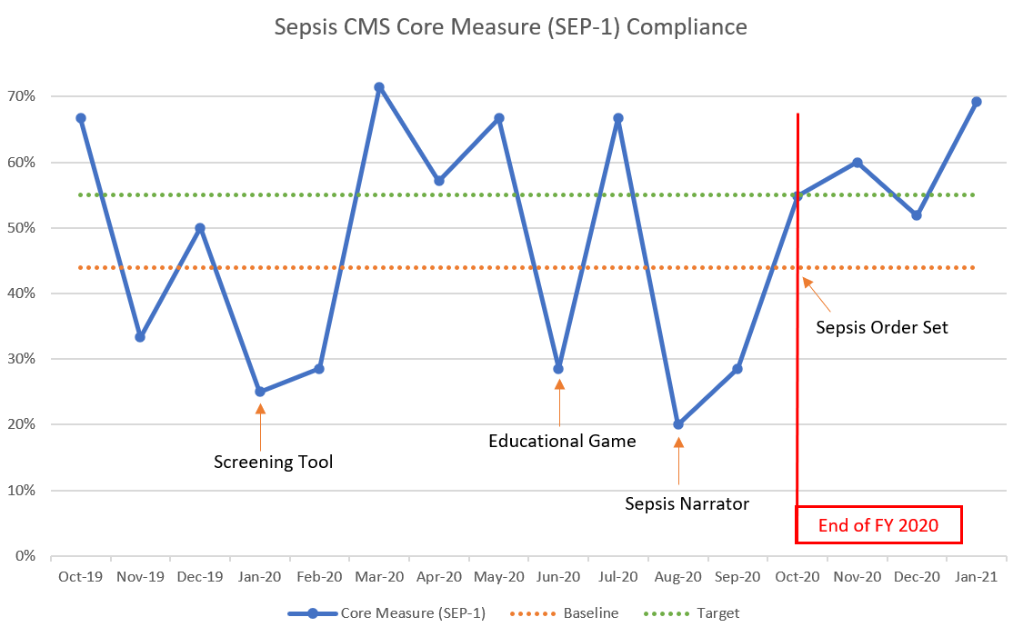
Results

Slide 6
Conclusion
Key Takeaway: Did not meet target, but still saw modest improvements in SEP-1 compliance (especially in the months directly following interventions)
Lessons Learned
  Successful interventions are integrated into preexisting workflow, not separate from it
  We have had success without a single “home-run” intervention, indicating that a combination of the approaches (or simply raising awareness) has been key
Limitations
  Only 93 patients met criteria for inclusion in the SEP-1 bundle in FY 2020. Small sample size + monthly reporting → data might be misleading

