Slide 1


Leaders in Innovative Care (LINC)
Mentored Longitudinal Quality Improvement Project:
Implementing Education, Instruction, and Data Collection Improvements to Reduce Blood Culture Contamination Rates in the Emergency Department i
Meera Patel¹, Triona Henderson, MD, MPH², Jeremy Yates, MT (ASCP)^{2,} Stephen Smith, MSN RN³.
1. ECU Brody School of Medicine, Greenville, NC. 2. Department of Pathology, Vidant Medical Center, Greenville, NC. 3. Education Nurse Specialist, Emergency Department, Vidant Medical Center, Greenville, NC
Meera Patel
ECU Brody School of Medicine
4th Annual Distinction Day 2021
Notes:
The project leader is Dr. Triona Henderson of the Dept of Pathology, along with her team of collaborators including physicians and technicians in the department.

Slide 2
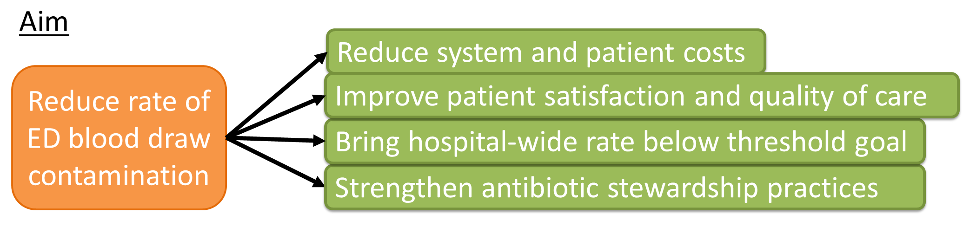
Introduction
Blood draws are an invasive procedure required for blood culture testing
If poorly executed, contamination of blood samples can lead to false positive blood culture results and downstream effects on quality of care:
  ↑ patient length of stay
  ↑ system costs for repeat cultures
  ↑ Unnecessary antimicrobial therapy
  ↓ Patient satisfaction due to excess testing, higher costs
In 2017, Vidant Medical Center (VMC) Emergency Department (ED) blood draw contamination rates were at an average of 6.0%, consistently above the 2.5% hospital-wide accepted threshold. All other adult units remained consistently below 2.5% in 2017.
Reduce the monthly rate of ED blood draw contamination by an absolute 1.5% (25% drop) below the ED monthly mean of 6.0% from October 2017 to August 2019.
There are no financial disclosures or conflicts of interest for the presented material

Slide 3
Methods
PDSA 1: Mass Re-education—April 2017
PDSA 2: Individual re-education sessions with checklist—October 2017
PDSA 3: Instructional Poster, Blood Draw Cart, Compliance Board, and Badge Cards—November 2017
PDSA 4: Increase data collection and distribution frequency to weekly and monthly—November 2017

Slide 4
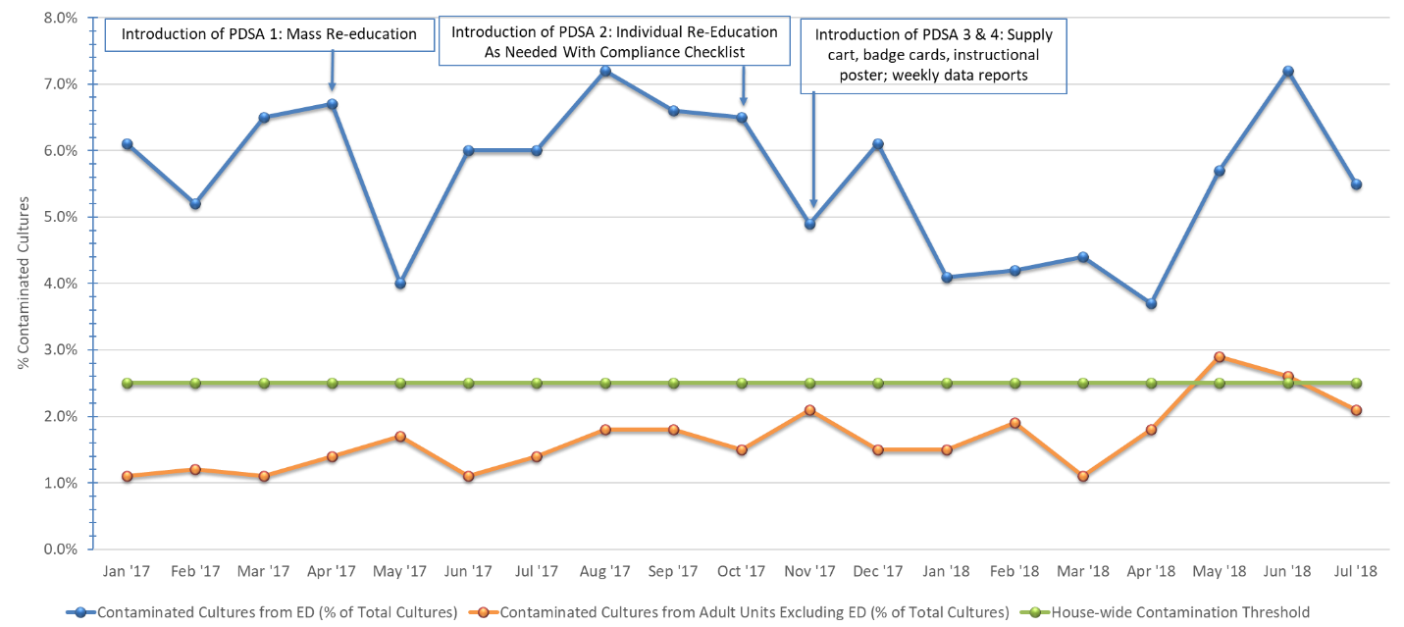
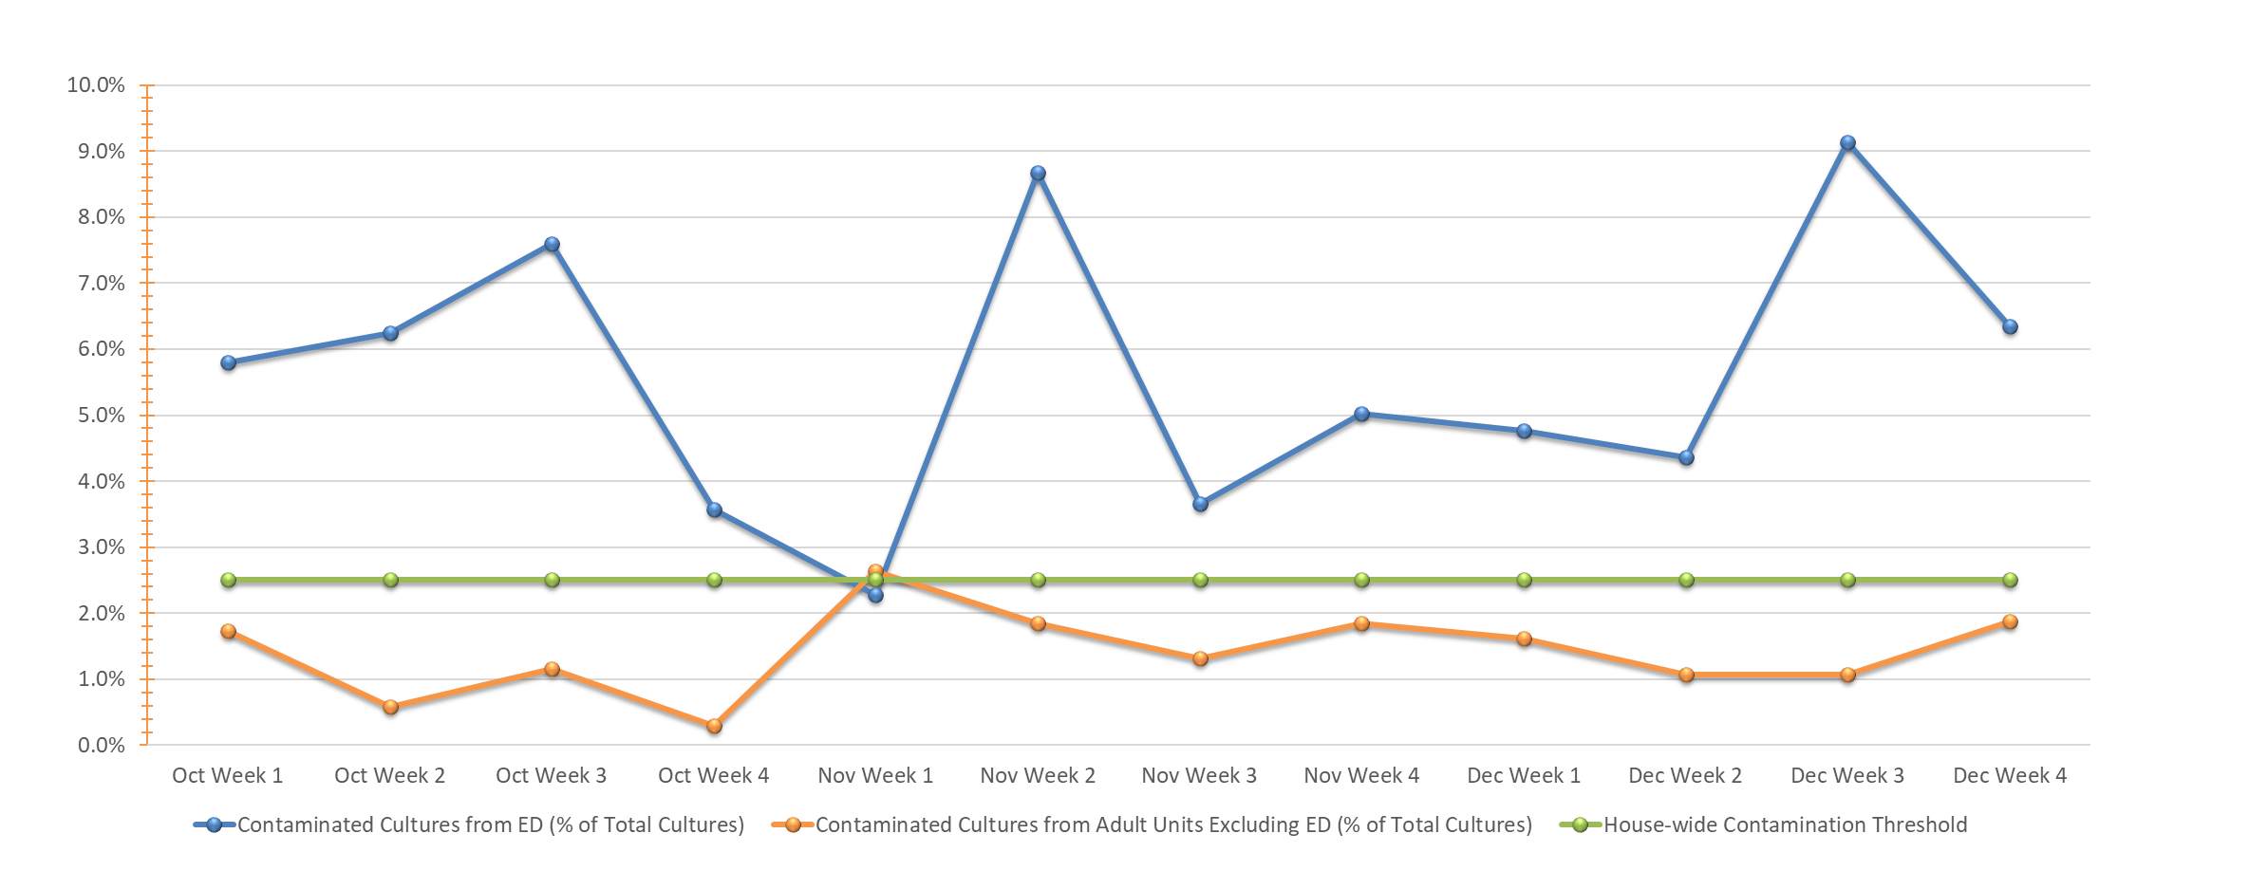
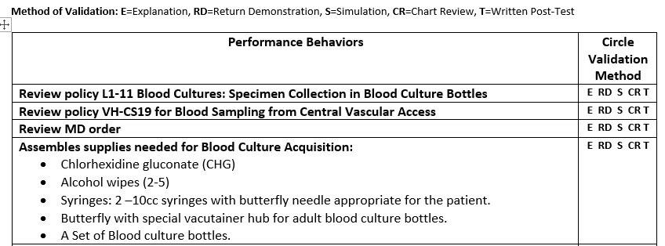
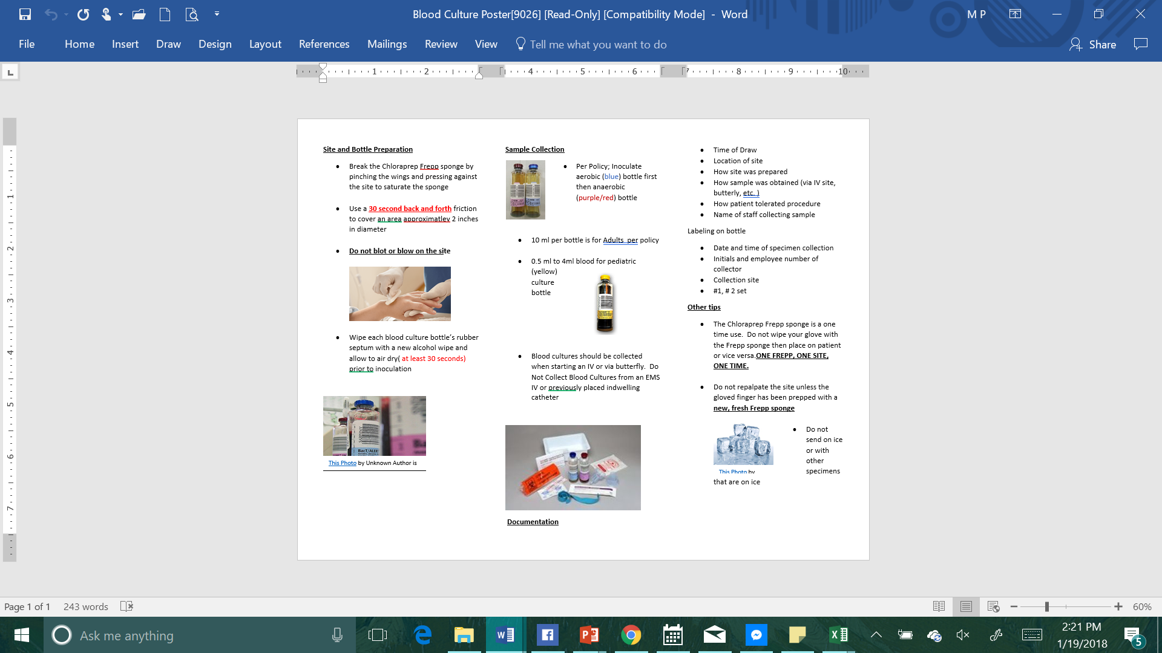
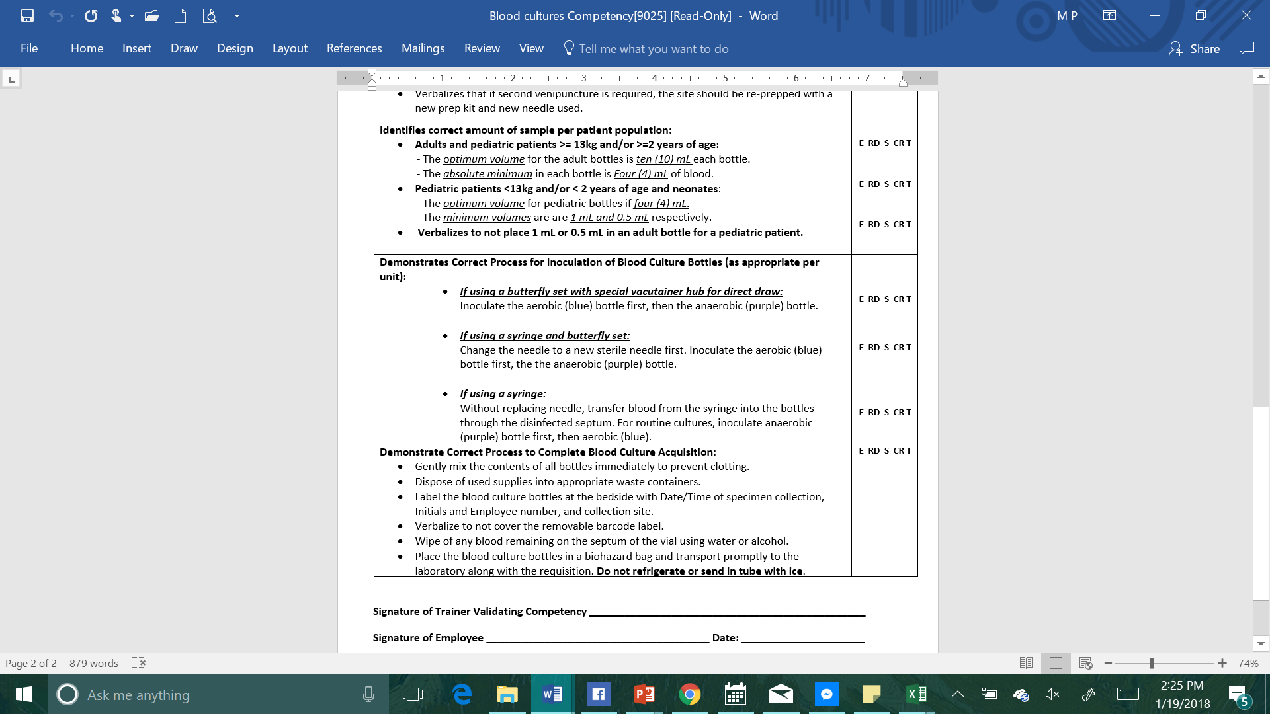
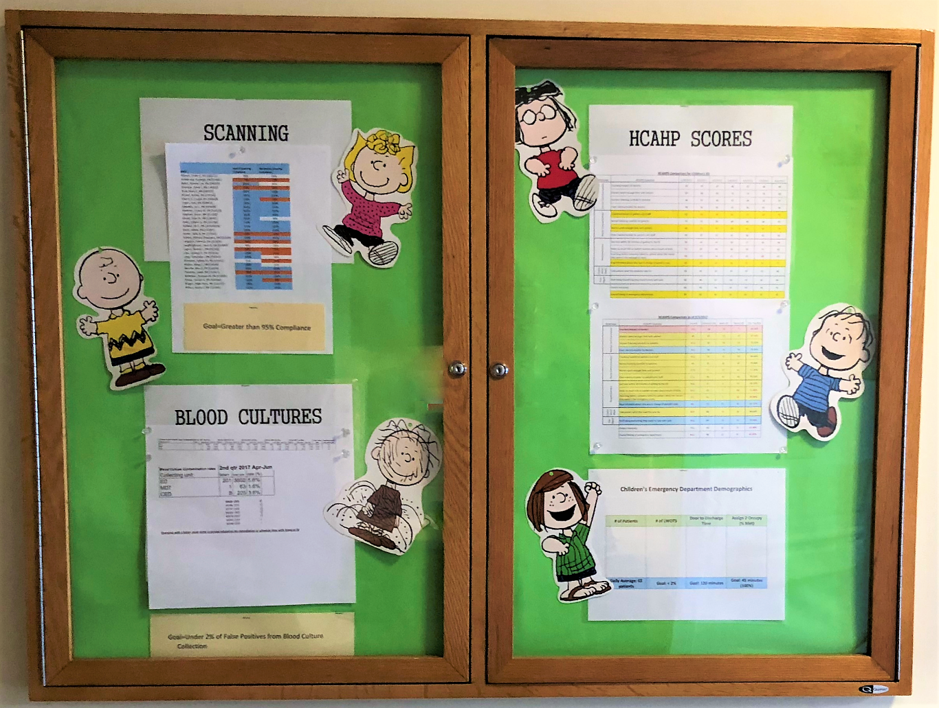
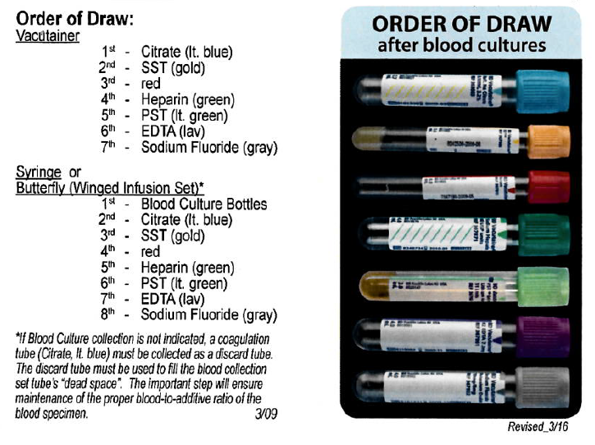
Results
Mean post-intervention ED blood draw contamination rate April 2017 to July 2018= 5.5% (0.5% lower than baseline; 12% relative reduction)
No special cause variation from baseline mean
Max upward trend= 4 pts from May 2017 to August 2017
Max downward trend= 5 points from August 2017 to November 2017
Lowest rate of change from January 2018 to April 2018; mean rate of 4.0% = a 2.0% decrease (25% relative reduction) from baseline
Single data point (December 2017) separates longest downward shift and the stretch with lowest rate of change—6 points would otherwise have been a significant, prolonged reduction
Weekly rate fell below 2.5% for first time (2.3% in November Week 1, 2017), but monthly rate for November 2017 was 4.3%
Figure 1. Monthly Blood Draw Contamination Rates from Emergency Department and Adult (excluding Emergency Department) Units (Jan-July 2018)
Figure 2. Weekly Blood Draw Contamination Rates from Emergency Department and Adult (excluding Emergency Department) Units (Oct-Dec 2018)
A.
B.
C.
D.
Figure 3. A) Blood culture acquisition competency checklist for one-on-one re-education; B) Instructional poster at redesigned blood draw cart and tube locations; C) Compliance board with contamination rates and deidentified list of ED nurses with contaminated draws; D) Distributed badge cards instructing order of draw.

Slide 5
Conclusions
The specific aim of this quality improvement initiative was not met.
There was a difference in pre- and post-intervention ED blood draw contamination rates, but it did not meet the goal rate of 4.5%. Several declines immediately following intervention implementation did not last or were disrupted.
Several limiting factors may contribute to this outcome:
  Nursing staff turnover rate is high in the ED, and often requires floater nurses from other units—may inhibit sustainability of education initiatives
  Fast-paced environment and complicated workflows in ED may prevent greater consideration given to blood draw practices
The outcomes of this study remain insightful
  Knowing how various change initiatives from different perspectives fit in the ED setting
  Identifying the kinds of barriers to change that exist in the ED setting.
These findings can be applied to better tailor interventions to key drivers in future improvement projects targeting ED blood draw contamination.

