Slide 1

Improving Hepatitis B Vaccination Timeliness for Very Low Birth Weight Infants in the NICU
Arjun Patel, LINC Scholar
Mentor: Ryan Moore, MD

Slide 2
Background/Introduction
Hepatitis B vaccination recommendations for infants born to HBsAg (-) women (American Academy of Pediatrics):
  Infants > 2000 g: Initial dose at birth (<24 hours)
  Infants < 2000 g: Initial dose at 1 month of age or hospital discharge
    Increased immunological response with deferral of Hepatitis B vaccination until 1 month.
Effectiveness and relative safety of Hepatitis B vaccination demonstrated in very low birth weight (VLBW) infants (<1500 g)
VLBW infants (<1500 g) continue to have a delayed immunization or complete lack of initial Hepatitis B immunization
Specific Aim: Improve timeliness (delivery by <33 days) of 1-month Hepatitis B vaccinations to VLBW (<1500 g) infants in the NICU from 63.1% to 80% by 12/2020
Notes:
My project focused on hepatitis B vaccination rates in the NICU for very low birth weight infants which is defined by <1500 grams. Current recommendations by the American Academy of Pediatrics states that infants >2000 grams should receive the vaccine within 24 hours while infants <2000 g should get the vaccine at 1 month or hospital discharge. This is due to the increased immunologic response found by deferring the vaccine to 1 month. Extensive studies have found that the vaccine in this patient population is effective and safe with minimal major side effects. Despite this, VLBW infants continue to have reduced immunization rates resulting in discharge without vaccination and delay in vaccination series.

Slide 3
Methods
Population: Very Low Birth Weight Infants (VLBW, < 1500 g)
Measures:
  Outcome: Monthly percent of VLBW infants admitted to the NICU that received Hepatitis B vaccination on time
  Process Measures: Number of staff receiving survey and education, Number of consent forms filled out in L&D/at admission and transferred with VLBW infant to NICU
Baseline vaccination data:
  Cross-referenced NICU admission data with Hepatitis B vaccination records (8 months: 01/2019-08/2019)
PDSA Cycles:
  PDSA 1: Survey to staff to identify knowledge limits and perceptions regarding VLBW vaccination and to guide future education (10/2019)
  PDSA 2: Education distributed to provide information related to vaccine administration, survey results, and changes to workflow (08/2020)
  PDSA 3: Hepatitis B consent process altered (08/2020)
Notes:
when to vaccinate infants, side effects, reasons to defer administration, and likert scale data on NICU performance, safety, and resulting clinical setbacks.
With limitations to in-person meetings, we distributed a flier via email (which was the preferred means of communication based on our survey). This flier consisted of information regarding timeline for vaccination, why we delay vaccination, lack of contraindications, and common non-emergent side effects of the vaccine. In addition, we provided details regarding the survey such as how well staff thought we vaccinated and the actual data.
In the past, consent was obtained from parents in person around the one month mark near the time the vaccine was to be delivered; however, there were a number of issues with this. One was that the providers would remember the vaccine too late. This would result in parents not coming into the hospital in time to give consent. Secondly, at around the 1 month period, parents are coming into the hospital less frequently, resulting in less opportunities to get consent. Lastly, we are unable to obtain consent via telephone due to not providing the vaccine information materials which is legally required. To change this process, we have been trying to obtain consent on admission of the mother to L & D in a process similar to other newborns with the consent form following the infant.

Slide 4
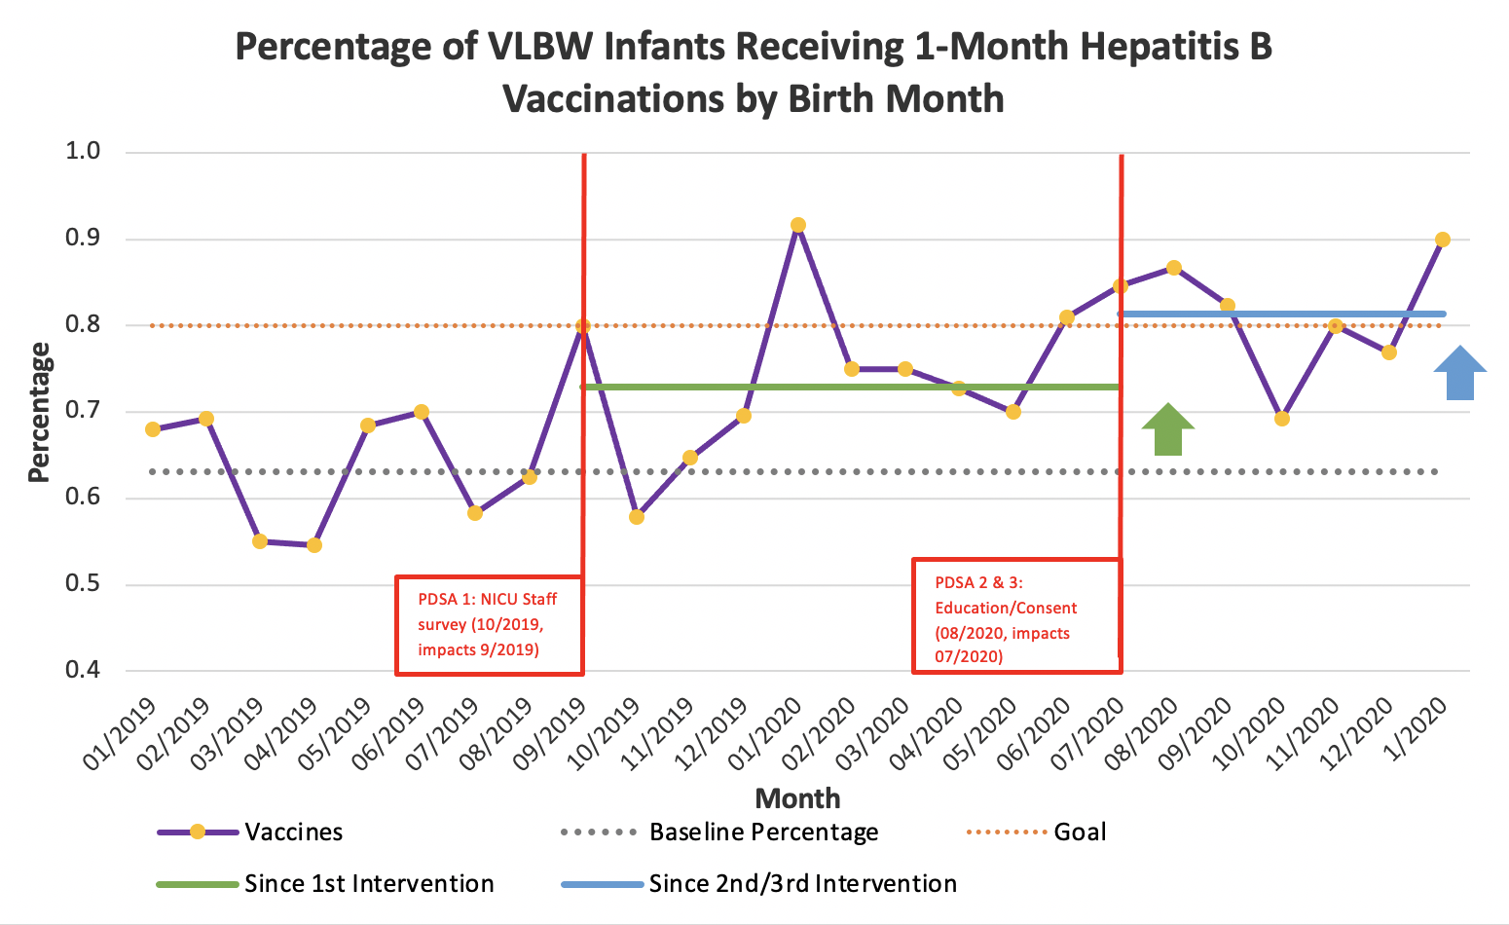
Results
VLBW Infants Vaccinated:
Baseline Data (01/2019-08/2019) | 82/130 (63.1%)
Post-PDSA 1 (09/2019-06/2020) | 110/151 (72.9%)
Post-PDSA 2 & 3 ((07/2020-1/2021) | 70/86 (81.4%)
Notes:
Our baseline data found that our percentage of VLBW infants vaccinated was 63.08% (82 infants/130 infants).
We had a total of 55 respondents (39 nurses, 2 resident/fellows, 5 APP, 9 attendings) and the majority of respondents did understand when the vaccine should be given at a rate of 81.8%.
A knowledge gap did exist of contraindications to immunizations, primarily amongst nursing with
Only 58.2% correctly identified no reason to defer (18 nurses, 1 R/F, 4 APP, 9 attendings) while 34.6% (17 nurses, 1 R/F, 1 APP) incorrectly identified both apnea/bradycardia and antibiotics (answer d) as contraindications.
In addition, the majority of staff incorrectly believe our NICU administered vaccines to >90% of infants (56.1%) with attendings being more likely to have this perception.
Following our survey in 10/2019, we noticed a gradual improvement in vaccination rates to an average of (72.85%).
Following PDSA 2 and 3, we saw an improvement in vaccination rates above aim to 80.95%; however, this data is only through November 2020 with need to continue monitoring to understand sustainability
In 8/2020, impacting vaccinations of babies born in 07/2020,

Slide 5
Conclusion
Original Hepatitis B vaccination delivery to VLBW infants in the NICU fell below specific aim of 80% (61.08%)
Survey:
  Deficiency in knowledge of actual NICU performance and contraindications to vaccine delivery was identified
  Staff possessed an adequate understanding of vaccine delivery time and a general belief that the vaccine is safe to deliver with limited clinical setbacks
Survey (PDSA 1) helped improved vaccination rates to >72.85% (<80% goal)
Education and consent process changes (PDSA 2 & 3) improved vaccination rates to 81.40% (>80% goal)
Notes:
In conclusion, our initial data found our vaccination rates fell below 80%. Our survey found that while the majority of respondents recognize the correct vaccination delivery timeline and understand that the vaccine is safe to deliver, we found a deficiency in understanding of NICU performance primarily in the attending subgroup and the contraindications to vaccine delivery primarily within the nursing subgroup.
Rates after PDSA 1 improved to 72.85% and our rates after PDSA 2 and 3 improved to 81.40%.

