Slide 1
Scott McLaughlin
Medical Education and Teaching Distinction Track Scholar
Supplementing Gross Anatomy Pelvis and Perineum Content with Video Modules: Effects on Student Learning
Mentors: Emily Askew, PhD and Kelly Harrell, PhD, MPT

Slide 2
Introduction
Medical education is moving toward a condensed curriculum model, taking time from the preclinical coursework and distributing it toward the clinical years
Gross Anatomy and Embryology is a critical foundational course taken at the beginning of medical school
A large portion of students’ time is spent in the cadaver laboratory during this course
To reduce course contact hours, will removing a dissection and supplementing the course with video modules, a prosection presentation, and a previously established flipped classroom improve student self-perception?

Slide 3
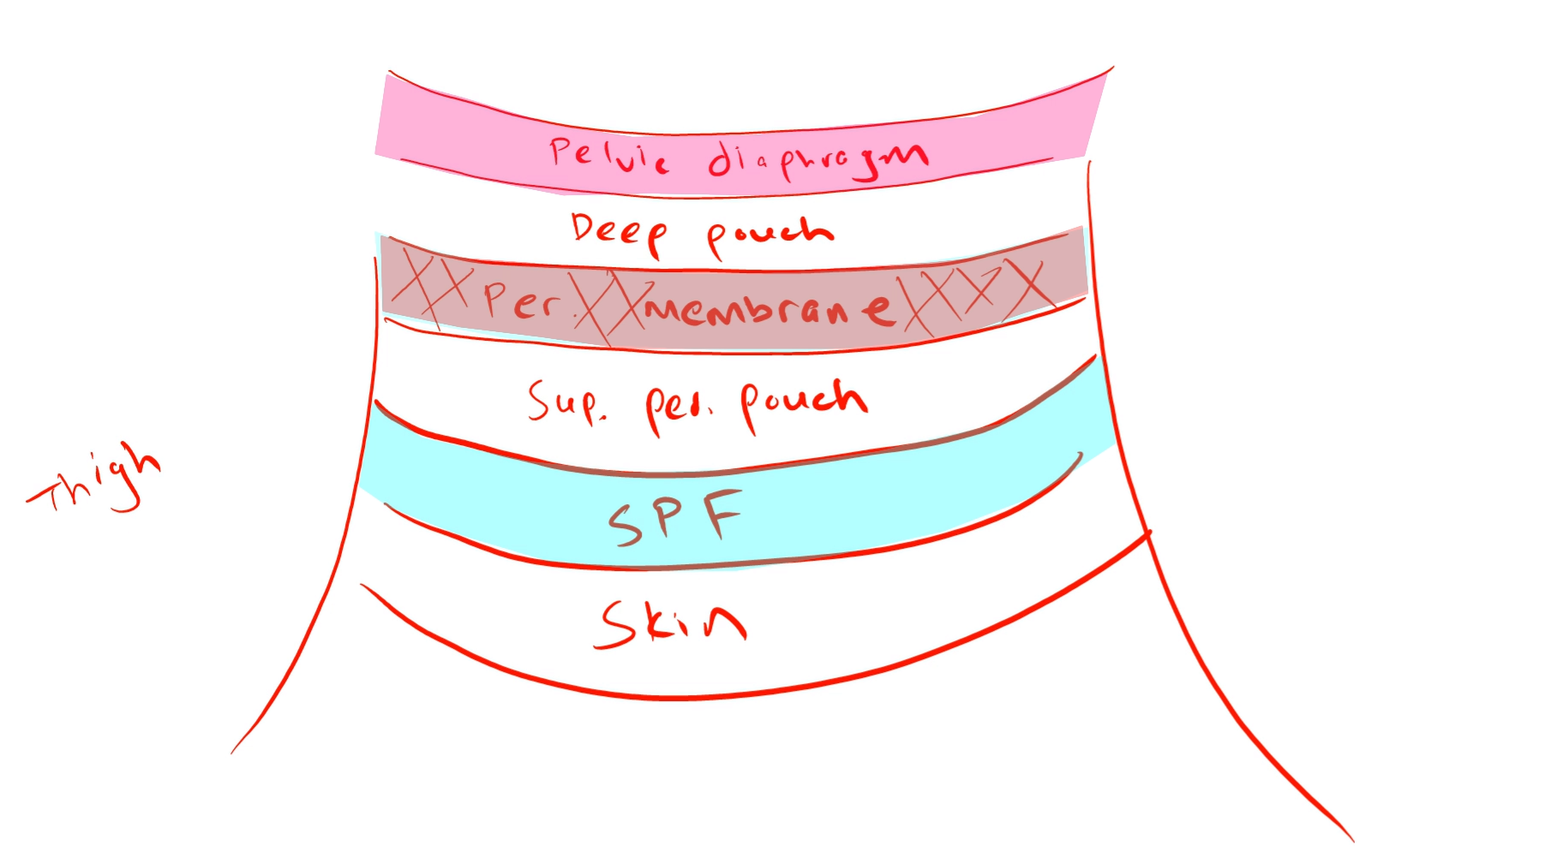
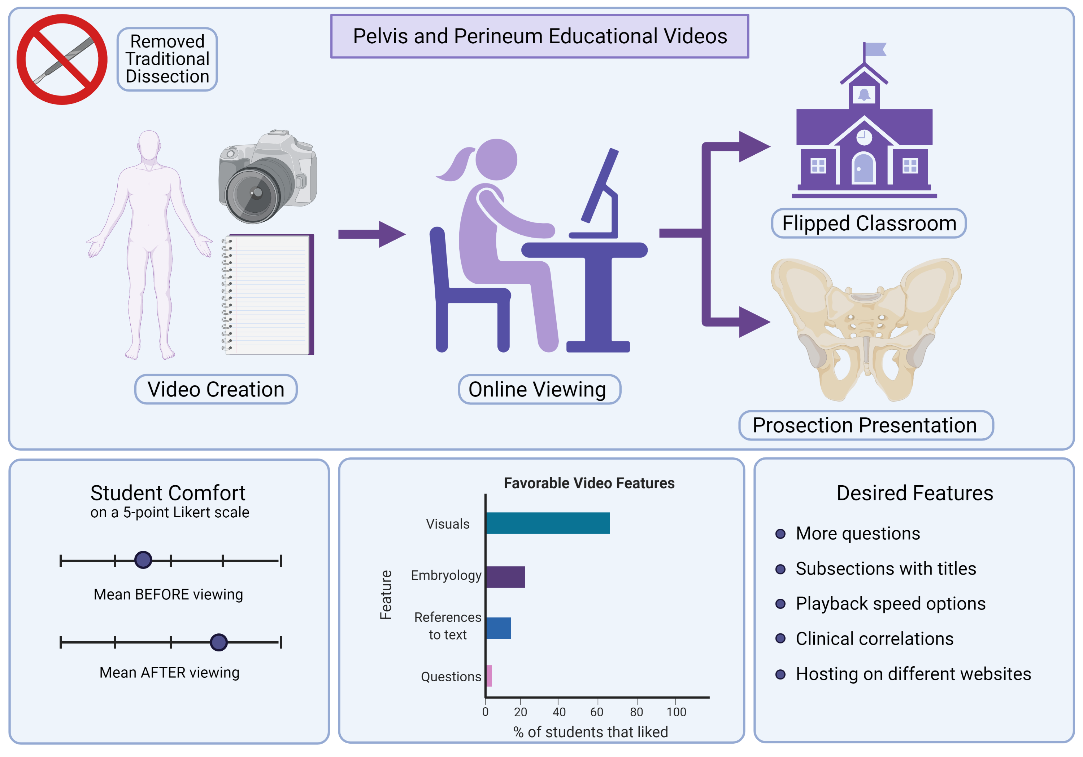
Methods
Educational study with IRB approval
86 first-year medical students enrolled in Gross Anatomy and Embryology at the Brody School of Medicine in 2019
Intervention: removal of pelvis and perineum dissection, implementation of video modules and prosection presentation, continuation of flipped classroom session
Main outcome measure: student self-perception

Slide 4
Results

Slide 5
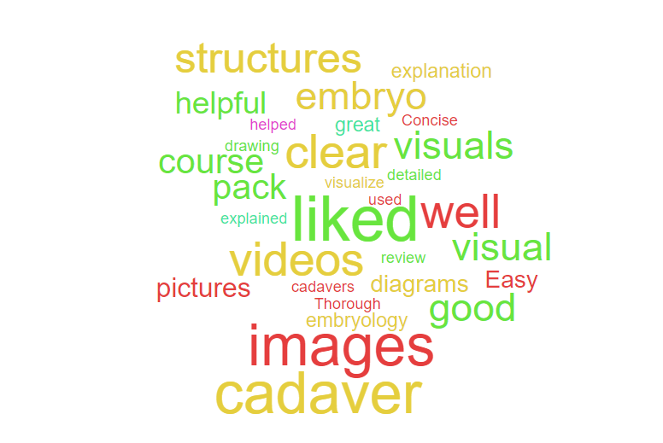
Results

Slide 6
Conclusion
Overall, the results suggest video modules, when used to supplement learning strategies such as prosection presentations and flipped classrooms, may be advantageous in reducing course contact hours
Further studies would be beneficial to explore the effects of this change on student examination performance, subsequent board scores, long-term knowledge recall
Limitations
  Recall bias
  Caution in generalizing results to other units
  Examination scores
  Does not completely replace the benefits of dissection and examining in 3D space

