Slide 1
Kyle Luke
LINC Distinction Track Scholar Improving Monthly Completion Rates for Patients Requiring Diabetic Foot Exams Mentor: Shiv Patil MD, MPH, BC-ADM

Slide 2
Introduction
Foot ulcers and amputations are common consequences of diabetic neuropathy and peripheral arterial disease (PAD) and represent major causes of morbidity and mortality in people with diabetes.
Early recognition and treatment of patients with diabetes at risk for these conditions can delay or prevent adverse outcomes.
The American Diabetes Association recommends a comprehensive foot evaluation annually to identify risk factors
Specific Aim
To improve the monthly percentage of completed diabetic foot exams (DFEs) for ECU Family Medicine Center’s Pirate Module patients with diabetes to ≥ 70.00% by December 2020.

Slide 3
Methods:
Setting: ECU Family Medicine Center Pirate Module
Population: Patients with Diabetes
Timeline: December 2019 to December 2020
Methods:
Literature review of prior initiatives
Data source: Electronic Health Record (Epic) dashboard
Monthly project meetings
Established baseline completion rate of 65%
PDSA cycles:
(Dec 2019 – Feb 2020), An exam room visual cue consisting of “red feet”
(Mar 2020), A weekly list of patients with diabetes due for a foot exam was given to the Medical Assistants
(Nov 2020), Educated providers on how to document exam in Epic. Implementation of a paper template of the DFE

Slide 4
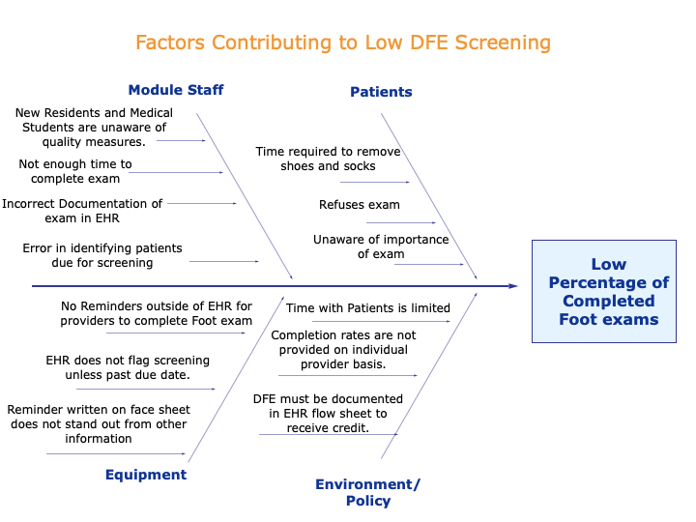

Slide 6
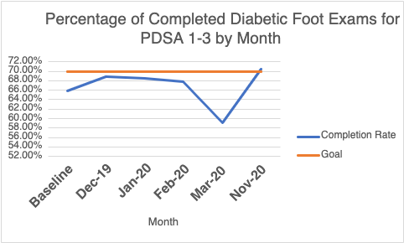
Results

Slide 7
Conclusion
Lessons learned and limitations:
Exam room visual cues are easy to implement and cost effective.
COVID-19
Problem of Improper Documentation
Future Steps:
Education on proper documentation
Are paper templates needed
Intervention to promote time management

