Slide 1
Brenham Hughes
MET Distinction Track Scholar
Problem-Based Learning: Approach to a Patient with a Generalized Rash
Dr. Lane Wilson, Department of Family Medicine
https://www.nicosia.sgul.ac.cy/medical-students-in-action/img_2954-1/
https://www.nicosia.sgul.ac.cy/introduction-to-programme/curriculum/teaching/

Slide 2
Introduction
Historically, there has been a lack of priority placed on dermatologic diseases and treatments in medical school curricula leading to student/physician diffidence¹
These “dermatologic gaps” are also reflected in the lack of research on the implementation of active learning sessions to teach dermatologic pathology and treatment.
This PBL case was designed for second year medical students at the Brody School of Medicine as a look at their PBL curriculum identified a disproportionate number of infectious disease cases

Slide 3
Methods
Learning Objectives
Identify and classify the presentation of various common dermatologic diseases and in DRESS specifically
Apply knowledge of the pathogenesis and epidemiology of DRESS and the ways in which they affect the function of the human body
Select, interpret and understand the indications and limitations of commonly used screening and diagnostic tests in DRESS
Collaborate within the group to determine and resolve identified learning issues related to DRESS
Describe the rationale and apply the principles of health systems science including practice improvement in increasing patient safety and enhancing quality of care
Design
Implemented in groups of 10-12 M2 students in their Foundations of Medicine/Doctoring course
Information was presented in a step-wise fashion (HPI, ROS, PMH, Fam Hx, Social Hx, Vital Signs, Exam)
One clinical and non-clinical facilitator were provided with a guide to aid students through the case
Students were given evaluation post-case to evaluate their level of comfort on a 5-point Likert Scale (1 – very uncomfortable; 5 = very comfortable

Slide 4
Results
27 students responded to the poll for a response rate of 32.1%
Level of Comfort BEFORE the case
Level of Comfort AFTER the case
M = 2.41, SD = 1.18
M = 3.85, SD = 0.53
M = 2.33, SD = 1.07
M = 3.93, SD = 0.55
M = 2.19, SD = 0.92
M = 4.04, SD = 0.52

Slide 5
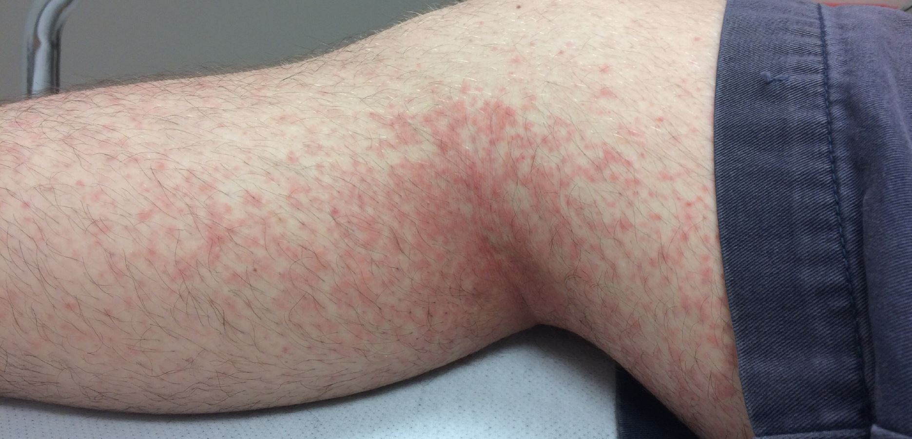
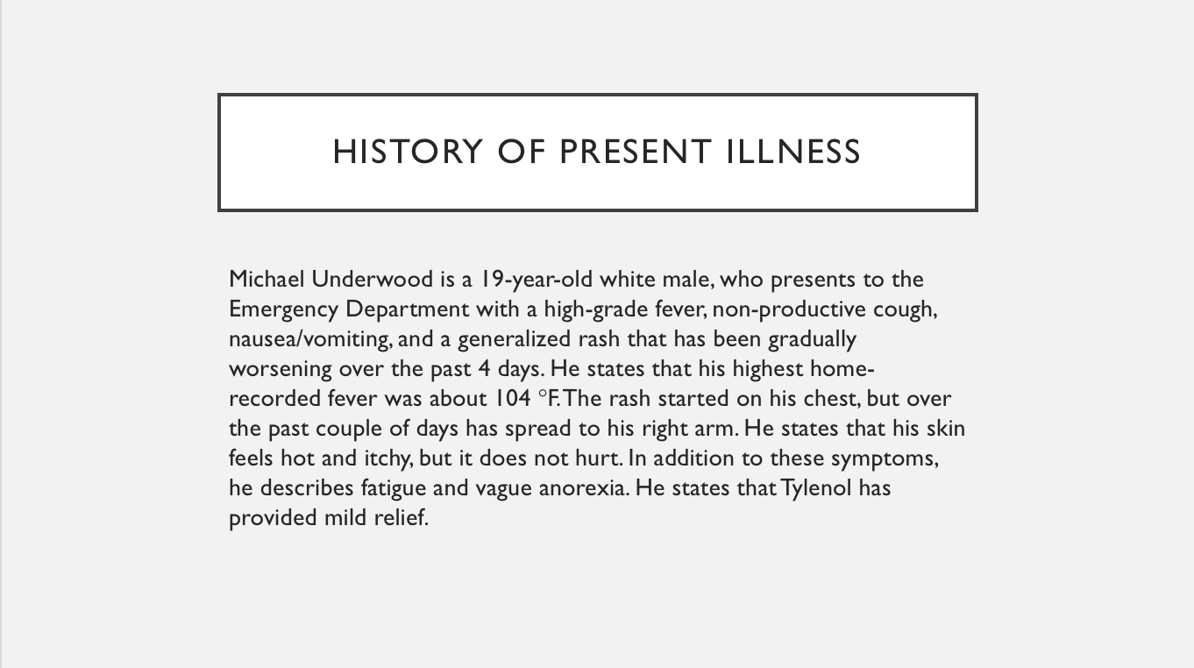
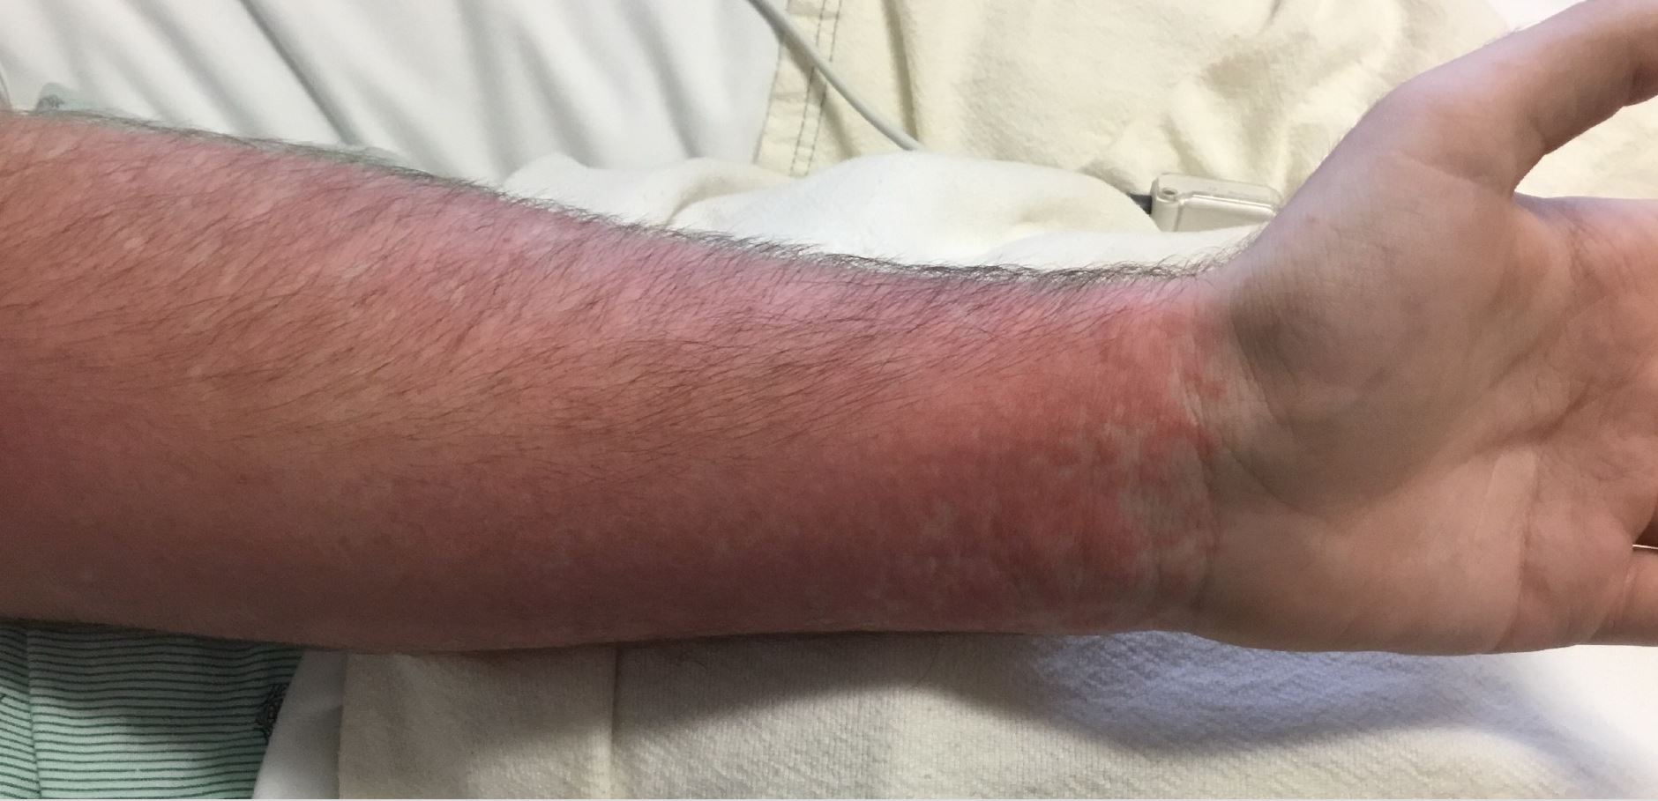
Results
52.9% of respondents believe that the Brody School of Medicine pre-clinical curriculum adequately covers dermatologic diseases and treatments
57.7% of respondents stated this case was more or much more comprehensive than other PBL cases
38.5% of respondents stated this case was more or much more organized than other PBL cases
80.8% of respondents stated this case was more or much more challenging than other PBL cases

Slide 6
Conclusion
Despite believing the curriculum adequately covers dermatological material, second year medical students were still not confident in their ability to evaluate the presentation of a rash
Implementation of this case aided in students understanding and self-confidence in approaching patients with dermatological presentations
Further research could examine students’ performance on standardized exams before and after implementation of this course into the M2 curriculum

Slide 7
References
[1] Hansra, N., O’Sullivan, M., Chen, C., Berger, T. (2009). Medical school dermatology curriculum: Are we adequately preparing primary care physicians?. Journal of the American Academy of Dermatology 61(1):23-29.

