Slide 1
Targeting Hemoglobin A1c Levels, Retinopathy, and Neuropathy to Improve the Health of Adult Patients with Diabetes
Juhi Gor
LINC Distinction Track Scholar
Mentor: Dr. Tim Powell

Slide 2
Introduction
Introduction
Among the chronic illnesses affecting our nation, uncontrolled diabetes is highly prevalent with many potential complications
Increasing hemoglobin A1c (HbA1c) levels increase the risk of complications, including diabetic neuropathy and retinopathy
Regular screenings lead to early recognition of diabetic neuropathy and retinopathy
Barriers to care include cost for eye examinations and medications, time constraints on provider’s end to perform foot exams, and lack of understanding on patient’s end on how to control their disease
Aim Statement
Global Aim: Improve the health of patients with diabetes by lowering HbA1c levels and increasing screenings for eye and foot exams
Specific Aim: Improve the health of patients with diabetes between 18-74 years of age in the ECU APHC Clinic by lowering percent of patients with HbA1c greater than or equal to 9 from 18% to 15%, increasing eye exams from 17% to 35%, and increasing foot examinations from 62% to 80% between June 2018 to December 2019

Slide 3
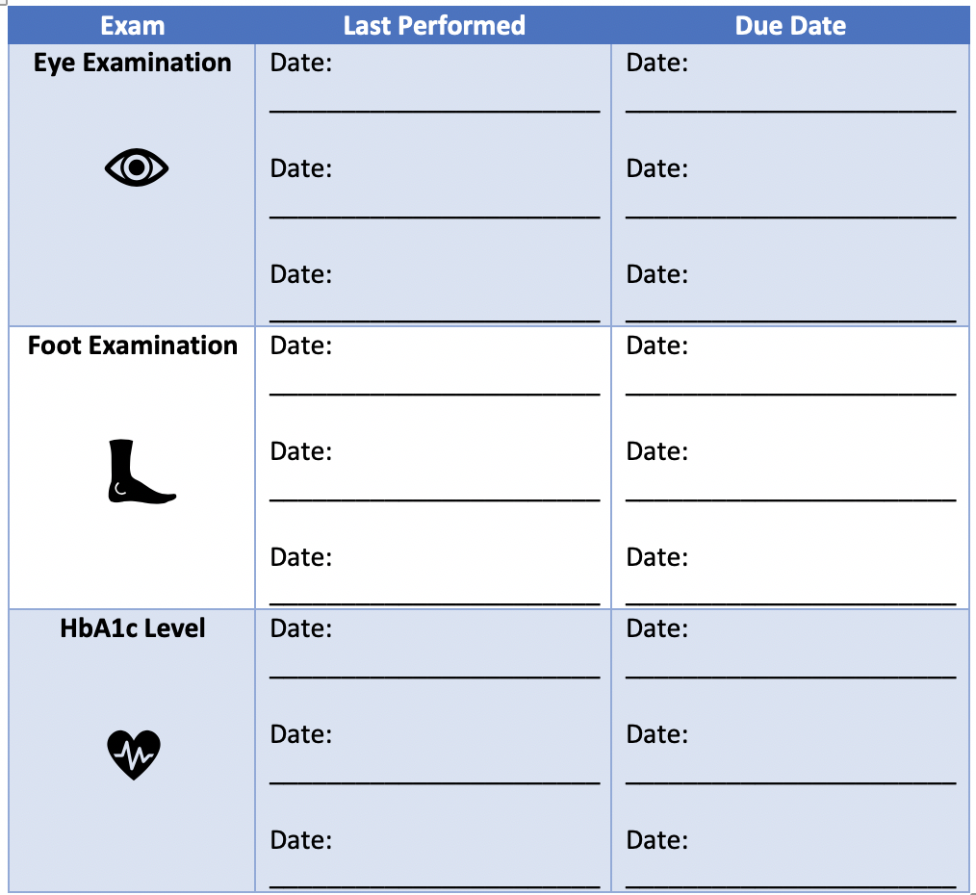

Methods
Population: Patients with diabetes, age 18 – 74 years old
Monofilaments kept in each patient room
Dot phrase created for foot exams to ensure data capture in EHR
Foot shaped cut out on patient doors
Identify patients with HbA1c >9%
Nurse manager began to arrange 1:1 teaching time with patients. A1c’s will be measured every 3 months
Patients unable to keep track of the severity of their conditions
Identify patients that need diabetic eye exam or foot exam
Distribute diabetes management cards
Little to no improvement in eye exams for diabetic patients
Refer each patient for a screening retinal exam
Patients remove their shoes prior to provider arriving in exam room
Identify if patient is due for annual eye exam in EHR
Place eye shaped cut out on the patient doors
Providers continue to forget to perform foot exams or fail to document

Slide 4
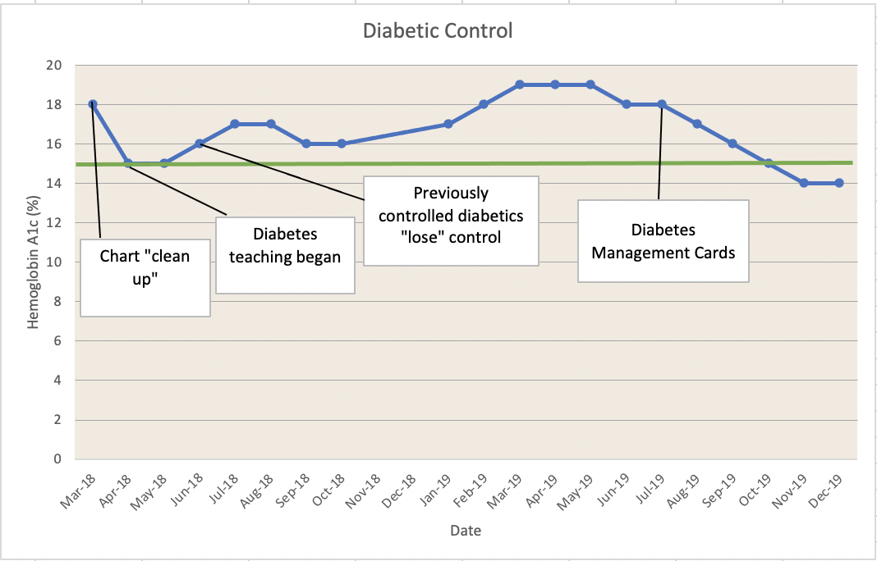
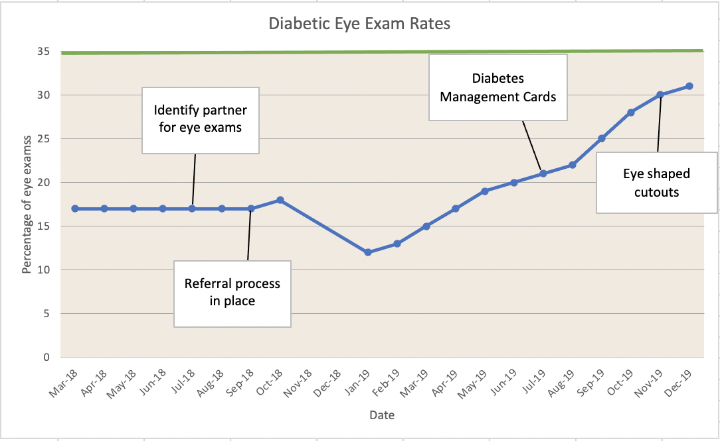
Results

Slide 5
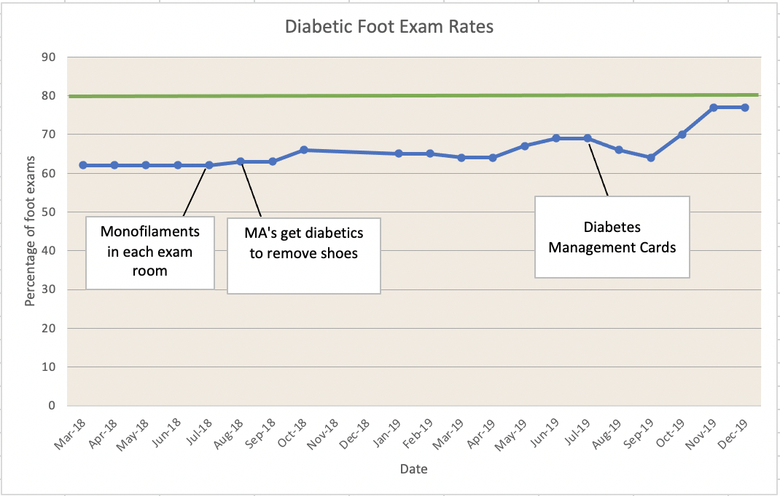
Results

Slide 6
Conclusion
Through our interventions, improvement seen in screening of diabetic neuropathy and retinopathy
  Eye exams steadily increased through multiple interventions
    Greater increase seen during 2nd year of study
  Foot exams had fluctuations through course of study, but steady increase was seen near end of study period
Patients with HbA1c levels > 9 dropped below our goal of 15%
Limitations
  Length of study in relation to most recent interventions
  Changes in team members through course of study
  Limited resources
    Access to retinopathy machine in ECU FM Clinic
    Dedicated diabetes education staff

