Slide 1
Lauren Forbes, MPH
Research Distinction Track Scholar
Association of Patient Sex and Pregnancy Status on Naloxone Administration in the Emergency Department

Slide 2
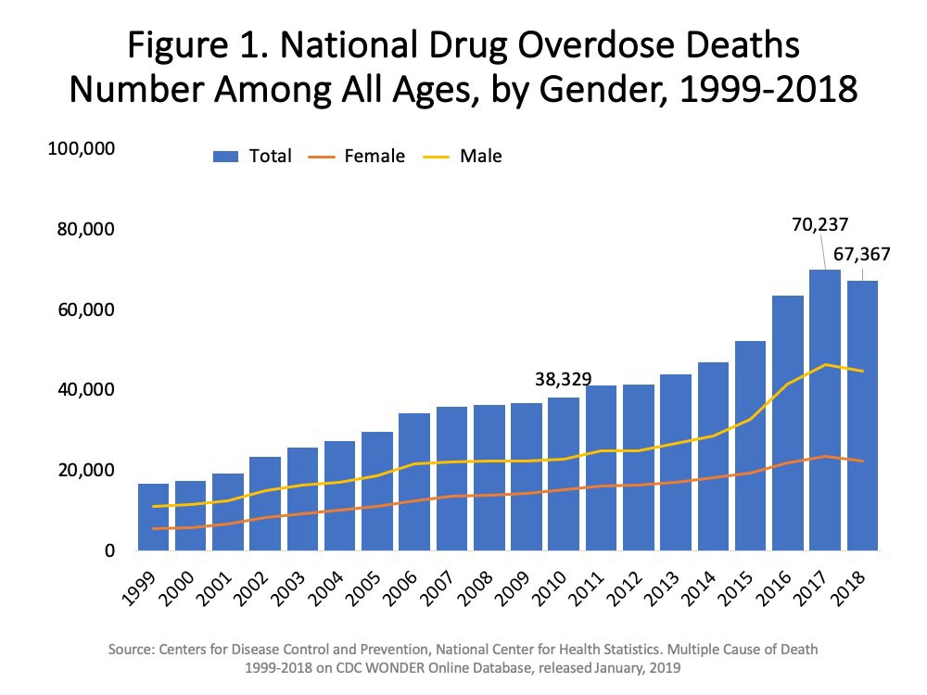
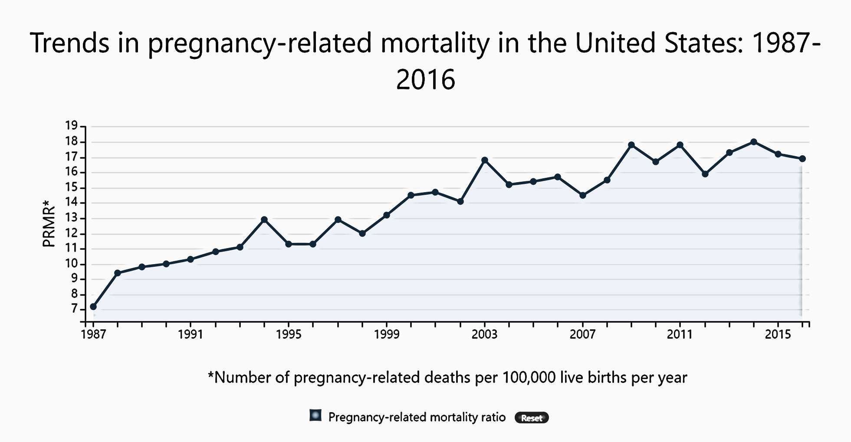
Background
2
Reproductive-aged women have the highest rates of drug misuse- or abuse-related emergency department visits among women.
Pregnancy-related mortality in the United States has generally increased for more than three decades.
Maternity mortality review committee data have identified drug overdoses to be a leading cause of pregnancy-related mortality.
Notes:
Looking at the figure, we see that the number of opioid-related deaths increased each year for two decades until 2018.
The rate of increase for female was greater than males, particularly for women of reproductive age who also had the highest rates of drug misuse- or abuse-related emergency department visits.
Concurrently, pregnancy related mortality has also increased.
A seminal report from 9 state maternal mortality review committees identified drug overdoses to be a leading cause of pregnancy-related mortality.
These trends suggest that opioid and pregnancy related mortality may be intersectional and we need novel ways to identify risk factors and conduct surveillance.

Slide 3

Gap in the Literature
Medical societies and public health agencies support the administration of naloxone to pregnant women in the setting of suspected opioid overdose.
Limited studies have evaluated the effectiveness of the healthcare system in administering naloxone based on sex, gender or pregnancy status.
Notes:
Medical societies such as the American College of Obstetricians and Gynecologists and public health agencies like the Substance Abuse and Mental Health Services Administration have clear guidelines recommending the use of naloxone to save a pregnant woman’s life.
However, few published studies have evaluated the effectiveness of the healthcare system in administering naloxone based on sex or gender and none have specifically studied women who are pregnant.

Slide 4

Study Aim
To investigate the
rates of naloxone administration in pregnant and non-pregnant women versus men with opioid overdose-related emergency department visits using the National Emergency Department Sample.
Notes:
NEDS is the largest all-payer ED database in the US and estimates about 145 million ED visits each year.

Slide 5
Opioid Overdose-related ICD10 Codes:
T40.0-40.4, T40.6
F11, F19, O99.32
R41.82, I46.9
Records with opioid overdose-related ED visit
n=1,454,253
WHO Defined Women of Reproductive Age:
15-49 years old
Men with opioid overdose-related ED visit
n=794,923
Women with opioid overdose-related ED visit
n=659,330
Excluded due to age <15 or >49 years old or missing age
n=351,209
Excluded due to age <15 or >49 years old or missing age
n=329,910
Reproductive-aged men with opioid-related ED visit
n=443,714
Reproductive-aged women with opioid-related ED visit
n=329,420
Notes:
We conducted a retrospective cohort study using eligible records from the 2016 and 2017 datasets. Eligibility was defined as the record having an opioid overdose-related ICD10 code and representing an indiviual of reproductive age as defined by the World Health Organization.
These data were then stratified by gender (men versus women)

Slide 6
Reproductive-aged women with opioid-related ED visit
n=329,420
CDC Defined ICD10 Codes for Pregnancy:
O00-9A
Pregnant, reproductive-aged women with opioid-related ED visit
n=25,056
Non-pregnant, reproductive-aged women with opioid-related ED visit
n=304,364
CPT Code for Naloxone Administration:
J2310
Pregnant, reproductive-aged women with opioid-related ED visit who received naloxone
n=69
Non-pregnant, reproductive-aged women with opioid-related ED visit who did not receive naloxone
n=24,987
Notes:
And then women were stratified by pregnancy status as determined by the prescence of an ICD10 O code. Lastly, a subgroup analysis was performed comparing pregnant women who did versus did not receive naloxone during an opioid overdose-related ED visit.

Slide 7



2.10%
NALOXONE ADMINSTRATION
1.70%
AOR: 0.86 (0.83-0.89)
0.27%
AOR: 0.16 (0.13-0.21)
Notes:
Presented are the results of our multivariate logistic regression model after adjusting for patient and ED facility characteristics. The adjusted odds ratio under the female symbol represents the comparison of non-pregnant women to men. And the adjusted odds ratio the under the pregnant woman image represents the comparision of pregnant women to non-pregnant women. For our primary outcome, non-pregnant and pregnant women were less likely to receive naloxone, with non-pregnant women having significantly lower odds.

Slide 8
27.2%
Subsequent facility admission
30.2%
AOR: 1.04 (1.03-1.06)
40.5%
AOR: 2.04 (2.00-2.10)
Notes:
For our secondary outcome of subsequent facility admission, non-pregnant and pregnant women were more likely to be admitted, with non-pregnant women having significantly higher odds.

Slide 9
2.99%
mortality
2.21%
AOR: 0.86 (0.83-0.89)
0.41%
AOR: 0.28 (0.23-0.35)
Notes:
And with our other secondary outcome, mortality, non-pregnant and pregnant women were less likely to die, with non-pregnant women having significantly lower odds.

Slide 10

Conclusions
Women were less likely than men to receive naloxone
Pregnant women were less likely than non-pregnant women to receive naloxone
Naloxone administration should be prioritized to reduce pregnancy- and opioid-related morbidity and mortality in US
Notes:
Going back to the aim of our study to investigate the
rates of naloxone administration for reproductive-aged men, nonpregnant women, and pregnant women with opioid overdose-related emergency department visits, we suggest these findings have public health and policy implications.
Women were less likely than men to receive naloxone and
Pregnant women were less likely than non-pregnant women to receive naloxone
When thinking about how to address this vulnerable population of pregnant women who use opioids, interventions should target pregnant women with the lowest income, who have Medicaid, or who have another concurrent mental health diagnosis.

Slide 11

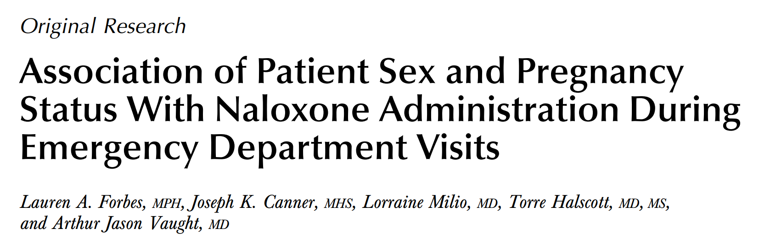



Jason Vaught, MD
Kori Brewer, PhD
Johns Hopkins OB/GYN
ECU Emergency Medicine
Joe Canner, MHS
Srikanth Ravisankar, MD
Previously Johns Hopkins Surgery
THANK YOU
Previously ECU Pediatrics
Torre Halscott, MD, MS
Linda May, PhD, MS
Johns Hopkins OB/GYN
ECU School of Dental Medicine
Lauren Forbes, MPH
Lorraine Milio, MD
Kimberly Kew, PhD
EVMS OB/GYN
Johns Hopkins OB/GYN
Previously ECU Brody
School of Medicine
@laforbestweets

