Slide 1
Caitrin Curtis
MET Scholar
Conflict Resolution: A Standardized Professional Case for Fourth-Year Medical Students
Mentor: Dr. John Norbury, MD

Slide 2
Study Team
Caitrin Curtis, MS4 (outgoing)
Ali Arafat, MS4 (incoming)
Dr. Stephen Charles, PhD
Luan Lawson, MD
John Norbury, MD

Slide 3
Introduction
Conflicts are a common occurrence in the medical workplace, associated with medical errors & higher ratings of personal stress.¹
  Positive impact on a team if managed effectively, facilitating damage control
In health care teams, avoidance is a common response to conflict, leaving many conflicts unresolved.²
History of avoidance may stem from the idea that conflict resolution skills are not formally taught or tested during medical school
  Physicians learn communication skills through a hidden curriculum²
Conflicts could be managed in a constructive way if medical students are provided with conflict management training

Slide 4
Introduction
Objective structured clinical exams (OSCE) have been well-documented to assess students’ interpersonal skills using the standardized patient (SP) model³
Recently, a standardized professional model has been introduced to assess professionalism and communication skills in resident physicians⁴
To our knowledge, the standardized professional model has not yet been utilized to teach or assess conflict resolution skills in medical students
Notes:
3 = 6
4 = 10

Slide 5
Standardized Professional Training
Standardized patients (SP) were recruited from the Office of Clinical Skills Assessment and trained as Standardized Professionals (S-Pro)
  The S-Pros were trained to act as senior residents in a scenario where they have been acting unprofessionally, “dumping work” on the intern, and giving poor sign outs
  Background story + video
  “Key phrases”
Notes:
Like any OSCE, the S-Pros improv the situation based on how they feel it may play out in real life. The script has evolved over the year as the S-Pros have gotten used to how students’ tend to act and how they can respond to the situation.
They were instructed to act defensively in the beginning & if the student communicates in an effective manner, they could switch to a more accommodating conflict position.

Slide 6
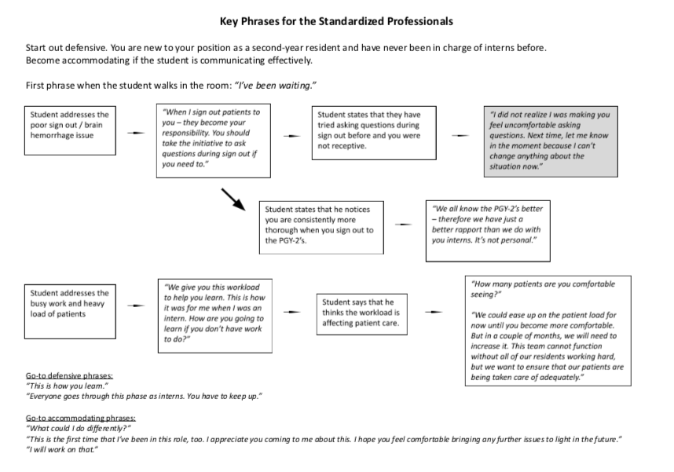

Slide 7
Conflict Resolution Didactic
Fourth-year medical students in the N-PM&R clerkship attended a didactic lecture where they were introduced to the D-E-S-C conflict resolution method from Team STEPPS®
  D – Describe the specific situation
  E – Express your concerns about the action
  S – Suggest other alternatives
  C – Consequences should be stated

Slide 8
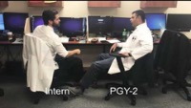
Case
Brief lecture on conflict resolution
DESC method
Shown case
10-minute OSCE to resolve the conflict
Debriefing session with S-Pro
Notes:
Students were instructed to put themselves into the shoes of an intern who in a nutshell was being “dumped on” by a second-year resident. The senior resident had been acting unprofessional at work & giving poor sign outs to the intern, which resulted in a patient safety concern. Here is a small snippet of the video.

Slide 9
Study Methods
Fourth-year medical students enrolled in the N-PM&R clerkship were required to attend the didactic
Participation in the research study was voluntary & informed consent was obtained
Students completed a pre-survey and a post-survey regarding their perception of conflict and their confidence in their own conflict resolution skills

Slide 10
Results
42 students completed both the pre-survey & the post-survey
90.5% of participants had observed conflict in the health care setting
100% of students agreed that the ability to manage conflict is an important skill for future physicians
Only 55% of students had previously received education and training on conflict management

Slide 11
Very confident
Moderate confidence
Slight confidence
Not confident
Figure 1. Self-reported survey of students’ confidence in their ability to resolve a conflict with a medical student, non-physician provider, resident physician, attending physician, and patient. All results were significant. (N=42)

Slide 12
Discussion
Filled a skills gap in the medical curriculum regarding interpersonal skills and conflict resolution
Standardized professionals were a useful tool to teach and practice conflict resolution skills
Limitation → data was self reported, low response rate (55%)
Next step → utilizing the OSCE to assess the students’ conflict resolution skills

Slide 13
References & Acknowledgements
[1] Greer, L. L., Saygi, O., Aaldering, H., & de Dreu, C. K. (2012). Conflict in medical teams: Opportunity or danger? Medical Education, 46(10), 935-942.
[2] Saltman DC, O'Dea NA, Kidd MR. Conflict management: a primer for doctors in training. Postgrad Med J. 2006;82(963):9-12. doi:10.1136/pgmj.2005.034306
[3] Lifchez, S. D., & Redett, R. J. (2014). A standardized patient model to teach and assess professionalism and communication skills: The effect of personality type on performance. Journal of Surgical Education, 71(3), 297-301.
[4] Lifchez, S. D., Cooney, C. M., & Redett, R. J. (2015). The standardized professional encounter: A new model to assess professionalism and communication skills. Journal of Graduate Medical Education, 7(2), 230-233.
Thank you to Patrick Merricks, the Standardized Professionals, and the Office of Clinical Skills Assessment for your participation and dedication to this project.

Slide 14
Questions?

