Slide 1
Hannah Conley
SLDT Distinction Track Scholar
PREP-Promoting Reproductive Health Education in Pitt County
Mentor: Kerianne Crockett, MD

Slide 2
Collaborative Team Members
Hannah Conley, MS4
Hannah Smith, MS4
Camille Bauer, MS3
Olivia Campbell, MS3
Thomas Irons, MD
Kerianne Crockett, MD

Slide 3
Introduction
In Pitt County, NC, rates of gonorrhea, chlamydia, and syphilis are above state and national averages.¹
From 2017 to 2018, Pitt County teen pregnancy rates increased from 19.0 to 22.1.¹
While education alone does not decrease risky sexual behaviors, states that taught comprehensive sex education, which included information on contraception, condom use, and abstinence, tended to have lower pregnancy and STI rates than states that taught abstinence-only education.²
As part of the NC Albert Schweitzer Fellowship, this educational project was developed to help decrease these rates.
Notes:
Break up into 2 slides- one to talk about need and then objectives

Slide 4
Introduction
Project objectives:
  To implement a comprehensive sexual health curriculum for at-risk adolescents.
  To demonstrate positive effects of comprehensive sex education on self-efficacy, sexual health knowledge, and rates of condom use.

Slide 5
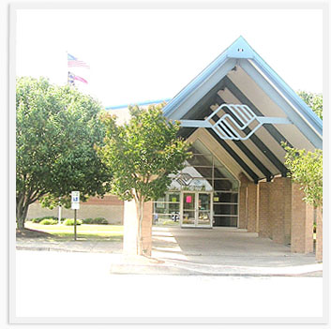
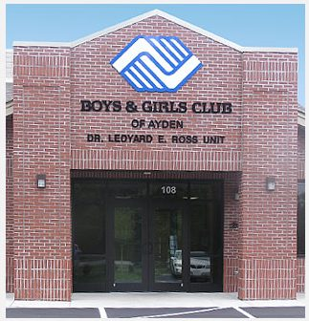
Methods
Location: 2 Boys & Girls Clubs in Pitt County- Jack Minges and Ayden
Participants: 8-12th graders. Parental consent was obtained.
3 pre- and post-program surveys were administered.
  General Self-Efficacy Scale,³ a previously validated survey
  Comprehensive knowledge assessment
  GTO sexual health measurement tool,⁴ a previously validated survey

Slide 6
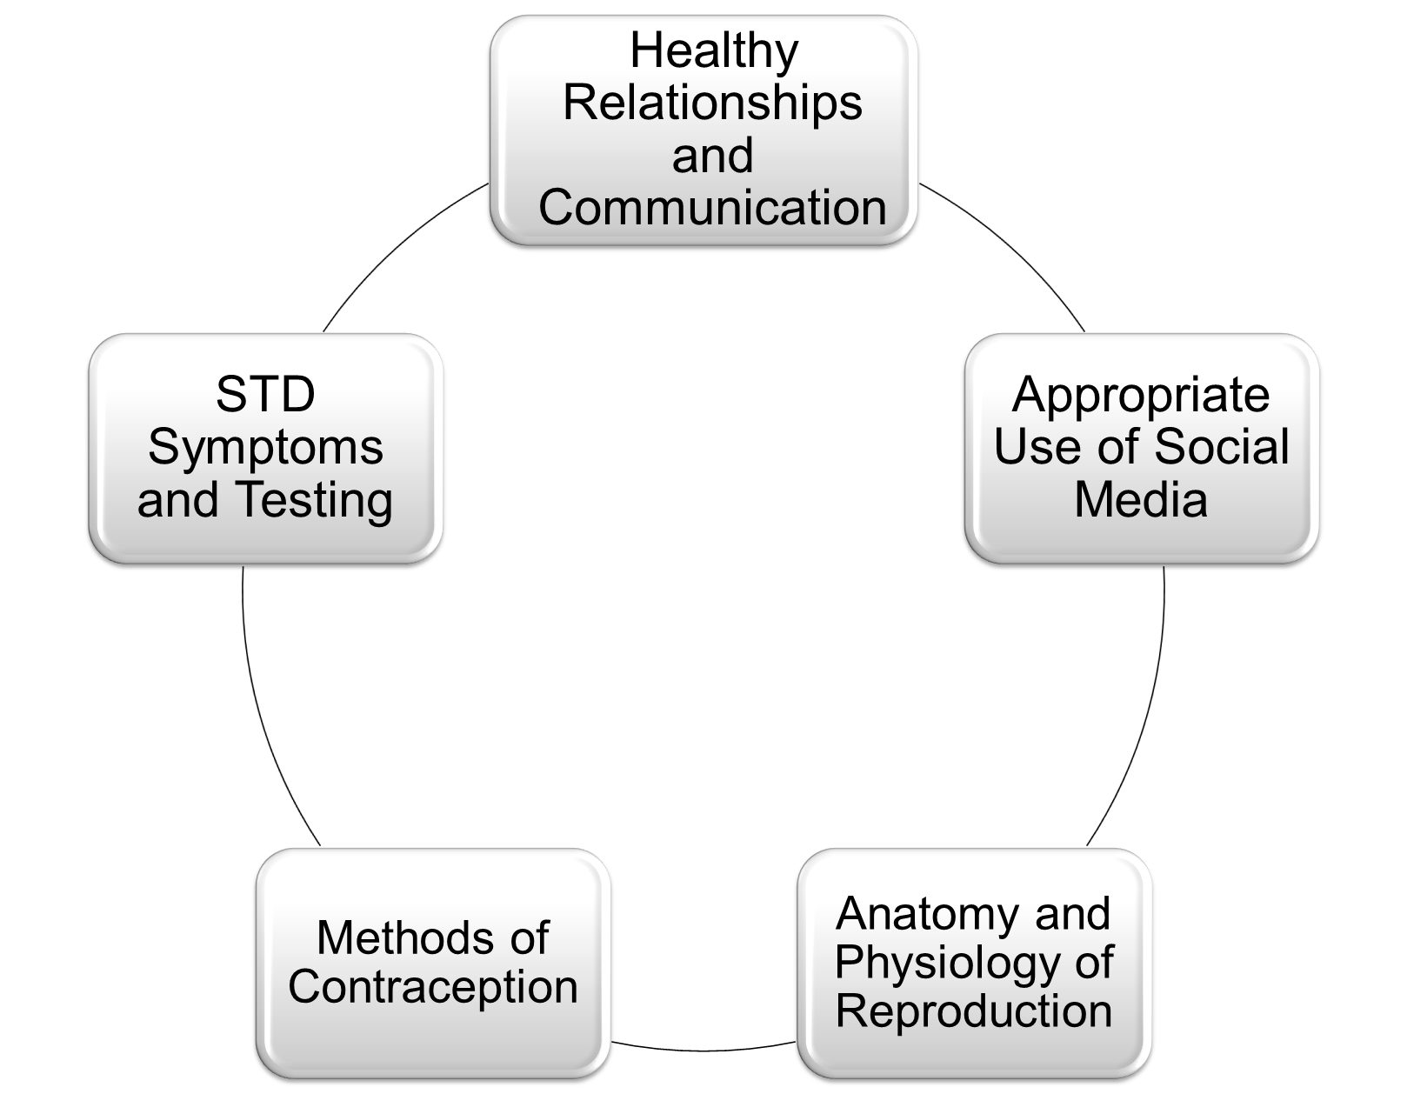
Methods
Study educators taught 4 series of 11 lessons. Participants were split into male and female groups based on how they identified.
Rights, Respect, Responsibility curriculum was used.⁵
  Meets the National Sexuality Education Standards, which address both the functional knowledge related to sexuality and the specific skills necessary to adopt healthy behaviors.
Topics included STIs, healthy relationships, contraception, social media, anatomy & physiology of reproduction.
Rights. Respect. Responsibility Curriculum
Healthy Relationships and Communication
Appropriate Use of Social Media
Anatomy and Physiology of Reproduction
Methods of Contraception
STD Symptoms and Testing

Slide 7
Results
  110 adolescents attended ≥1 of the program sessions.
  37 adolescents completed pre- and post-program surveys.
    Attendance was inconsistent so we only used matched surveys for pre and post data
  Mean comprehensive knowledge assessment scores increased significantly from pre- to post-program from 70.5% to 79.6% (range 0-100; P = .003).

Slide 8
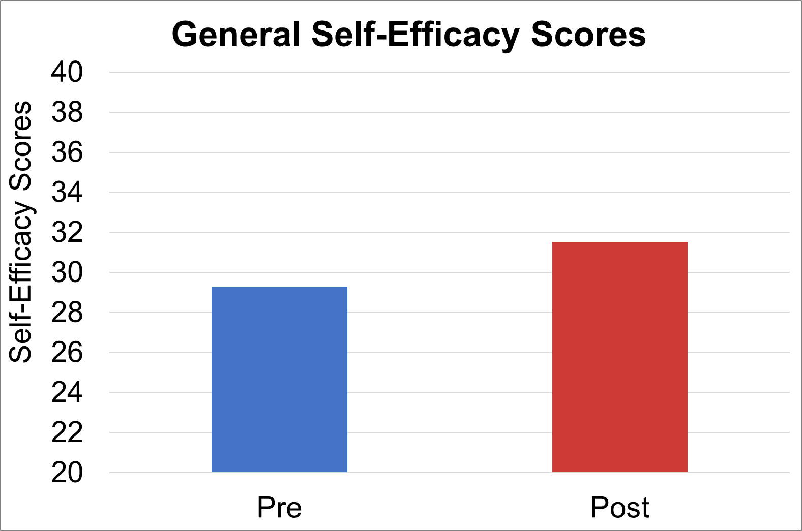
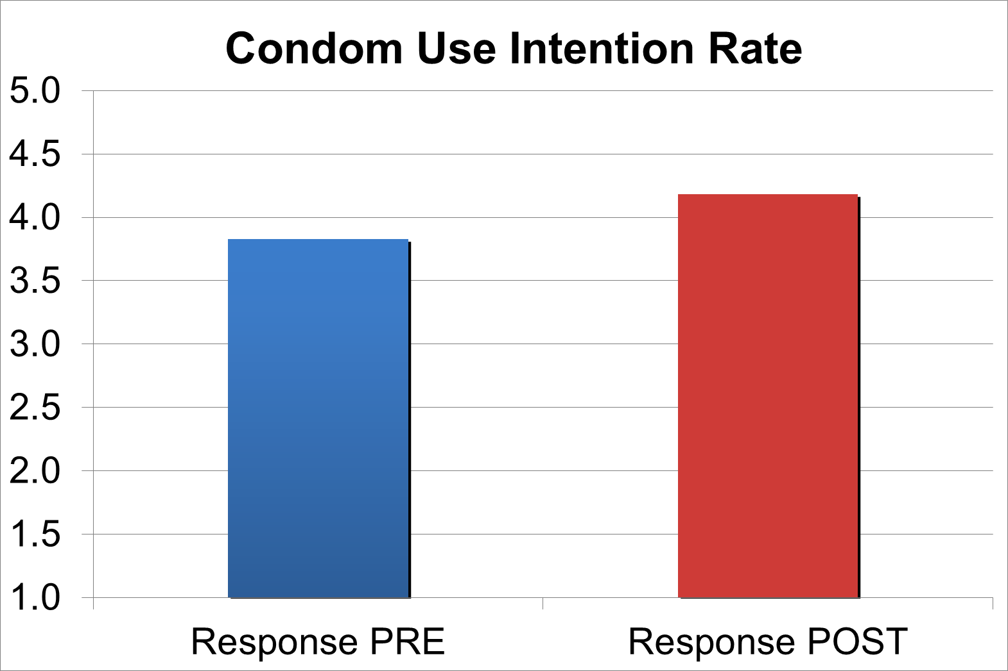

Results
4.2
3.8
31.5
29.3
Figure 1: General self-efficacy scores pre- vs post-program.
Figure 2: Condom use intention rates pre- vs post-program.
Healthy Relationships and Communication
Appropriate Use of Social Media
Anatomy and Physiology of Reproduction
Methods of Contraception
STD Symptoms and Testing
Notes:
Range 10-40
Range 1-5

Slide 9
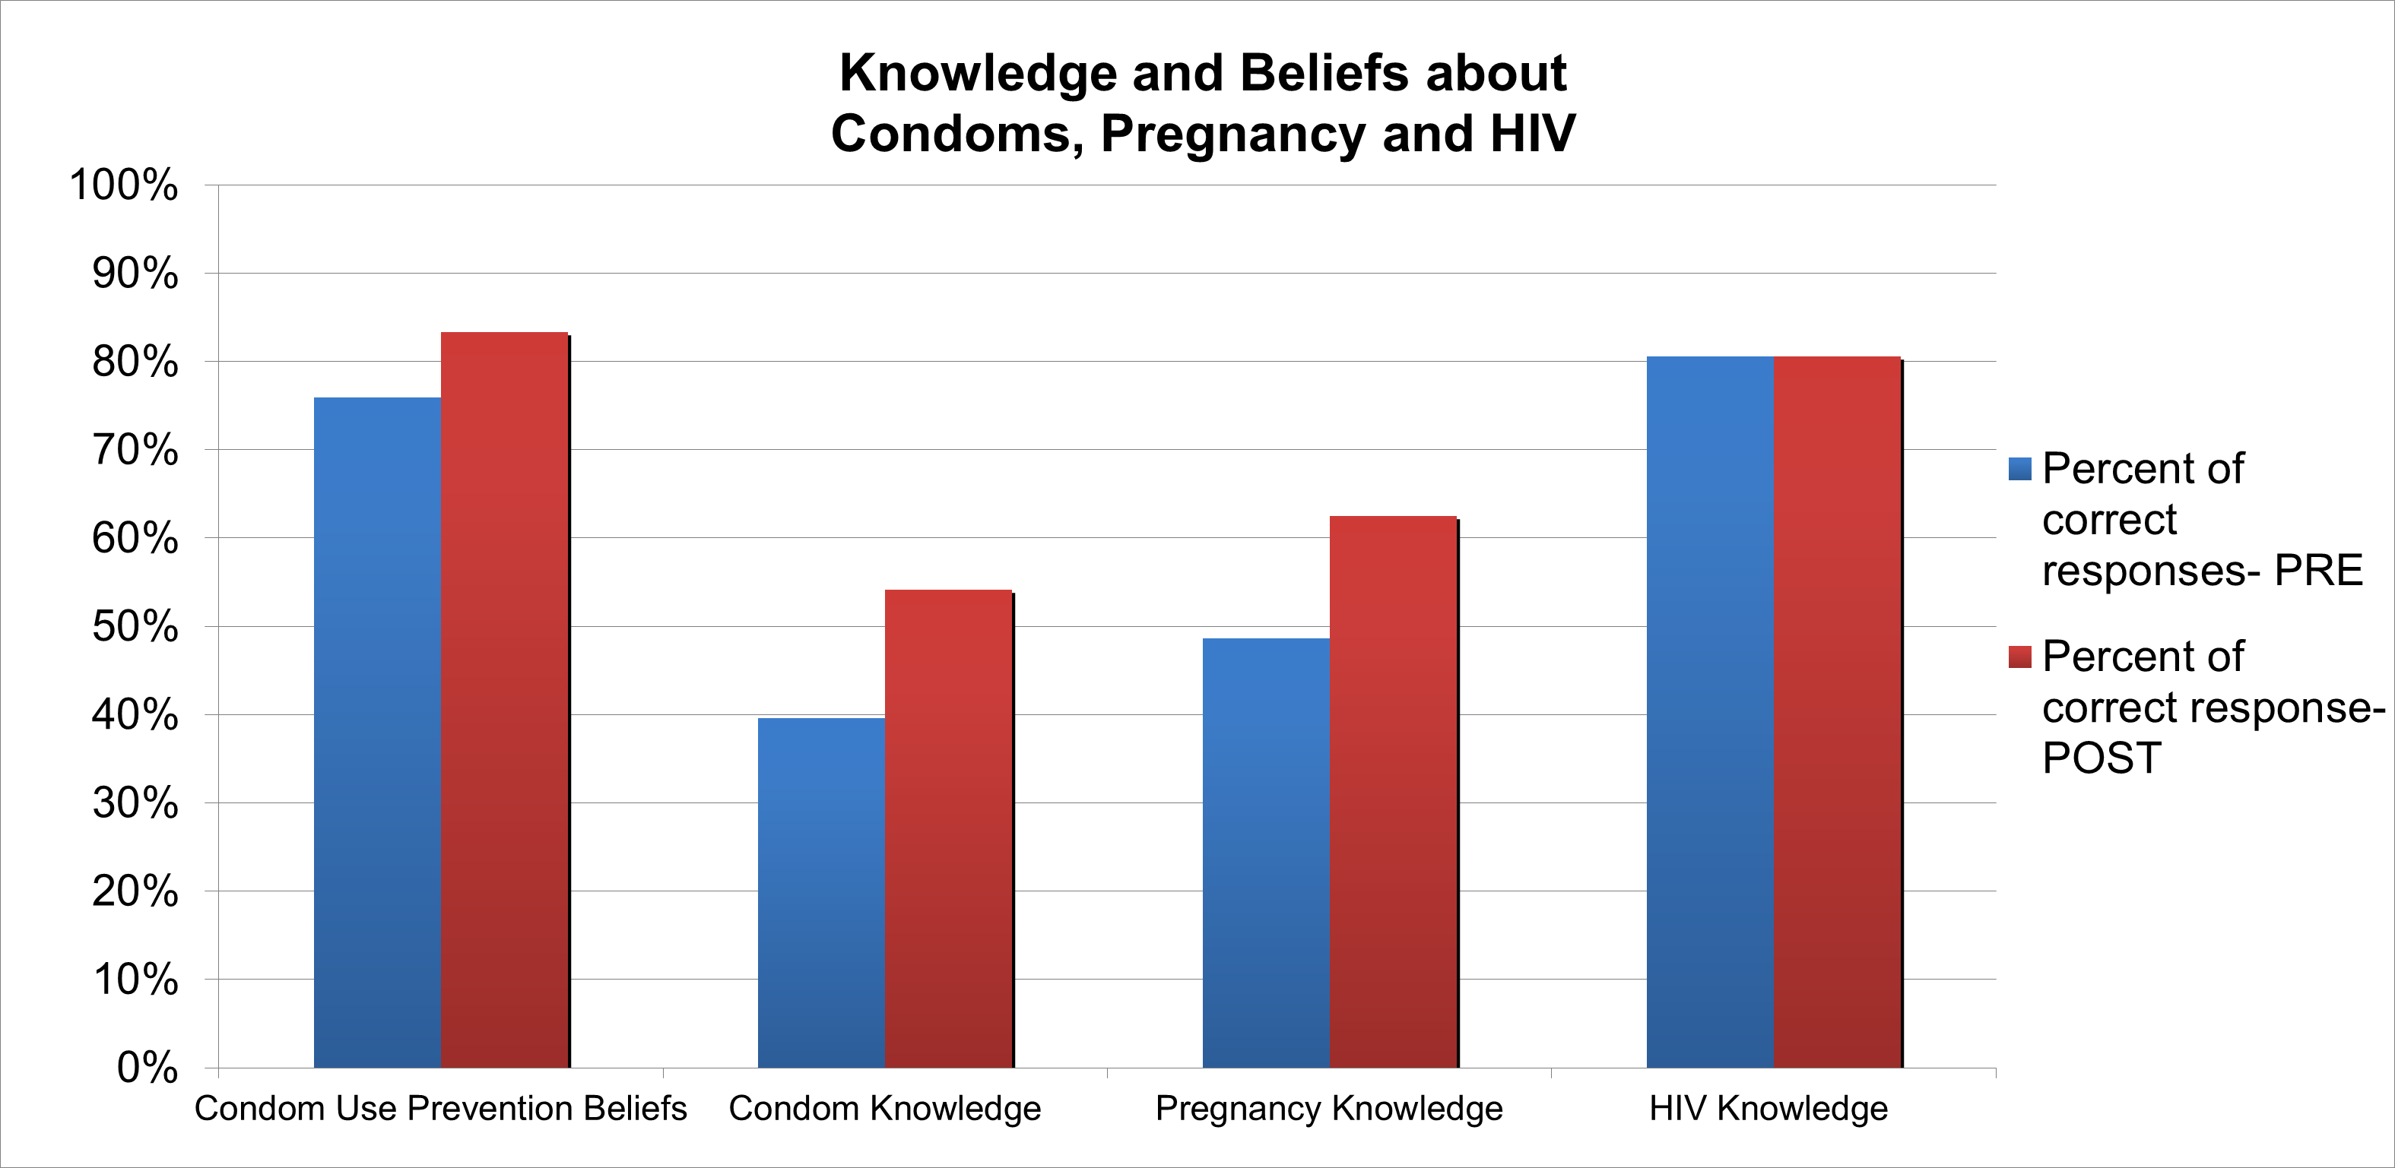


Results
83.3
80.6
80.6
75.9
62.5
54.2
48.6
39.6
Figure 3: Knowledge and beliefs about condoms, pregnancy and HIV pre- vs post-program.
Healthy Relationships and Communication
Appropriate Use of Social Media
Anatomy and Physiology of Reproduction
Methods of Contraception
STD Symptoms and Testing
Notes:
Range 0-100

Slide 10
Discussion/Conclusions
Participants who enrolled in a sexual health curriculum demonstrated increased self-efficacy, sexual health knowledge and condom use intention rate.
Increased self-efficacy helps teens overcome misinformation and develop confidence to reduce their level of risk. ⁴
Increased condom use intentions should decrease STI and pregnancy rates.
Implementation of this curriculum could:
  Reduce sexual risk-taking
  Delay or reduce sexual activity
  Increase condom use
Limitations: small sample size, lack of participant follow up.

Slide 11
Future Directions
Future research should investigate longitudinal data with an emphasis on participant knowledge retention and self-efficacy to better understand strategies to improve STI and teen pregnancy rates.
The teen directors at both Boys and Girls Clubs will sustain the program.
Notes:
f/u and sustainability- make sure to put into words

Slide 12
Acknowledgements
We would like to thank the Albert Schweitzer Fellowship as well as:
Dr. Kerianne Crockett, Dr. Tom Irons (Academic Mentors)- ECU Brody School of Medicine
Anastasia Hunter, Heather Joyner (Site Mentors)- Jack Minges Boys & Girls Club
Emily Mead (Site Mentor)- Ayden Boys & Girls Club

Slide 13
References
1. NC Statistics and Reports- County-level. NC SCHS. https://schs.dph.ncdhhs.gov/data/county.cfm.
2. Stanger-Hall KF, Hall DW. Abstinence-only education and teen pregnancy rates: why we need comprehensive sex education in the U.S. PLoS One. 2011;6(10):e24658. doi:10.1371/journal.pone.0024658
3. Schwarzer, R., & Jerusalem, M. Generalized Self-Efficacy scale. In J. Weinman, S. Wright, & M. Johnston, Measures in health psychology: A user’s portfolio. Causal and control beliefs. 1995; pp 35-37.
4. Chinman, M, J Acosta, P Ebener, C Sigel, and J Keith. Getting to Outcomes Guide for Teen Pregnancy Prevention. RAND Corporation, 2016. https://www.rand.org/pubs/tools/TL199.html.
5. Rights, Respect, Responsibility. https://3rs.org/3rs-curriculum/3rs-curric-search/. 2020.

Slide 14
Questions?
Contact Info
Hannah Conley (MS-4)
conleyha17@students.ecu.edu

