Slide 1
Elizabeth Cochran
Service-Learning Distinction Track Scholar
Literacy promotion in children via book distribution programs and primary care providers
Dr. Jennifer Crotty, ECU Pediatrics

Slide 2
Introduction
Regularly reading aloud with young children stimulates early brain development in language and expression, while also strengthening the parent-child relationship.¹
Reading experiences with young children also promote kindergarten readiness, which affects their future education trajectory.²
A majority of children 400% above the federal poverty threshold are read to daily, whereas only a third of children 100% below the poverty threshold are read to daily.¹
High PC, Klass P, Council on Early Childhood, COUNCIL ON EARLY CHILDHOOD. Literacy promotion: an essential component of primary care pediatric practice. Pediatrics. 2014;134:404-409.
High PC, and Committee on Early Childhood, Adoption, and Dependent Care and Council on School Health, American Academy of Pediatrics Committee on Early Childhood, Adoption, and Dependent Care and Council on School Health, and the Committee on Early Childhood, Adoption, and Dependent Care and Council on School Health. School Readiness. Pediatrics. 2008;121:e1008-e1015.

Slide 3
Introduction
Initiatives to promote childhood literacy and to combat socioeconomic disparities have been pursued in the community and primary care setting via Reach Out and Read (ROR) and Dolly Parton’s Imagination Library (DPIL).
  Reach Out and Read (ROR) is a national program that provides books to children at well child visits from 6 months to 5 years of age, while also counseling the parent on the importance of reading aloud.
  Dolly Parton’s Imagination Library (DPIL) is a program that sends a new book each month to children from birth to five years at no cost to the families.
The goal of this project is to expand literacy promotion in the local community by utilizing the existing program of DPIL through visits with primary care providers.

Slide 4
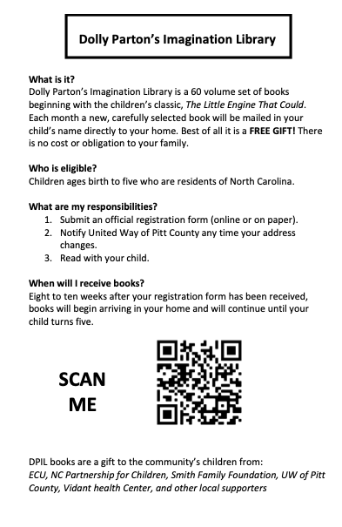
Methods
The main intervention of this project was to introduce and increase DPIL sign-ups to all ECU clinics that see children from newborn to 5 years old beginning in August 2020.
  Clinics include ECU Pediatrics, ECU Medicine-Pediatrics, ECU Family Medicine, and ECU Pediatric Dentistry
  This was achieved through QR codes placed in patient rooms.
  If a parent did not feel comfortable or did have adequate technology, paper forms were offered.

Slide 5
Results
From August 1, 2020 to March 31, 2021, there were 80 QR codes utilized for DPIL sign-ups.
From September 1, 2020 to March 31, 2020, there were 74 children that were signed up via paper registration forms at ECU Family Medicine.
This is a potential for over 9,000 books to be distributed in the community!

Slide 6
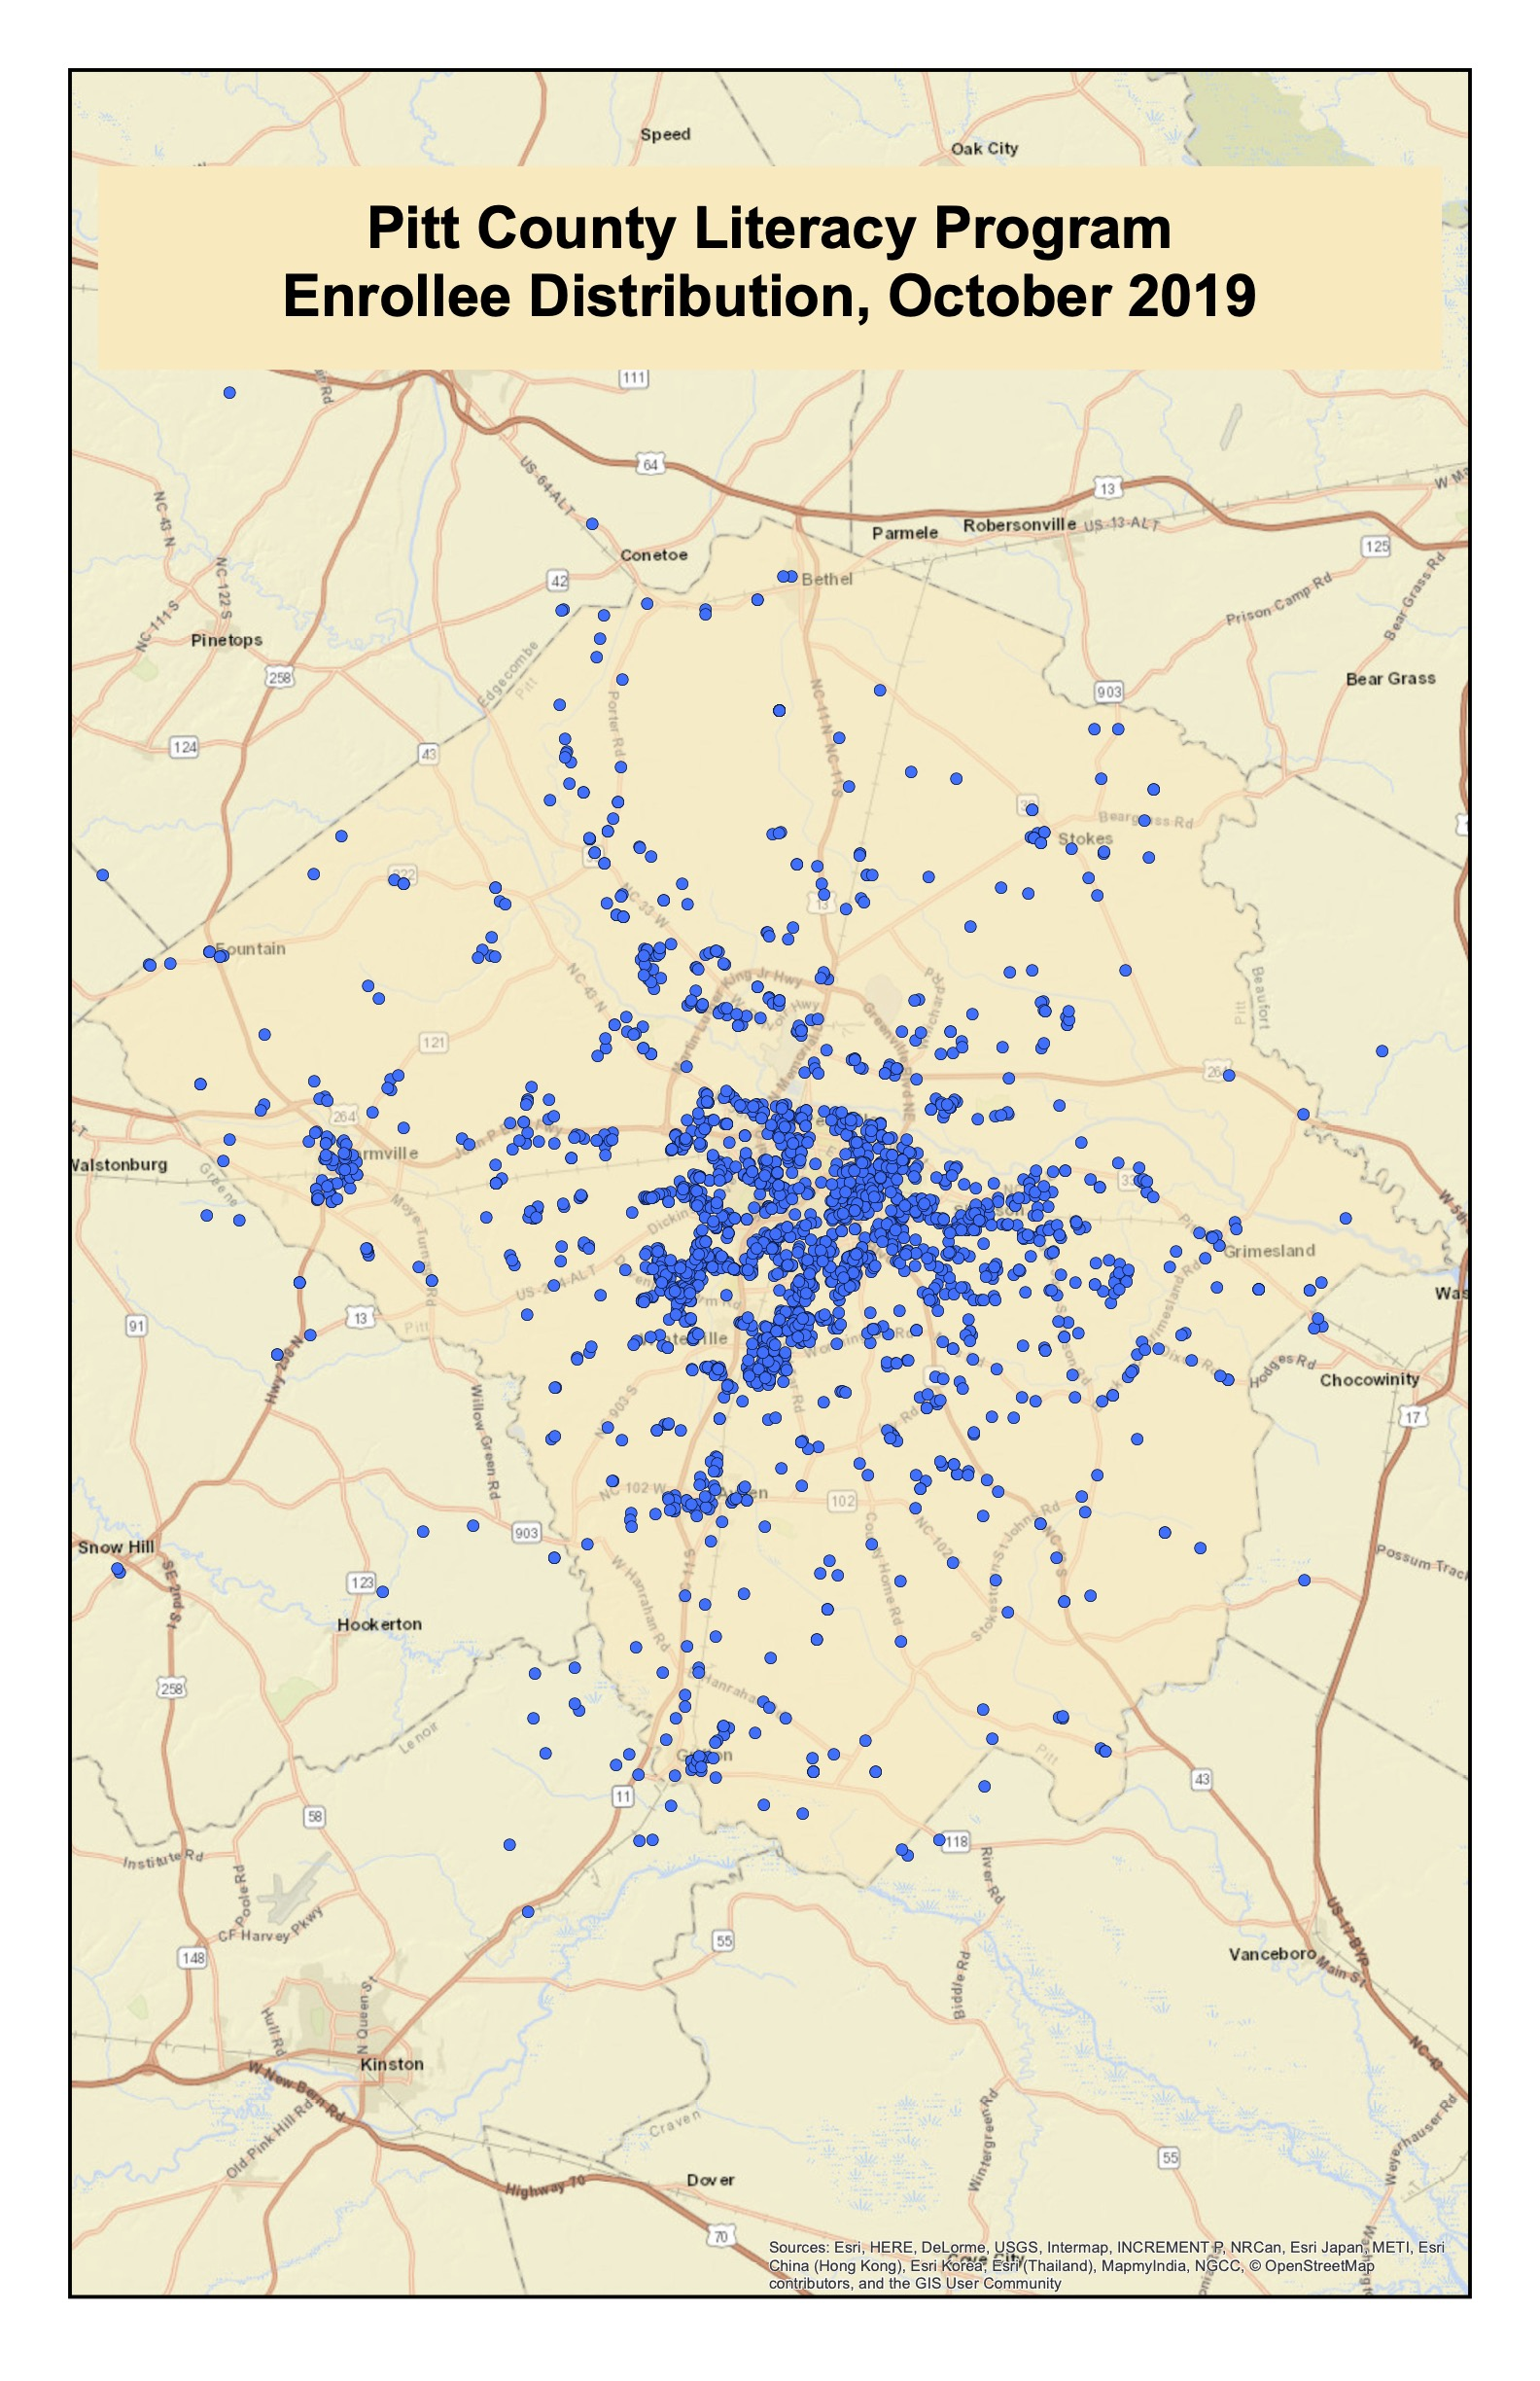
Results
United Way and ReadENC tracks percent of active recipients in the Pitt County 0-5 population per Smart Start, as well as number graduated each month.

Slide 7
Conclusion
COVID-19 impacted many aspects of children’s lives, including school attendance and in-person well-check visits. While this influenced data collection, it also emphasized the importance of at-home reading experiences.
Ultimately, more children in the local community, regardless of socioeconomic status, have access to more reading resources prior to beginning school in hopes of improving language skills and kindergarten readiness.
Additional acknowledgements to Dr. Terry Atkinson with ECU College of Education for her direction, resources, and advice on this project!

