Slide 1
Lindsey Burleson, Research Distinction Track Scholar
Dr. Johanna Hannan, PhD
Female Genitourinary Dysfunction following
Pelvic Radiation Therapy
I have no disclosures.

Slide 2
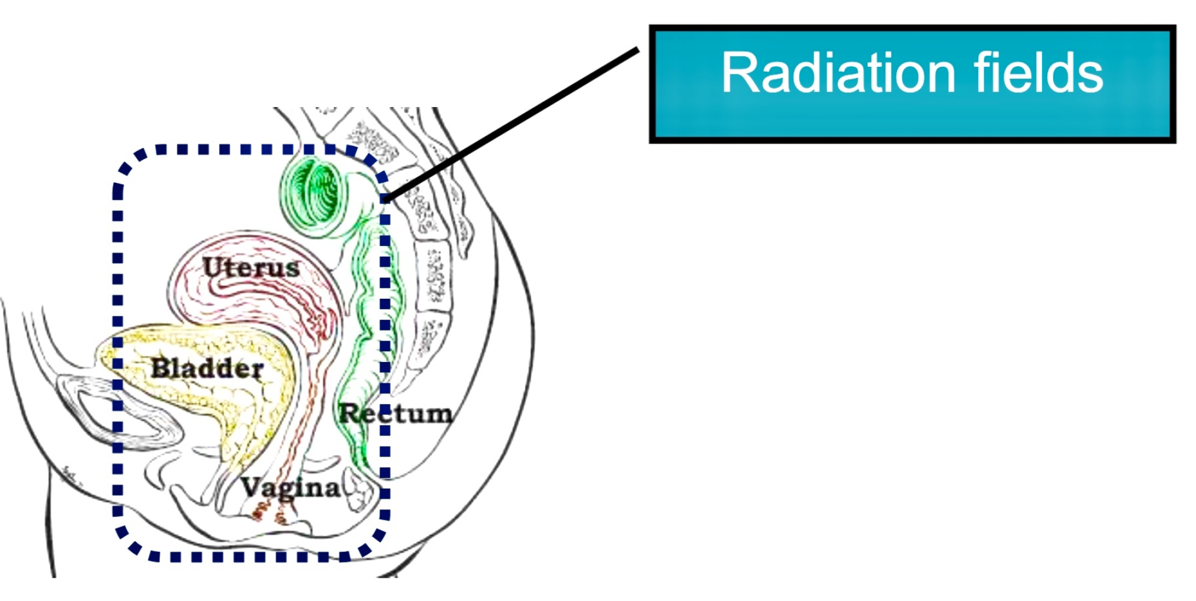
Introduction
Gynecologic cancers are becoming the most commonly treated cancers in developed countries
Local radiation therapy has become a mainstay in pelvic cancer treatments
Healthy tissue is at risk of receiving collateral radiation → vaginal dryness, radiation cystitis, sexual dysfunction
There are animal models of prostatic RT-induced erectile dysfunction, but no female models exist
Objectives:
  Investigate acute and chronic changes to genitourinary structures following pelvic radiation
  To establish a female rat model of RT-induced sexual dysfunction.
  To investigate the role of oxidative stress and inflammation on RT-induced vaginal injury.

Slide 3
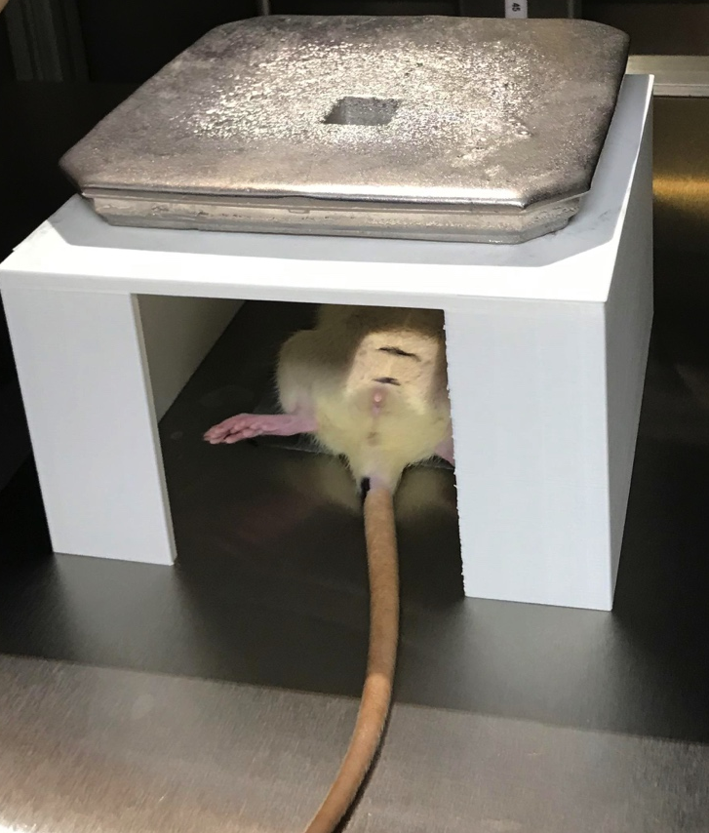
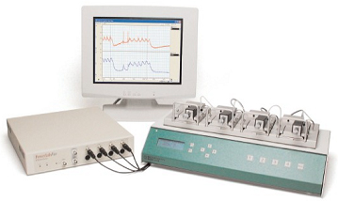
Methods
Female Sprague-Dawley rats (12 wks)
Rats are anesthetized and recieve either 1 dose of 0 or 20 Gy external radiation treatment to the lower pelvis
Experiments were conducted at 4 or 9-weeks post-RT
Experimental measurements:
  Nerve-mediated changes in vaginal blood flow
  Vasoreactivity of vagina, bladder, and internal and external urethral sphincters (IUS, EUS)
  Gene expression of vaginal oxidative and inflammatory markers via PCR (IL-6, TNF-a, NOX2, and NOX4)

Slide 4


Vaginal Vasoreactivity
Vaginal Inflammation
A
B
A
B
Total vaginal blood flow decreases 4 weeks post-RT, then returns to baseline
Cholinergic contractions decrease 4 weeks post-RT, but returns to baseline
NOX2 and NOX4 gene expression increase acutely following pelvic RT
C
D
C
D
Adrenergic and Neurogenic contractions increase 9 weeks post-RT
IL-6 and TNF-α gene expression increase acutely following pelvic RT
N=7/8 per group, p <0.05
Notes:
Get rid of “results” and add separate titles to the sections to indicate tissue types

Slide 5
Bladder Vasoreactivity
Urethral Vasoreactivity
A
B
A
B
Neurogenic contraction increases in both IUS and EUS following RT
C
D
Caffeine
KCl
Bladder neurogenic contractions decrease 4 weeks following RT
EUS caffeine and KCL-mediated contraction increase 9 weeks post-RT
N=7/8 per group, p <0.05

Slide 6
Conclusion
Pelvic radiation acutely induces an inflammatory state and decreases vaginal blood and chronically increases vaginal contraction.
Chronic post-RT vaginal dryness and dyspareunia occur secondary to decreased blood flow and fibrosis.
Bladder contractility is decreased following pelvic radiation, but external urethral contractility increases post-RAD.
Urinary incontinence may occur after RT secondary to acute inflammation and changes in vasoreactivity, respectively.

