Slide 1
Improving Pediatric Asthma Management by Utilizing a Scoring System and Care Pathway Julie Brown LINC Scholar Kathleen Bryant, MD LINC Mentor, Department of Emergency Medicine

Slide 2
Introduction
Acute exacerbations of asthma are prevalent in pediatric population
Differences in management exist among Emergency Department (ED) types and individual practitioners
Pediatric Asthma Severity (PAS) scoring can guide therapeutic management and improve outcomes
AIM Statement: Improve the efficiency of asthma exacerbation care in the Children’s ED by decreasing the length of stay for patients presenting with acute asthma exacerbation by 10% in an initial 1-year period and 5% in subsequent years

Slide 3
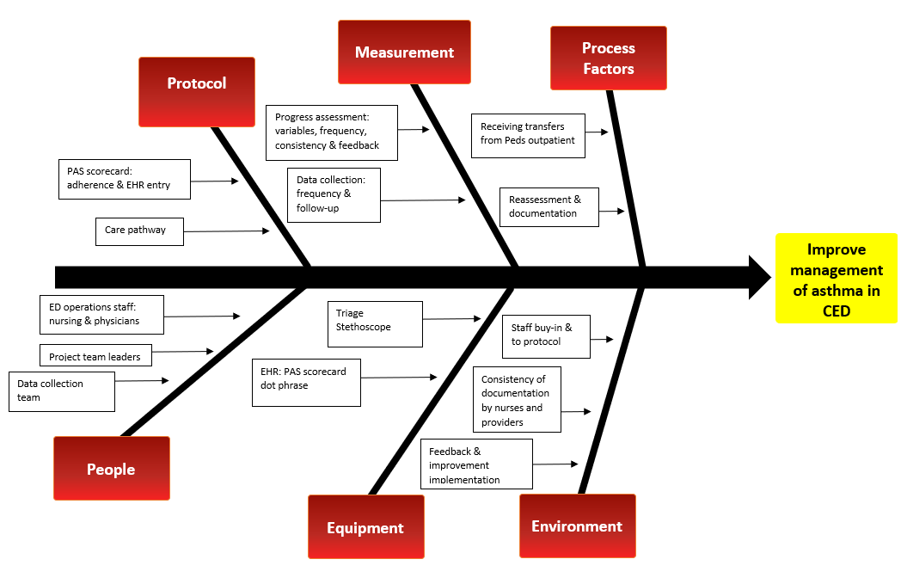
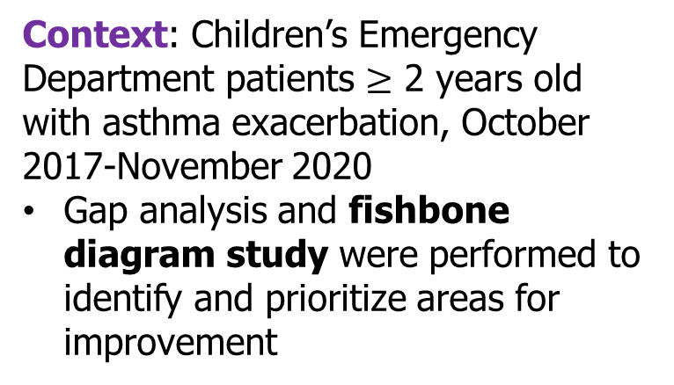
Methods
Context: Children’s Emergency Department patients $≥$ 2 years old with asthma exacerbation, October 2017-November 2020
Gap analysis and fishbone diagram study were performed to identify and prioritize areas for improvement

Slide 4
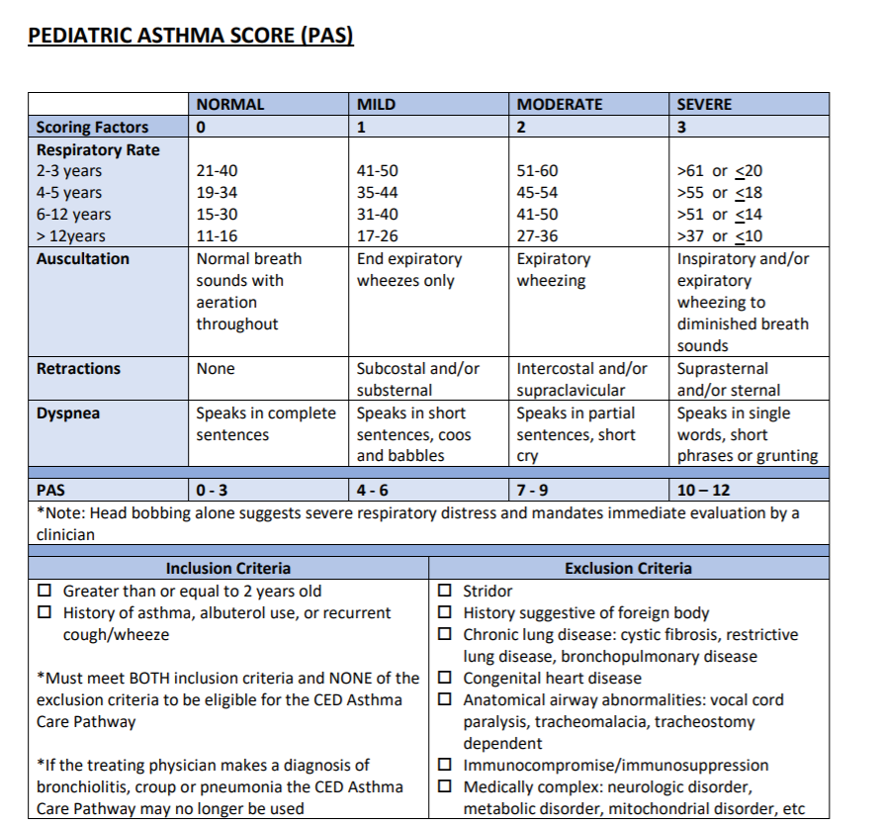
Methods
Primary Interventions/PDSA cycles:
Implementation of PAS scoring system
Nursing staff and provider education on PAS risk stratification scoring system and Asthma Care Pathway (3 separate education sessions)
Implementation of Asthma Care Pathway
Transformation of Asthma Care Pathway into EHR-compatible QuickTool

Slide 5
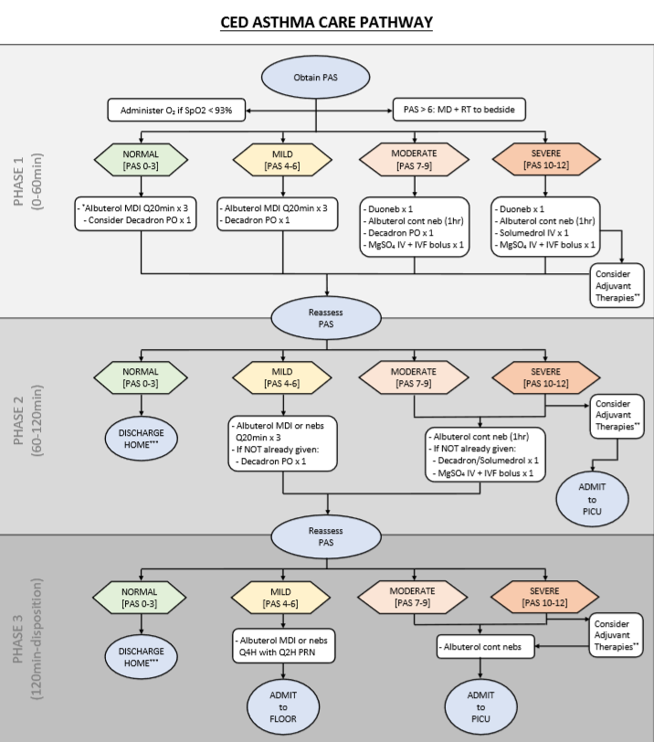
Methods: Measuring Change
Metrics and Measures:
Data Collection: chart audit in 2-month increments as four study periods:
October 2017 – November 2017 (Pre-Intervention)
October 2018 – November 2018
October 2019 – November 2019
October 2020 – November 2020
Parameters evaluated:
Triage start time
Time to medication administration
Time to Discharge
Time to Admission
Primary outcome measure: Average ED Length of Stay (LOS)

Slide 6
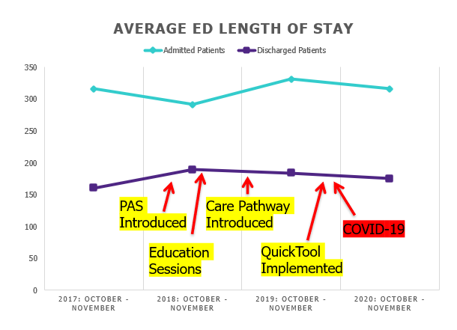
Results
Overall, average Length of Stay (LOS) was maintained for both discharged and admitted patients
Year 1: LOS for admitted patients decreased by 8%
Following incorporation of Asthma QuickTool, LOS decreased for all patients:
Admitted patients: 4.5%
Discharged patients: 4.9%

Slide 7
Conclusion
Use of an integrated pediatric asthma care pathway can decrease the length of stay for discharged patients and patients admitted to the hospital
Limitations: Medication redistribution (COVID-19 impact), QuickTool utilization
Future directions: continue to trend data (seasonal variation), evaluate additional outcome/process measures, reincorporate education sessions

